Slide 1

Minimizing Elements

Slide 2
Strategies
Simple: Remove nonessentials

Slide 3
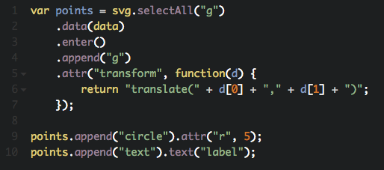
Remove Nonessentials

Slide 4
Strategies
Simple: Remove nonessentials
Use canvas backend

Slide 5
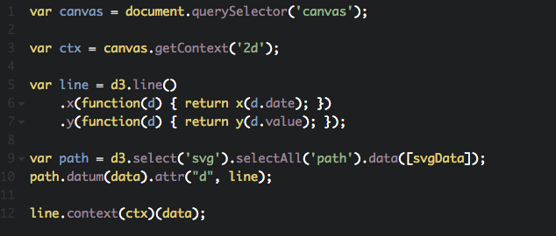
Use Canvas Backend

Slide 6
Strategies
Remove nonessentials
Use canvas backend
Filter data

Slide 7
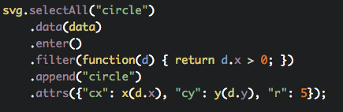
Filter Data

Slide 8
Strategies
Remove nonessentials
Use canvas backend
Filter data
Use paths instead of many elements

Slide 9
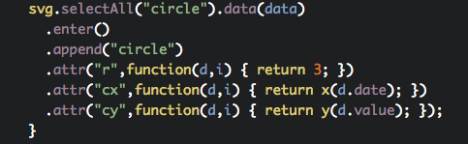
Using Paths

Slide 10
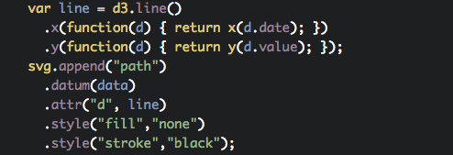
Using Paths

Slide 11


