Slide 1

Update Pattern

Slide 2
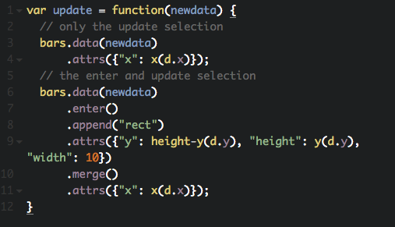
Using Update Pattern

Slide 3


