Slide 1

Timeline Debugging

Slide 2
Using Timeline
Inside web inspector, open Timeline tab

Slide 3
Using Timeline
Inside web inspector, open Timeline tab
Refresh to save data

Slide 4
Using Timeline
Inside web inspector, open Timeline tab
Refresh to save data
Use event log to search for function call

Slide 5
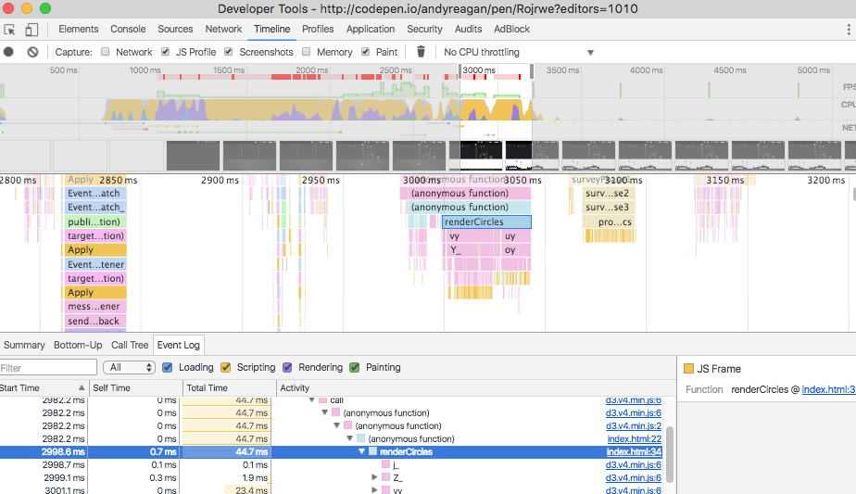
Using Timeline

Slide 6
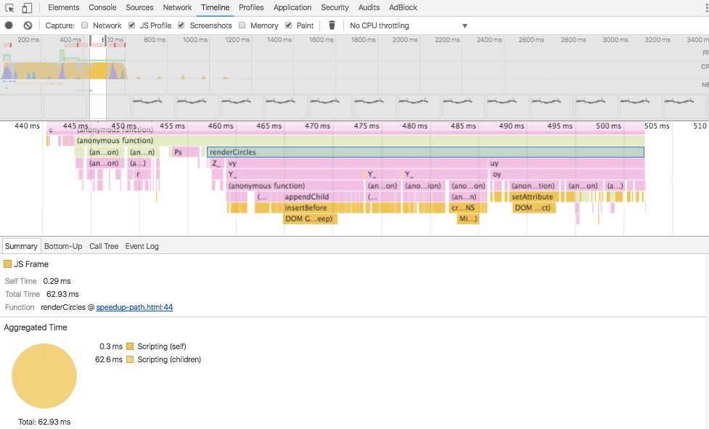
Using Timeline

Slide 7


