Slide 1

Reducing Complexity

Slide 2
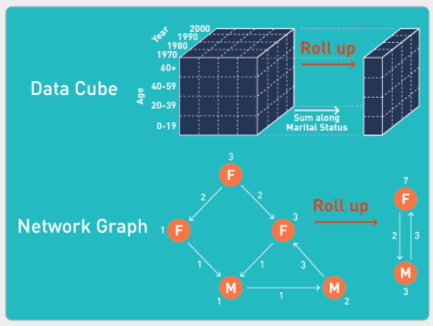
Notes:
we’ve see this type of thinking already
now with networks

Slide 3
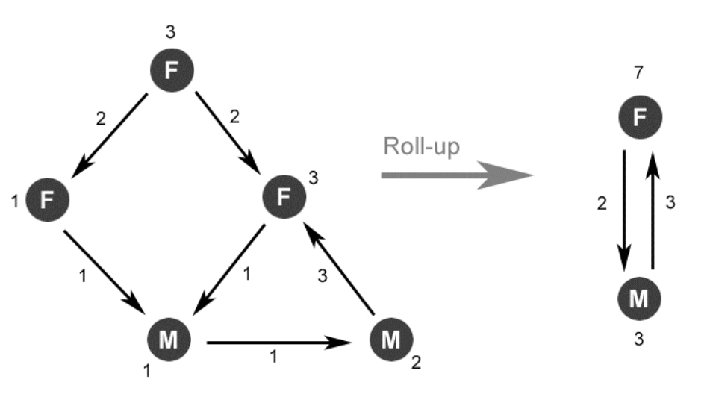
PivotGraph (Wattenberg)
Notes:
implemented by wattenberg (at Microsoft research)

Slide 4
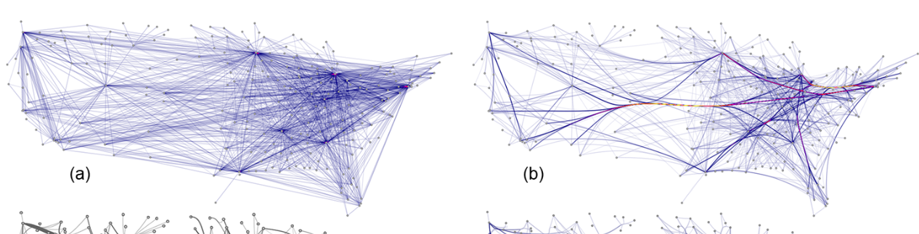
Edge Bundling
Holten & van Wijk, 2009
force-directed
edge bundling
unbundled
Holten, D., & Van Wijk, J. J. (2009). Force‐directed edge bundling for graph visualization. In Computer Graphics Forum (Vol. 28, No. 3, pp. 983-990).
Notes:
Initially Holten and van Wijk, https://www.win.tue.nl/vis1/home/dholten/papers/forcebundles_eurovis.pdf
also see,
http://vis.stanford.edu/files/2011-DividedEdgeBundling-InfoVis.pdf

Slide 5
Filtering, Subsetting, Binning
Techniques often necessary for static vis and complement interactive/exploratory vis
Combine with network statistics (attributes)
Statistical pitfalls for subsetting on networks (caution)
Notes:
our bag-o-tricks
2003: it is shown empirically that the sampling procedure may induce a power-law, even if the underlying graph is not scale-free! [Lakhina et al., 2003]

Slide 6
Sampling Strategies
Random node selection
Random edge selection
Crawling (random walks)
Notes:
uniform, degree-based, pagerank-based
uniform, random, hybrid, induced
BFS, DFS, RW, FFS

Slide 7
Goals
Statistically represente subgraph
Re-estimation of network parameters, node/edge attributes
Vis!
Notes:
all of the sampling strategies will affect biases
is the network you have the universe…or is it a sub-sample itself??

Slide 8


