Slide 1

New Narratives

Slide 2
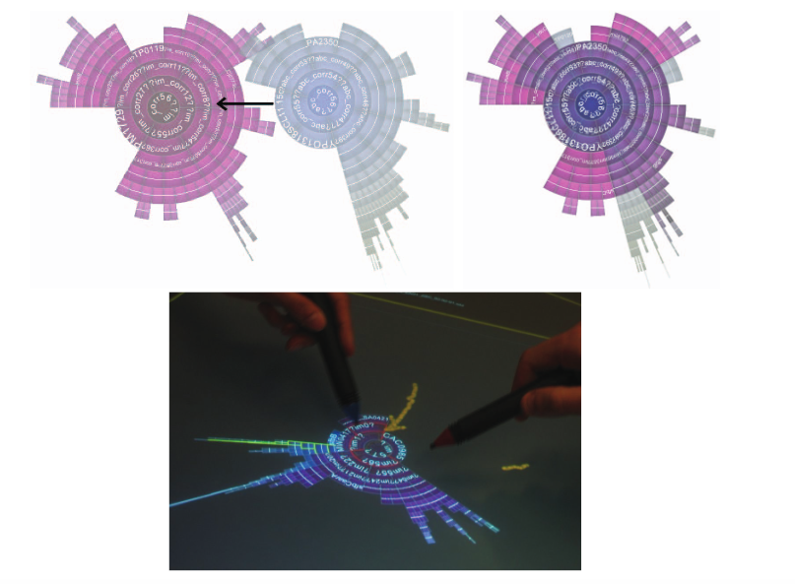
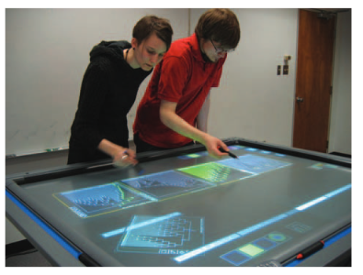
Collaborative Annotation
Isenberg, P., & Carpendale, S. (2007). Interactive tree comparison for co-located collaborative information visualization. IEEE Transactions on Visualization and Computer Graphics, 13(6), 1232-1239.
Notes:
CREATIVE TOOLS for interaction ..
Exploratory or explanatory
Isenberg and Carpendale, way to compare trees and annotative them.

Slide 3
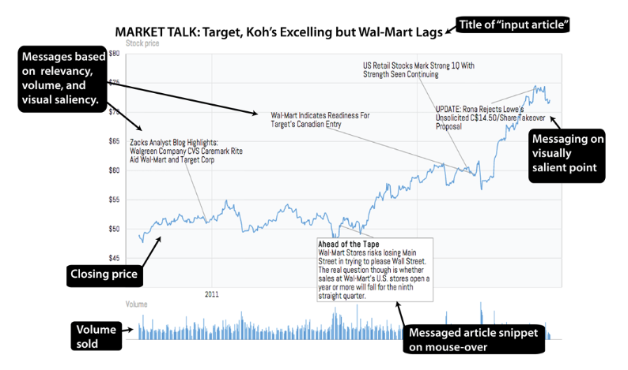
Source: Hullman, J., Diakopoulos, N., & Adar, E. (2013). Contextifier: automatic generation of annotated stock visualizations. In Proceedings of the SIGCHI Conference on Human Factors in Computing Systems (pp. 2707-2716). ACM.
Notes:
Contextifier, uses automated approaches
Linguistic relevancy from news database
Visual saliency: peak, change etc
Volume: only so much information

Slide 4
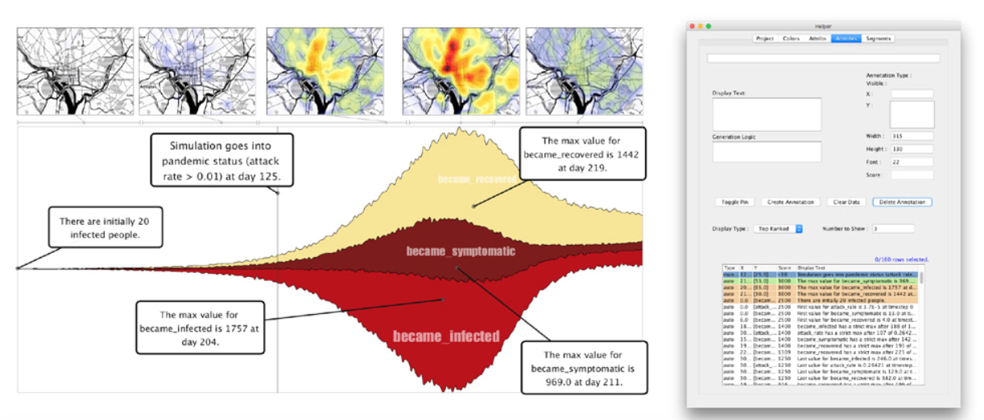
Temporal Summary Images
Bryan, C., Ma, K. L., & Woodring, J. (2017). Temporal summary images: An approach to narrative visualization via interactive annotation generation and placement. IEEE Transactions on Visualization and Computer Graphics, 23(1), 511-520.
Notes:
Bryan, Ma, Woodring
Recommend relevant features for time series

Slide 5
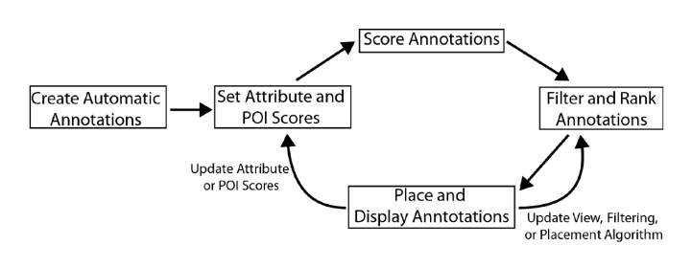
Bryan, C., Ma, K. L., & Woodring, J. (2017). Temporal Summary images: An approach to narrative visualization via interactive annotation generation and placement. IEEE Transactions on Visualization and Computer Graphics, 23(1), 511-520.
Notes:
Data points of interest starts, stops, state dev POI score
Annotations observational or additive manually or automated
Density based placement algorithm
More important

Slide 6
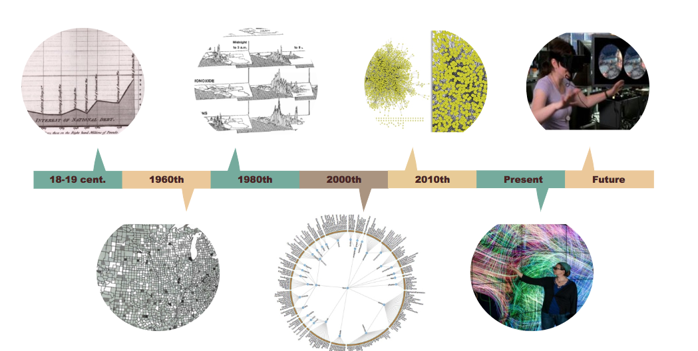

Slide 7
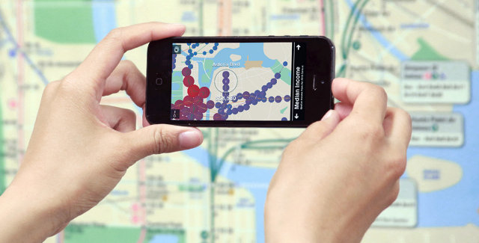
A Mixed Reality
Notes:
How visualization annotation works in a mixed reality world.

Slide 8
Contextual Data
Contextual metadata (activities, location, text/speech, biosignal, etc.)
Notes:
On the design decisions and process, what was found or used

Slide 9
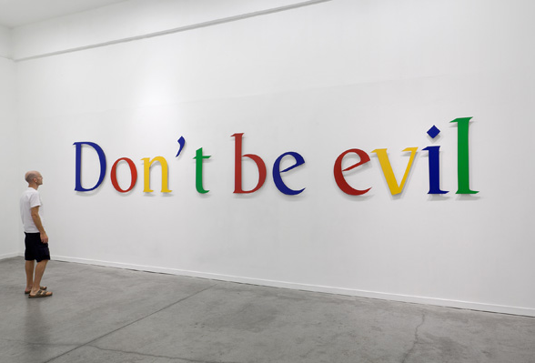
Image Source: http://ctj.org/images/2014/googleevil.jpg

Slide 10
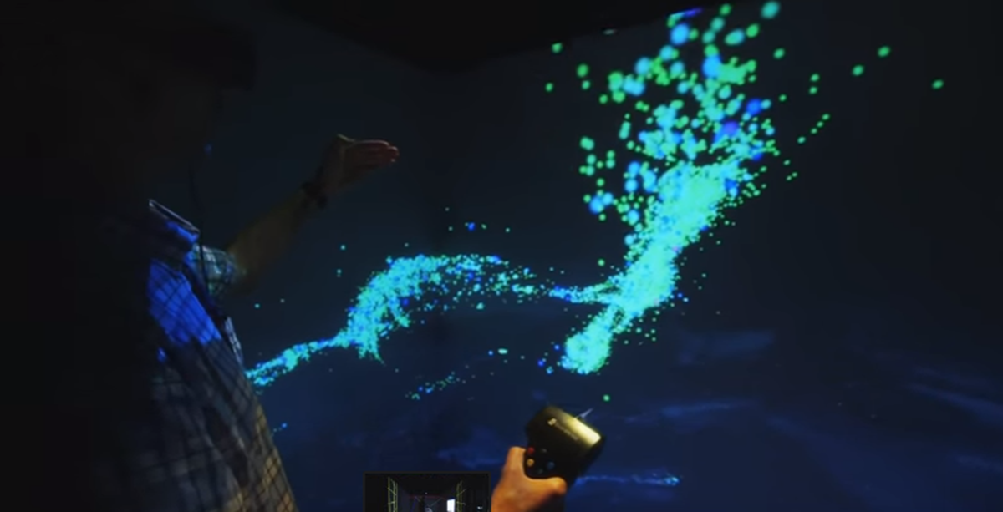
Notes:
Be awesome! Visualization is one of the most powerful, use these combined with other data sources to harness for good.

Slide 11


