Slide 1

Course Topics

Slide 2
Part One
Fundamental techniques
for encoding data
Notes:
Use D3 for this.

Slide 3
Components
Data structure to visual form
Selecting charts
Spatial layout & patterns
Color & contrast
Interactions
Notes:
Use D3 for this.

Slide 4
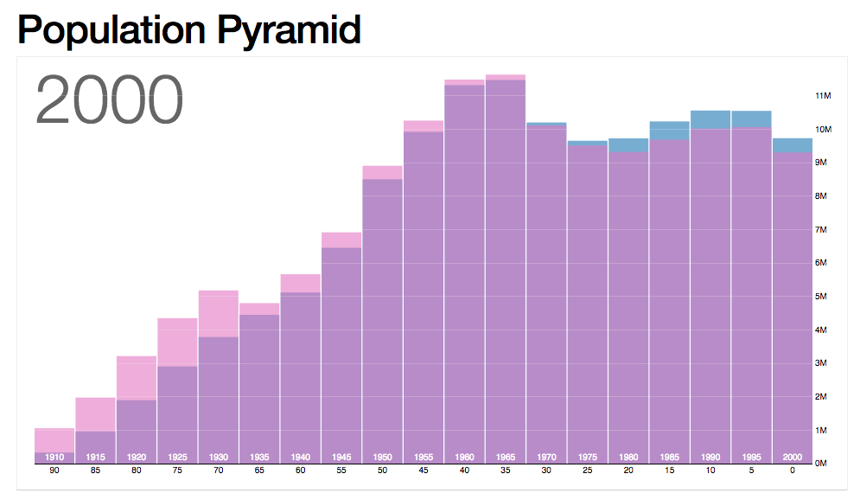
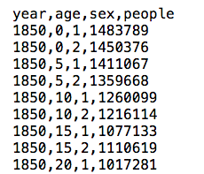
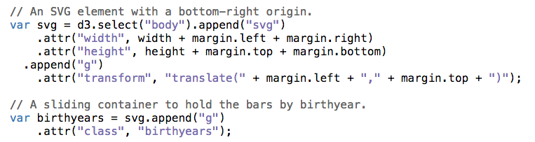
http://bl.ocks.org/
mbostock/4062085

Slide 5
Part Two
Design & Tools
Notes:
Use D3 for this.

Slide 6
Components
Exploratory data analysis
Design process
Visualization tools
Notes:
Use Tableau for exploration and

Slide 7
[placeholder slide for image]

Slide 8
Part Three
Specialized Topics
Notes:
Use D3 for this.

Slide 9
Components
Time & place
Multidimensional data
Performance
Networks
Narrative
Notes:
Use Tableau for exploration and

Slide 10
[placeholder slide for image]

Slide 11

Hands-On
Approach
flickr cc 2.0
Image by NAVFAC
]
Notes:
PLACEHOLDER IMAGE (GET NON NAVFAC) Merge ways to try it out and apply the concepts you’re learning through out.
Image source: https://flic.kr/p/eaBzvA

Slide 12


