Slide 1

Principles of Visualization

Slide 2
What makes for a good visualization?

Slide 3
“Graphical excellence is the well-designed presentation of interesting data – a matter of substance, of statistics, and of design.”
[Tufte, 1983]
Notes:
The data has to be good and of substance. It can be a beautiful visualization but if it’s not actually useful data then it’s really just some nice art. The right statistical models and transformations should be done on the data when needed. The design has to be good, and this takes advantage of the perceptual aspects for amplifying cognition. Good design doesn’t just mean pretty but means effective.

Slide 4
“complex ideas communicated with
clarity,
precision,
and efficiency”

Slide 5
Efficient
“the greatest number of ideas
in the shortest time
with the least ink
In the smallest space”

Slide 6
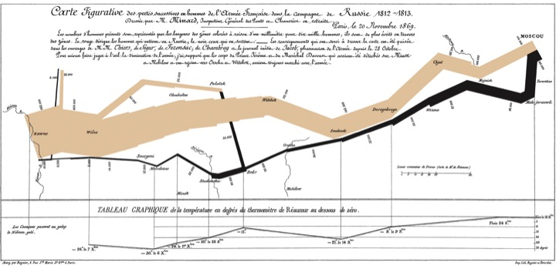
Multivariate

Slide 7
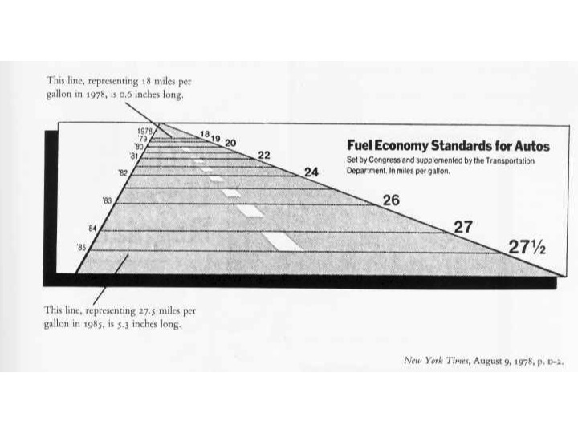
Truthful
Tell the truth

Slide 8
Graphical Integrity
Notes:
Must have interesting data!

Slide 9
Visual graphics directly proportional
to their numeric quantities

Slide 10
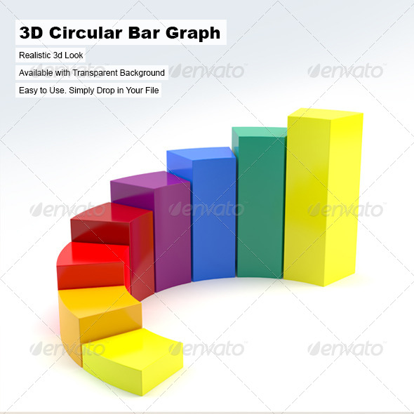
[placeholder image]
Arquitectostyles

Slide 11
[placeholder image]
280 px
280 – 42 = 238
42 × 8 – 42 = 294
Lie Factor = 238/294 = 0.81
42 px
Arquitectostyles

Slide 12
Lie Factor = (size of effect shown in graphic) / (size of effect in data)

Slide 13
Clear and thorough labeling

Slide 14
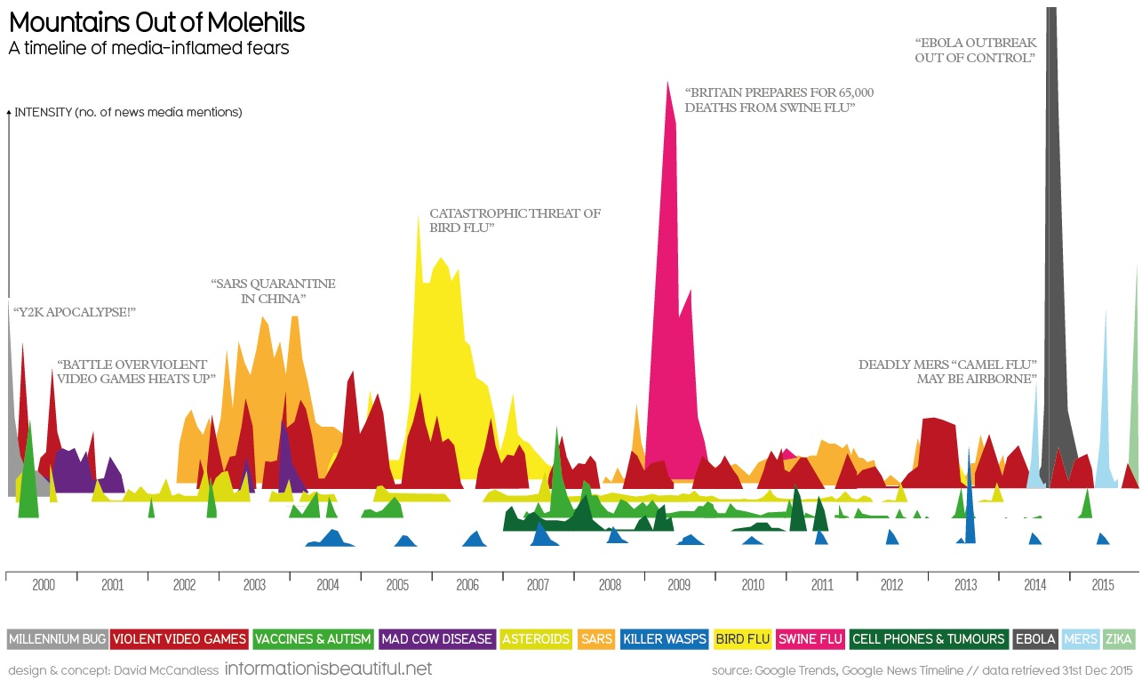
[placeholder for image]
http://www.informationisbeautiful.net/visualizations/mountains-out-of-molehills/

Slide 15
Provide context

Slide 16
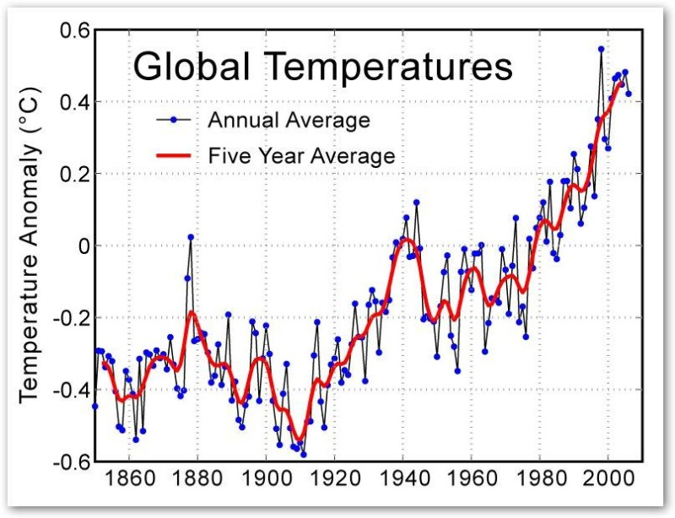
[placeholder for image]
(Image: Global Warming Art)

Slide 17
Show data variation, not design variation

Slide 18
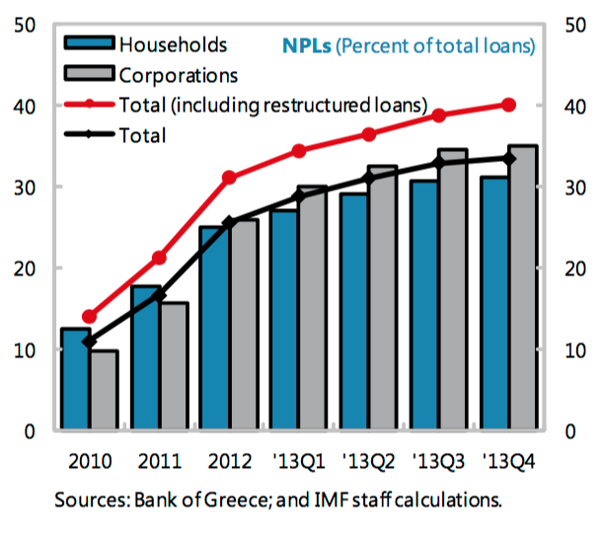
[placeholder for image]
https://www.imf.org/external/pubs/ft/scr/2014/cr14151.pdf

Slide 19
data-ink ratio = (data ink) / (total ink to print graphic)

Slide 21
Notes:
Tufte’s principles provide good guide posts but Tufte does not have the last word. An evolving field.

Slide 22
One Definition
“Data visualization is the creation or study of systems of abstract visual encodings of data, designed to aid human insight.”
Notes:
Systems – primarily computational now, can be interactive
Abstract visual encodings – not reproductions of natural phenomena (not simulations, not technical illustrations)
Designed – requires a leap of abstraction, not easy!!
For Humans – need to understand the user’s tasks/questions
Insight – the ultimate goal
exploratory: trying to turn a lightbulb on in your own head, explanatory: trying to turn on in someone else’s head the same lightbulb that went on in your head

Slide 23
Beyond Tufte
User-centered design (study user needs, prototype, test, iterate)
Interaction (can update data & manipulate views)
Aesthetics (minimalism can be taken too far)
Notes:
Whether on the backend or frontend more easily update the data, and can manipulate how that data is shown. Andy will discuss the evolution of this form. Important to field of data science …

Slide 24


