Slide 1

Taxonomy of visualization
Subtitle goes here

Slide 2
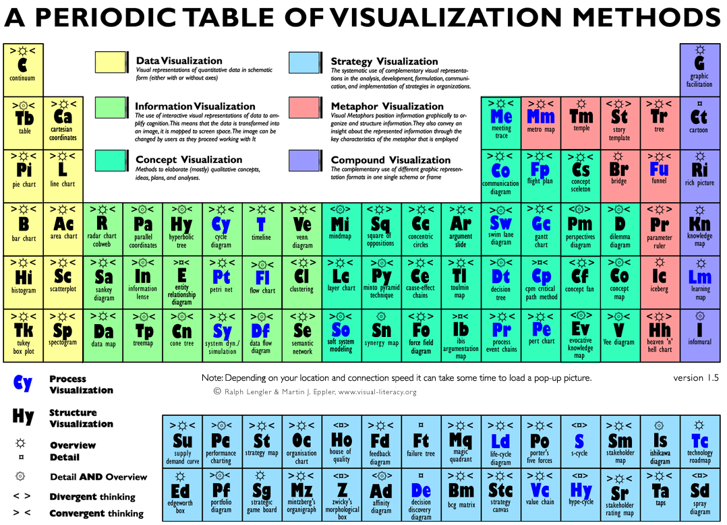
Header
Text starts here
Bullet 1
Bullet 2
Bullet 3
Bullet 4
Bullet 5

Slide 3
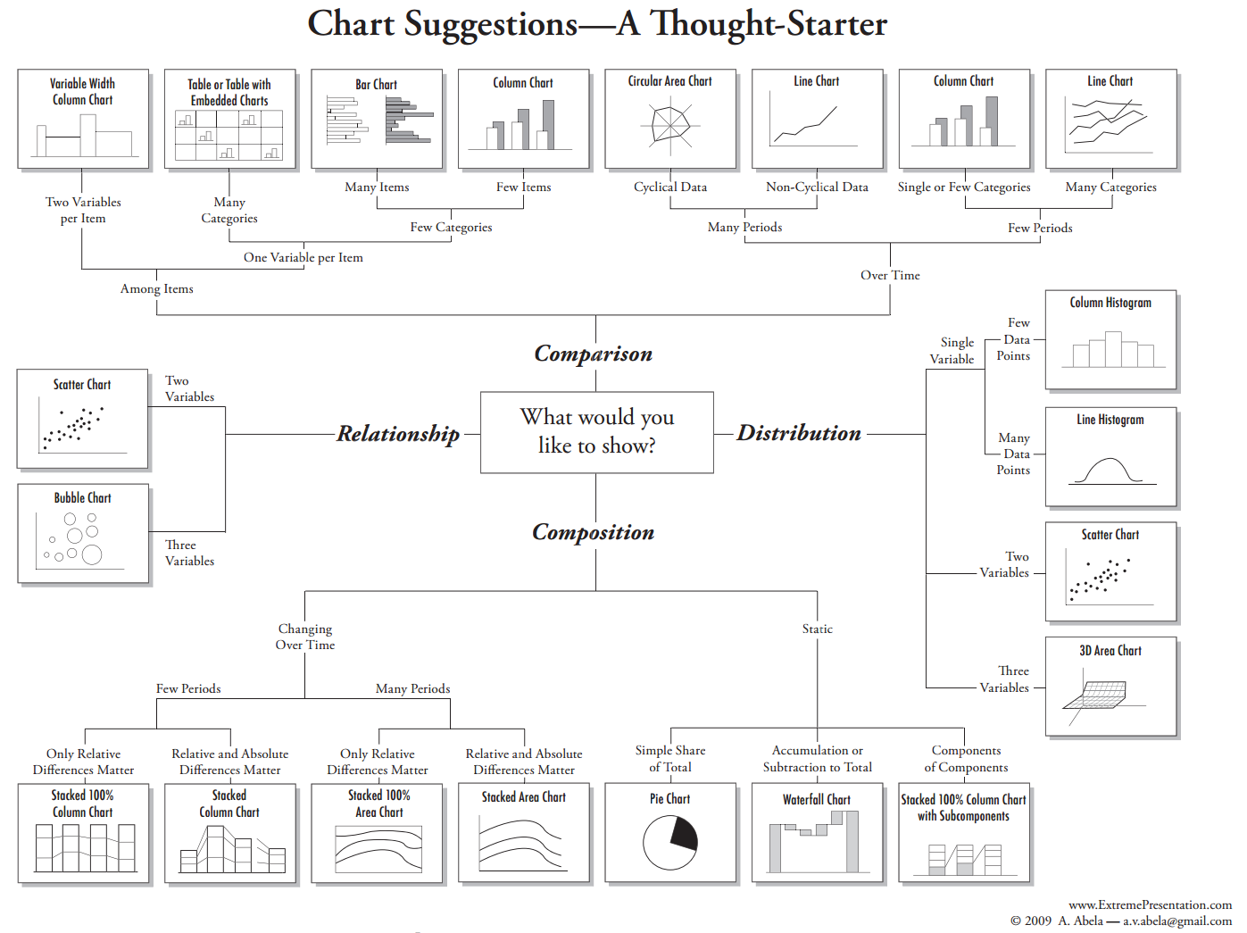

Slide 4
Tables vs. Graphs
Table
Textual information displayed in columns and rows
Placement relative to column or row heads encodes meaning
Graph
Graphical information displayed on one or more axes
Placement of marks relative to axis origins encodes meaning

Slide 5


