Slide 1

A Reference Model

Slide 2
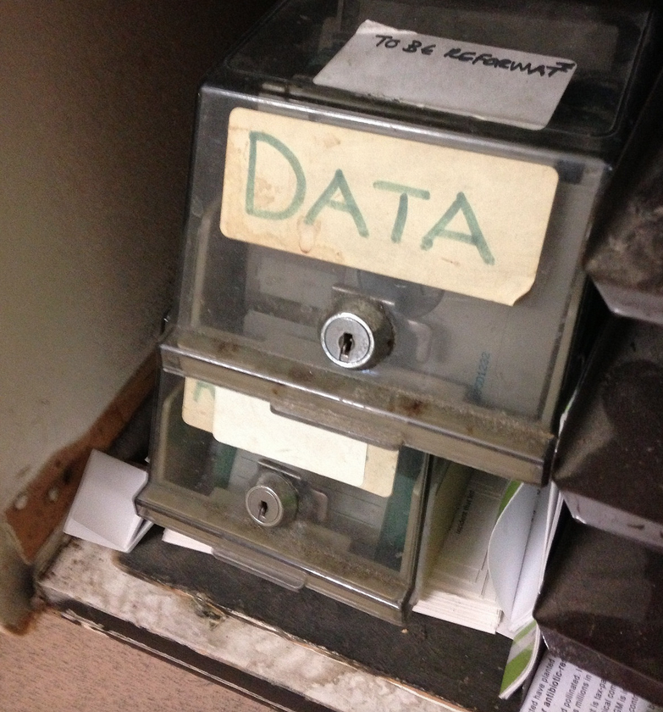
flickr cc 2.0
DATA by Janet McKnight
]
Notes:
How to get data, which is often ungainly, clunky, dirty ….

Slide 3
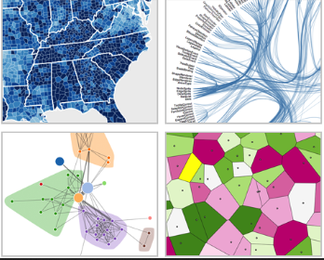
Notes:
PLACEHOLDER IMAGE NEED HIGHER RES Into a form that is elegant and easily perceivable by the human perceptual system?

Slide 4
[Placeholder for Perception Image]
Notes:
Importance of quickly and effectively interpreting the visualization.

Slide 5
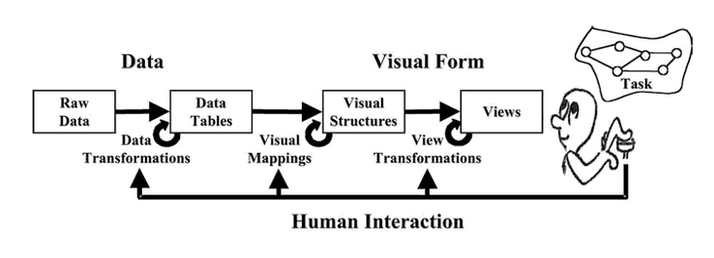
A Reference Model

Slide 6


