Slide 1

Data Tables & Types

Slide 2
.0034
455,600
Notes:
The physical type such as float or integer can also impact.

Slide 3
Scales of measurement
Stevens, 1946

Slide 4
Scales of Measurement
Nominal: data are classified with no inherent order or ranking
Ordinal: data are ranked
Interval: meaningful difference between values (temp.)
Ratio: meaningful 0 point and ratio between values

Slide 5
Univariate
Bivariate
Trivariate
Multivariate

Slide 6
[Image placeholder for univariate,bivariate, multivariate]

Slide 7
Dimension and Measures

Slide 8
Dimension: discrete variables such as dates and categories
Measure: data values that can be aggregated (average, sum, count, etc.)

Slide 9
[placeholder dimension measure image]

Slide 10
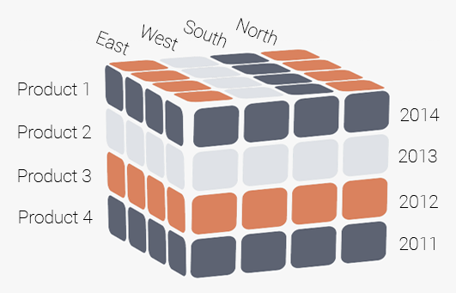
The Data Cube
[Placeholder Image]
Notes:
PLACEHOLDER IMAGE

Slide 11
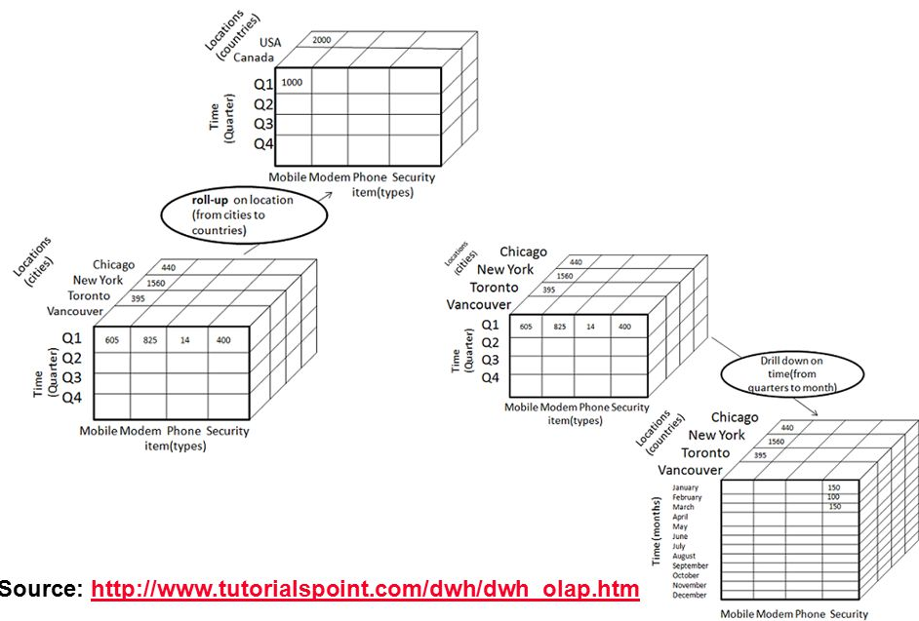
Roll-Up / Drill-Down

Slide 12
Row vs. Column Database
Notes:
IMAGE HERE

Slide 13


