Slide 1

Visual Encodings

Slide 2
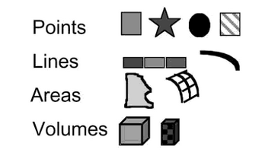
Marks

Slide 3
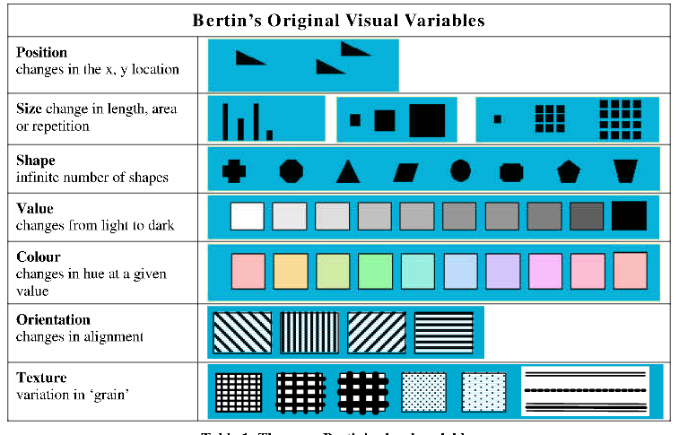
Diagram Source: Carpendale, 2003

Slide 4
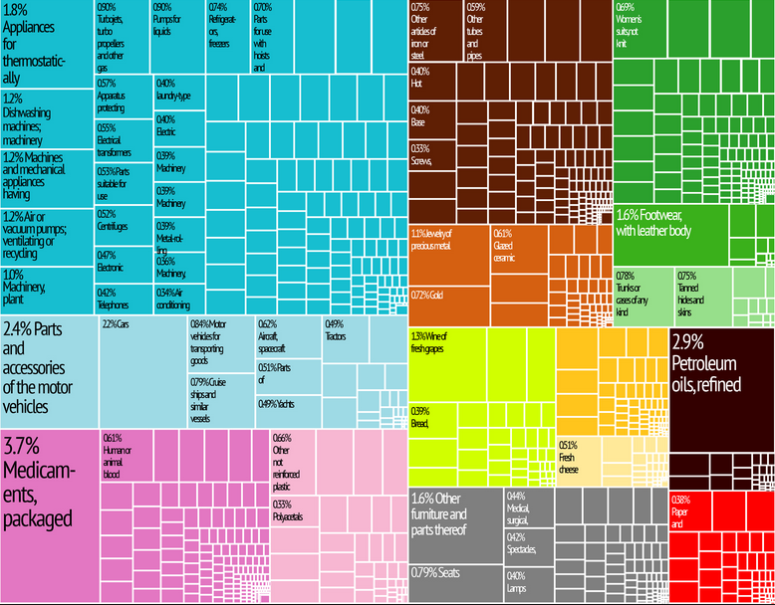
Additional Encodings
Enclosure & Connection
(e.g., tree maps, network graphs)
[Placeholder Image]
Notes:
PLACEHOLDER IMAGE

Slide 5
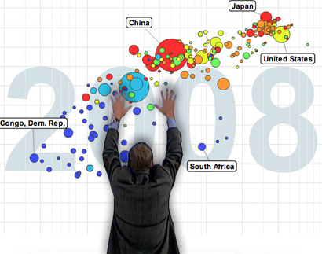
Additional Encodings
Time
(e.g., animation)
Image Source:
http://www.gapminder.org
Notes:
Cite Hans Rosling Image

Slide 6


Slide 7
Dissecting a Visualization

Slide 8
A Process Model
1) Decide which variables to map into spatial positions
2) Combine mappings (transform as needed)
3) Use visual encoding for variables
4) Decide on controls for interaction
5) Apply attention reactive features
[Card, 1999]
Notes:
Check this model!

Slide 9
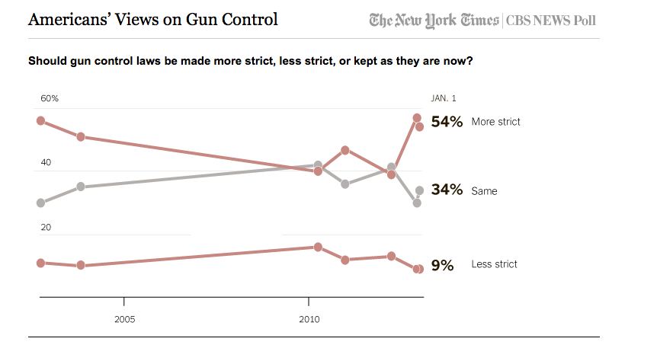

Slide 10
Notes:
REDESIGN TABLE (with additional varaibles)

