Slide 1

Dissecting a Visualization

Slide 2
A Process Model
1) Decide which variables to map into spatial positions
2) Combine mappings (transform as needed)
3) Use visual encoding for variables
4) Decide on controls for interaction
5) Apply attention reactive features
[Card, 1999]
Notes:
Check this model!

Slide 3
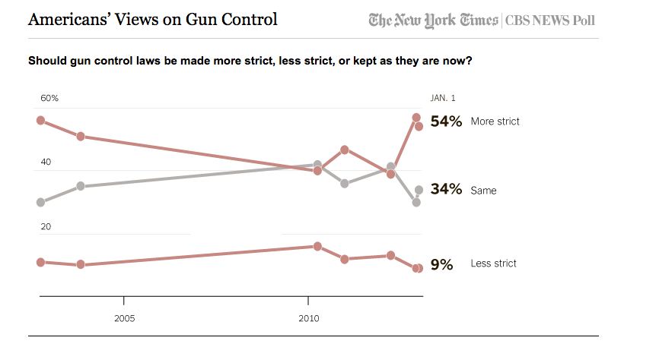

Slide 4
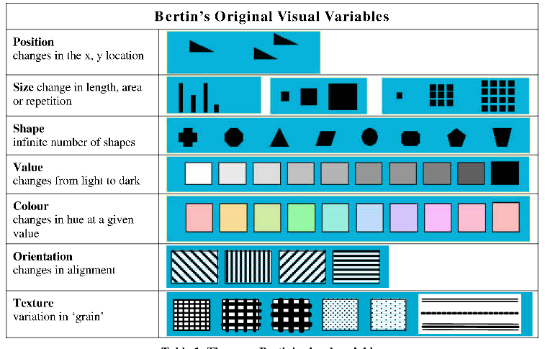
Notes:
REDESIGN TABLE (with additional varaibles)

Slide 5


