Slide 1

Encoding Data Models
Subtitle goes here

Slide 2
Bertin’s Levels of Organization
Position
Size
Shape
Value
Color
Orientation
N Nominal
O Ordinal
Q Quantitative
Texture
Notes:
REDESIGN TABLE. Use white board.

Slide 3
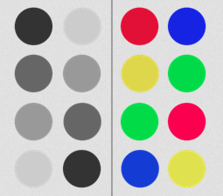
Order these
Notes:
REMAKE IMAGE

Slide 4
Trivariate Data:
Two variables map to points
(e.g., scatter plot)
Third variable map to color, size, shape

Slide 5


