Slide 1

Basic Chart Types
Notes:
Established previously that there are multiple ways of encoding. We’ll talk about how to make the most effective choices and chart types that support these choices.

Slide 2
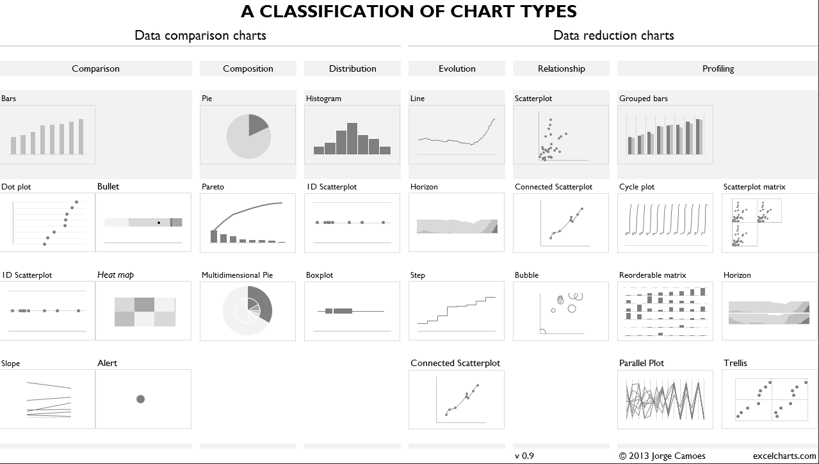
[Placeholder example for image]
Notes:
IMAGE RELEVANT TO EVALUTING CHARTS USING TABLE?

Slide 3
Bar Charts

Slide 4
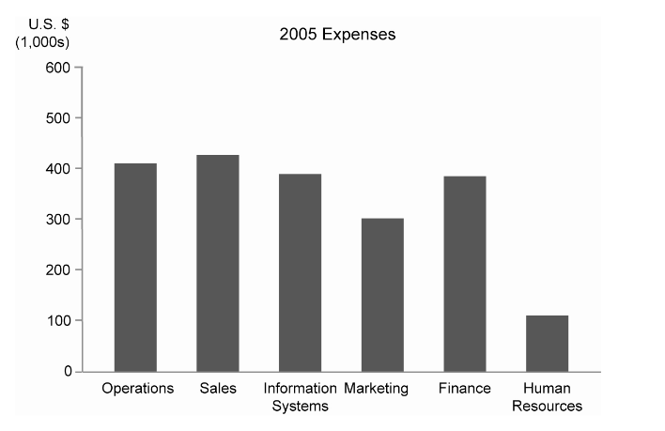
[Placeholder Example Image]

Slide 5
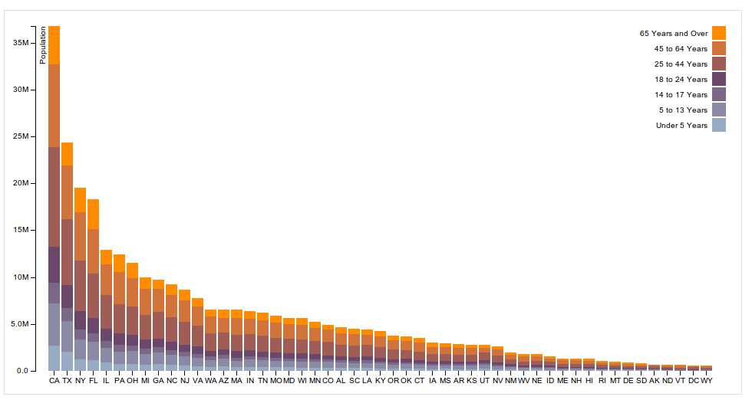
[Placeholder Example Image]

Slide 6
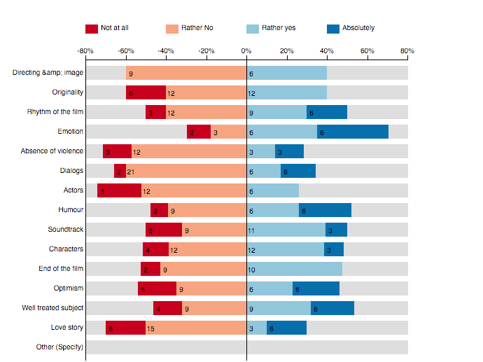
[Placeholder Example Image]

Slide 7
Line Charts

Slide 8
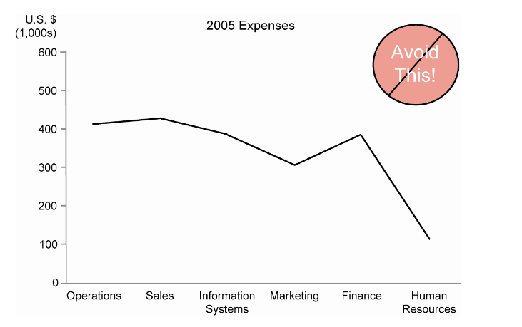
[Placeholder Example Image]

Slide 9
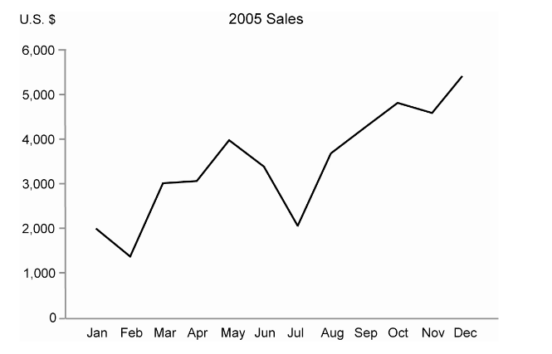
[Placeholder Example Image]

Slide 10
Scatter/ Dot Plot

Slide 11
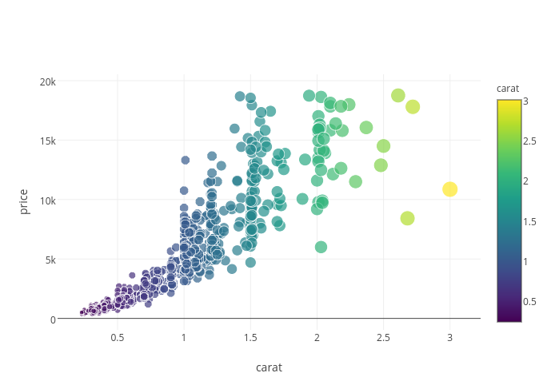
Notes:
https://plot.ly/~RPlotBot/1143.png

Slide 12
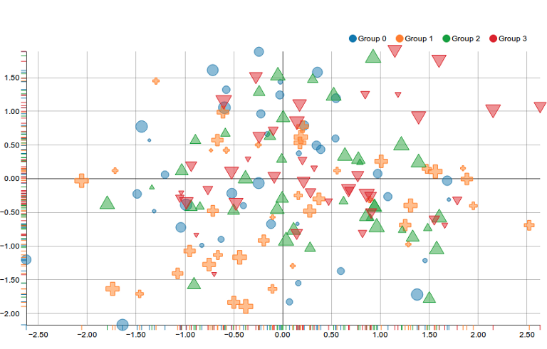
Notes:
Shape and position.

Slide 13
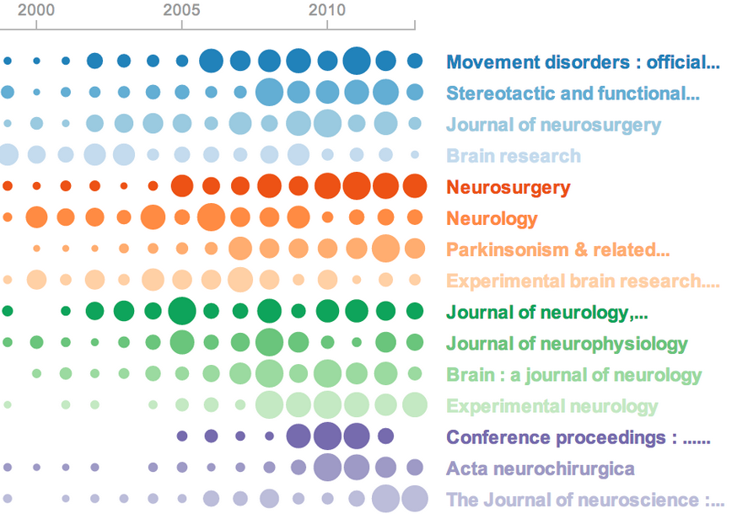
[Placeholder Example Image]
Notes:
http://neuralengr.com/asifr/journals/

Slide 14
Tables & Heatmaps

Slide 15
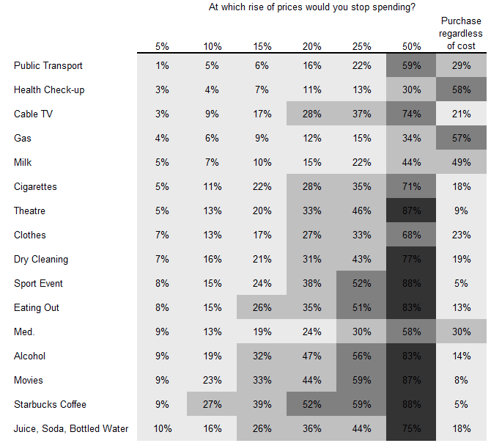
Notes:
http://www.clearlyandsimply.com/clearly_and_simply/2009/02/there-is-more-than-one-way-to-heat-a-map.html

Slide 16
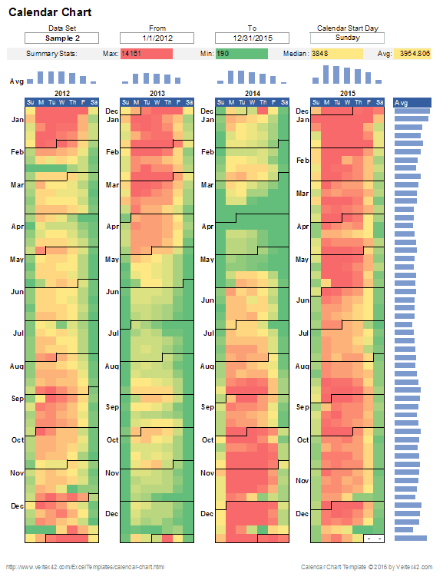

Slide 17
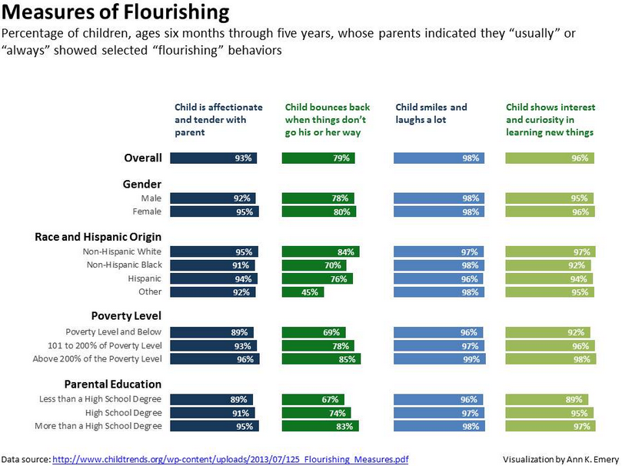

Slide 18


