Slide 1

Core Modules in D3
Subtitle goes here

Slide 2
d3-selection
Recall- this is the core object we’ll be working with in d3!

Slide 3
the circle of D3
select
attr
data
append
enter

Slide 4
the circle of D3
select
attr
data
append
update

Slide 5
why did we need D3?

Slide 6
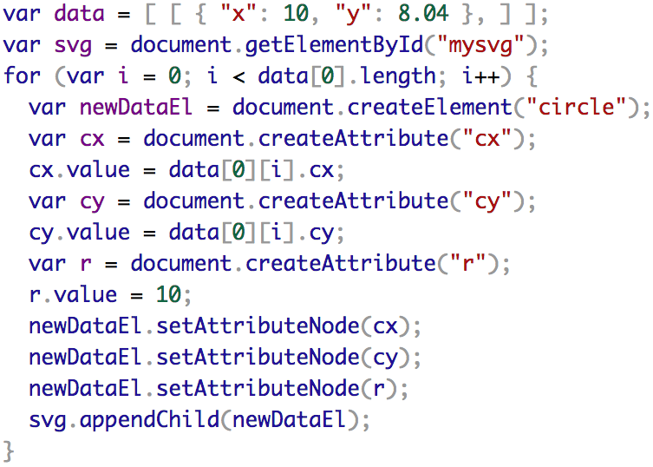
why did we use D3?

Slide 7
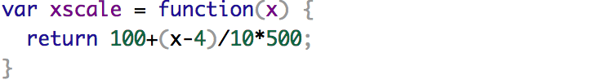

Slide 8
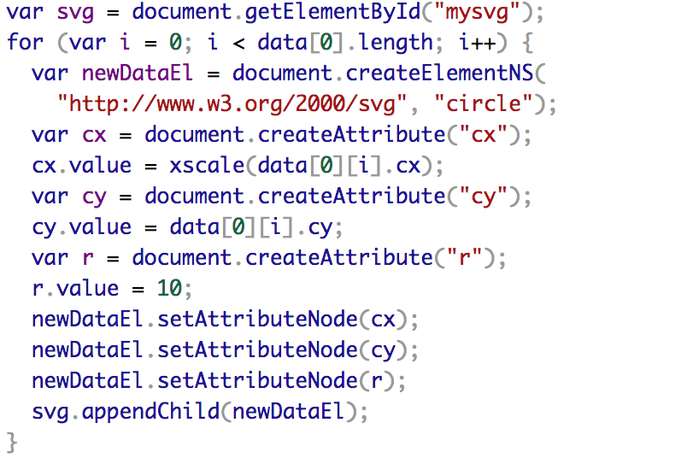

Slide 9
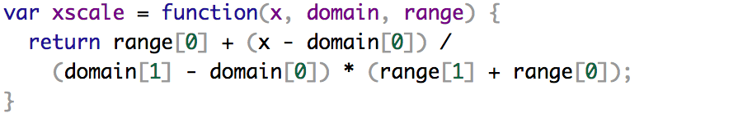

Slide 10
d3-scale
data: .003 -> 16
data space
pixels: 0 -> 500
ink space

Slide 11
d3-scale
data: .003 -> 16
data space
pixels: 0 -> 500
ink space
Notes:
linear

Slide 12
d3-scale
data: .003 -> 16
data space
pixels: 0 -> 500
ink space
Notes:
ah! bezier curve?

Slide 13
d3-scale
data: .003 -> 16
domain([.003,16])
d3.scaleLinear
range([0,500])
pixels: 0 -> 500

Slide 14
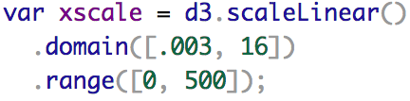
d3-scale
data: .003 -> 16
data space
pixels: 0 -> 500
ink space

Slide 15


d3-axis

Slide 16
d3-path, d3-shape, d3-polygon

Slide 17


