Slide 1

Other Chart Types

Slide 2
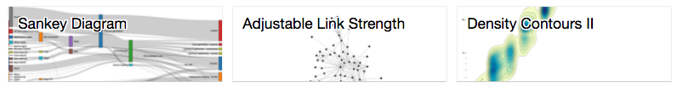
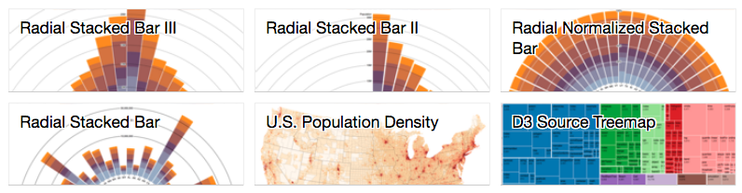
https://bl.ocks.org/mbostock

Slide 3
What is the data? (data type & structure)
Why is the user using the vis tool? (tasks)
How are the visual encodings & interactions constructed?
Munzner, T., 2014. Visualization analysis and design. CRC press.
Notes:
A framework that helps us think about ways to select more complex new representations for chart types.
Stevens’s nominal, ordinal interval, Scheiderman’s data type classifications including the number of dimensions, and temporal, tree/ hierarchical, and network data

Slide 4
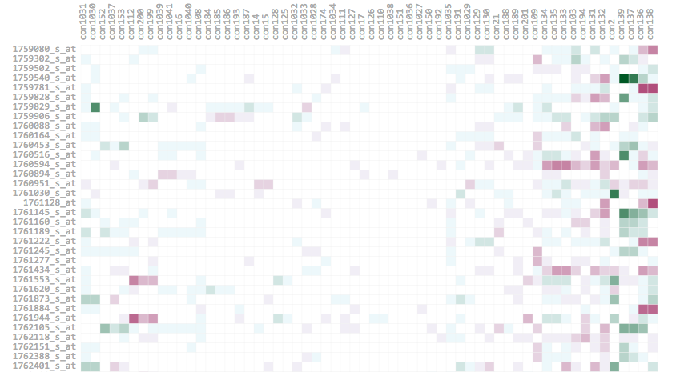

Heatmap
http://bl.ocks.org/ianyfchang/8119685
Notes:
A heatmap provides a compact summary of a quantitative value attribute uses 2D matrix alignment by two key attributes and area marks colored with a diverging colormap.

Slide 5
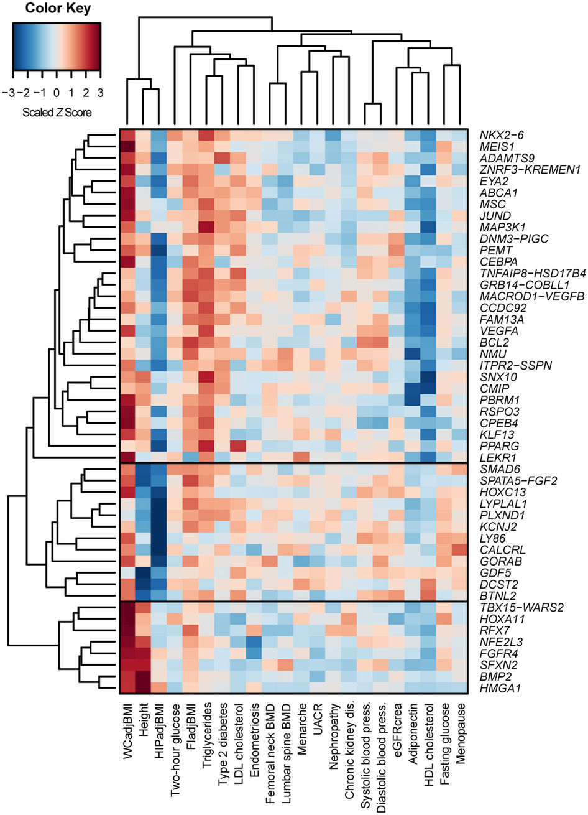
Source: Shungin, D. et al. (2015). New genetic loci link adipose and insulin biology to body fat distribution.
Nature, 518(7538), 187.
Notes:
The cluster heatmap includes trees drawn on the periphery showing how the matrix is ordered according to the derived data of hierarchical clusterings on its rows and columns
The matrix of Z-scores representing the set of associations was scaled by row (locus name) and by column (trait) to range from −3 to 3. Negative values (blue) indicate that the WHRadjBMI-increasing allele was associated with decreased values of the trait and positive values (red) indicate that this allele was associated with increased values of the trait. Dendrograms indicating the clustering relationships are shown to the left and above the heat map

Slide 6
Cluster Heatmap
What: 2 categorical attributes (locus, trait),
1 quantitative association
Why: provide overview, find clusters,
find outliers
How: alignment of area marks,
diverging color map (hue & brightness) for
association,
dendrogram uses connection lines for
hierarchy of parent-child nodes

Slide 7
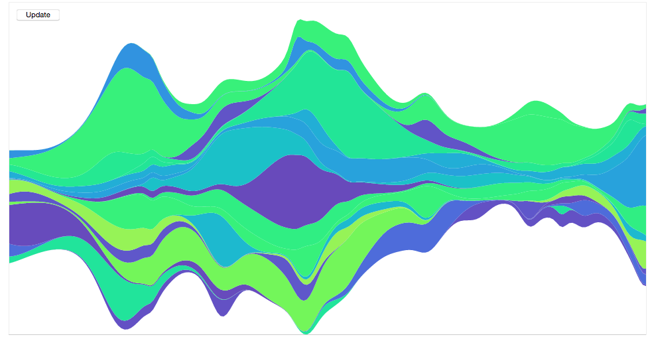
Streamgraph
https://bl.ocks.org/mbostock/4060954
Notes:
Algorithm to produce an organic derivced geomtry. for slihoutte of the entire shape, the amount of wiggle in the baseline, and the deviation of each layer from the baseline. Lee Byron and Martin Wattenberg paper, note that the original creation was to create something novel that felt organic and emotionally pleasing.

Slide 8
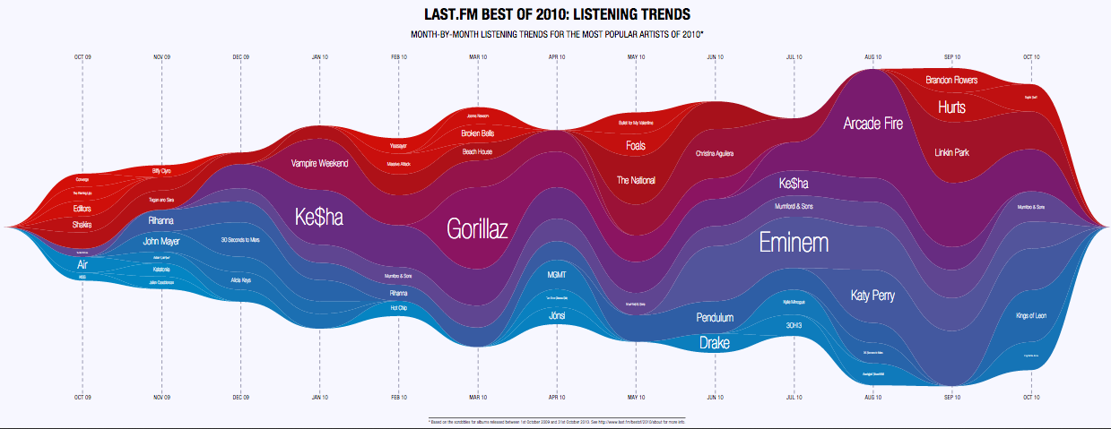
http://cdn.last.fm/blog/posts/bestof2010_streamgraph.pdf

Slide 9
What: multidimensional:
1 quantitative (songs shared), 1 temporal
quantitative or ordinal (month & year),
1 categorical (artist)
Why: provide general trends,
compare artists, be visually pleasing / engaging
How: derived height & area for count, hue for
categorical, position for temporal
Notes:
Stevenss data types, quantitative data, shcneiderman’s also

Slide 10
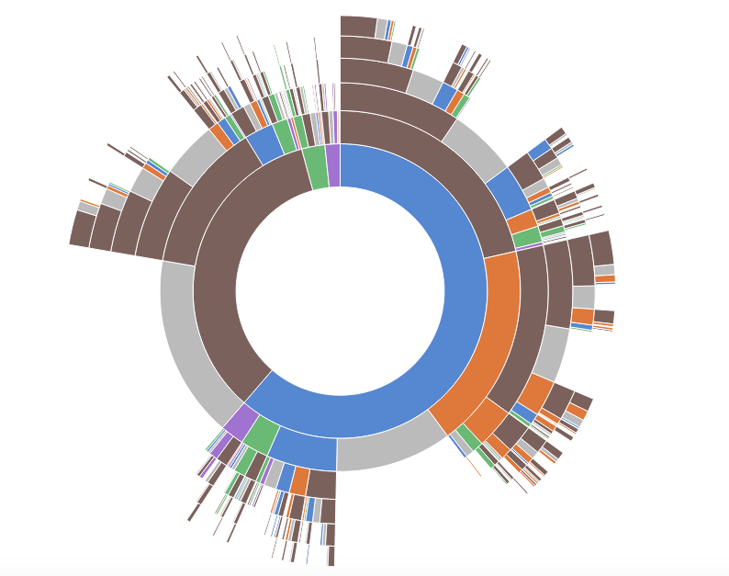
Sunburst
https://bl.ocks.org/kerryrodden/7090426
Notes:
The sunburst chart uses polar coordinates with wedges or bars radiating from the center.

Slide 11
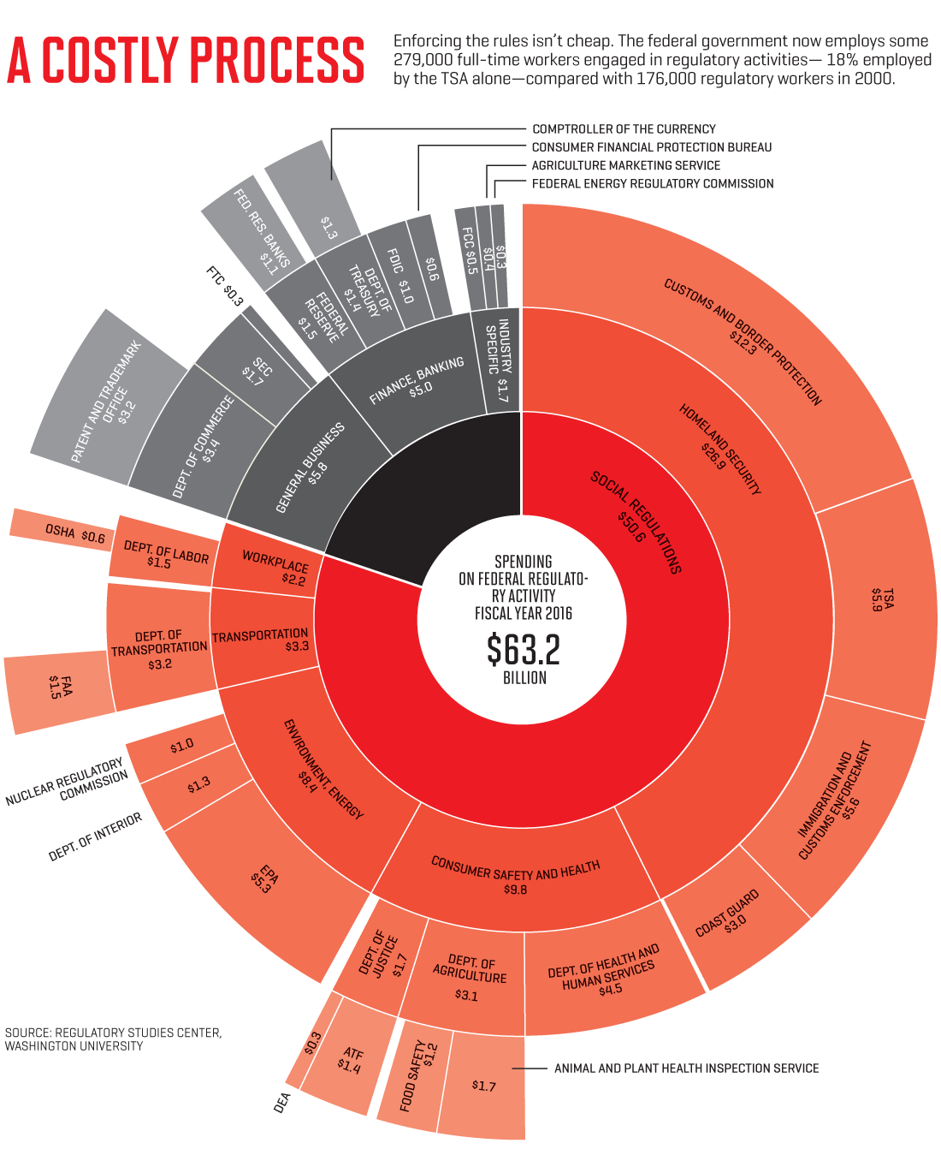
Sunburst
Source:
http://fortune.com/red-tape-business-regulations/
Notes:
Vis that appeared in Fortune looking at regulatory spending

Slide 12
What: 1 quantitative ($ spent),
1 categorical & hierarchical
(department or category of spending)
Why: overview,
find relationships, compare amounts
How: connection, hue, brightness used
for hierarchical categories, length / area
for quantitative
Notes:
Stevenss data types, quantitative data, shcneiderman’s also for hierarchical data. We’ll talk about additional ways of representing this later in the tern.

Slide 13
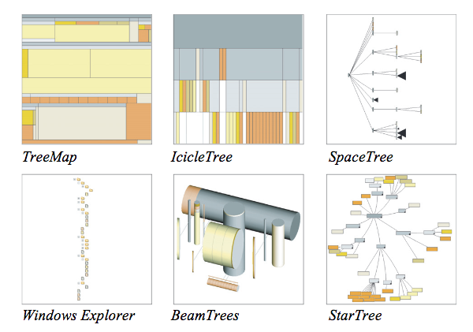
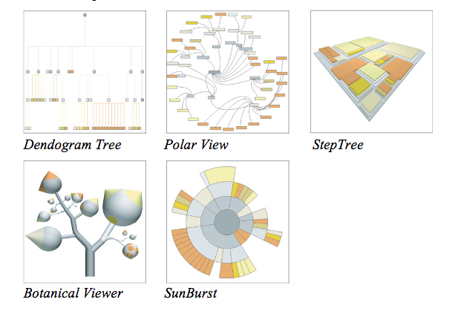
What: file folder hierarchy
Why: determine structure & attribute relationships
Cawthon, N. and Moere, A.V., 2007, July. The effect of aesthetic on the usability of data visualization. In Information Visualization, 2007. IV'07. 11th International Conference (pp. 637-648). IEEE.
Notes:
14 questions.

Slide 14
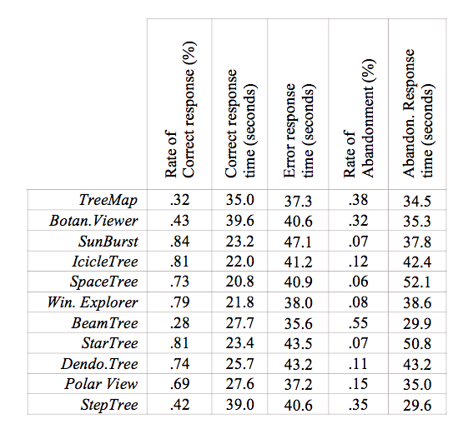
[Cawthon & Moere., 2007]
Notes:
Tasks matter and you’ll want to have ways of testing these tasks for your chart types early on.

Slide 15
What is the data? (data type & structure)
Why is the user using the vis tool? (tasks)
How are the visual encodings & interactions constructed?
Munzner, T., 2014. Visualization analysis and design. CRC press.
Notes:
A framework that helps us think about ways to select more complex new representations for chart types.
Stevens’s nominal, ordinal interval, Scheiderman’s data type classifications including the number of dimensions, and temporal, tree/ hierarchical, and network data

Slide 16
What is the data? (data type & structure)
Why is the user using the vis tool? (tasks)
How are the visual encodings & interactions constructed?
Munzner, T., 2014. Visualization analysis and design. CRC press.
Notes:
A framework that helps us think about ways to select more complex new representations for chart types.
Stevens’s nominal, ordinal interval, Scheiderman’s data type classifications including the number of dimensions, and temporal, tree/ hierarchical, and network data

Slide 17
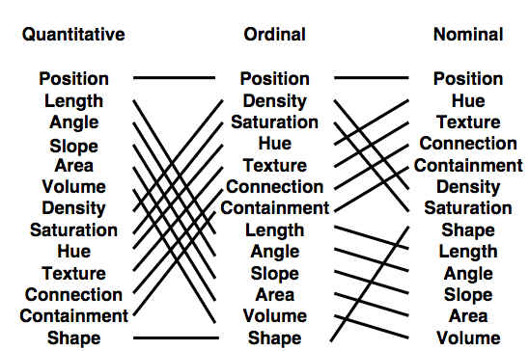
[Mackinlay, 1987]

Slide 18
What is the data? (data type & structure)
Why is the user using the vis tool? (tasks)
How are the visual encodings & interactions constructed?
Munzner, T., 2014. Visualization analysis and design. CRC press.
Notes:
A framework that helps us think about ways to select more complex new representations for chart types.
Stevens’s nominal, ordinal interval, Scheiderman’s data type classifications including the number of dimensions, and temporal, tree/ hierarchical, and network data

Slide 19
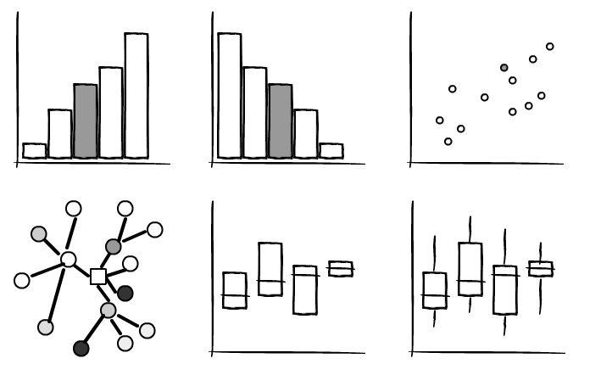
Come up with a list of tasks
Design a vis mock up (pen & paper, digital)
Have users sit down and try to perform the tasks with the mock up
Picture Source: https://mockupstogo.mybalsamiq.com/projects/diagrams/story

Slide 20


