Slide 1

Detection in Visual Search
Notes:
Discuss what graphical perception of patterns is in intro.

Slide 2
Which data features are the focus?
Notes:
What are you looking for in the data? You’ll want to use graphical elements that are more visually salient for the more important data. Sounds obvious but realize that when working with large data sets with multiple dimensions and measure you will need to make decisions.

Slide 3
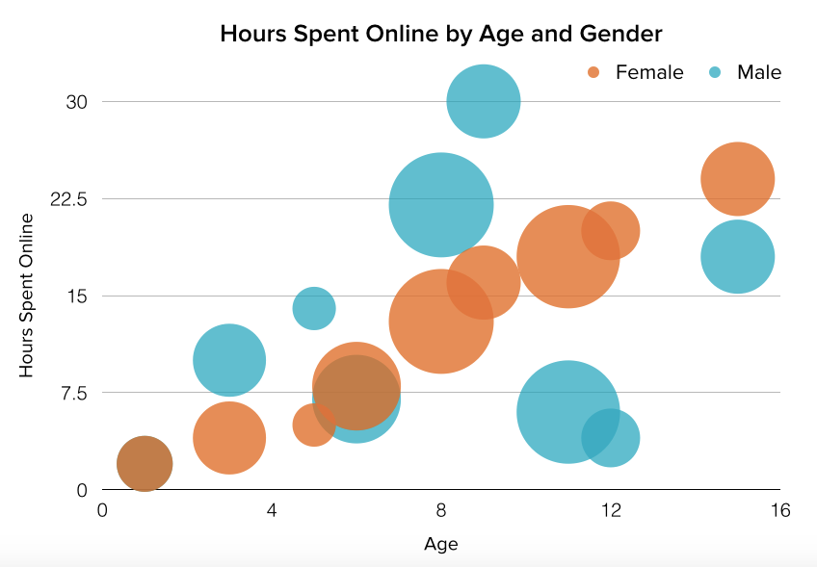
[EXAMPLE IMAGE]
Notes:
If you recall, when we were looking at comparing quantitative data

Slide 4
Preattentive
200 – 250 milliseconds

Slide 5

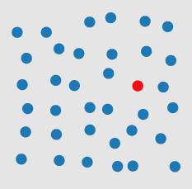
Color/ Hue
Diagram Healey
https://www.csc2.ncsu.edu/faculty/healey/PP/index.html
Notes:
https://www.csc2.ncsu.edu/faculty/healey/download/tvcg.12a.pdf

Slide 6
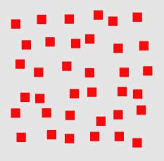

Shape
Diagram Healey
https://www.csc2.ncsu.edu/faculty/healey/PP/index.html
Notes:
shape is preattentive

Slide 7

Line Orientation
Diagram Healey
https://www.csc2.ncsu.edu/faculty/healey/PP/index.html
Notes:
angle of orientation is preattentive cockpit dials work if most aligned same

Slide 8

Curvature
Diagram Healey
https://www.csc2.ncsu.edu/faculty/healey/PP/index.html
Notes:
curvature is preattentive

Slide 9

Intersection
Diagram Healey
https://www.csc2.ncsu.edu/faculty/healey/PP/index.html
Notes:
intersection is preattentive

Slide 10
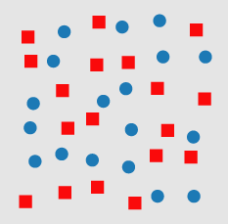
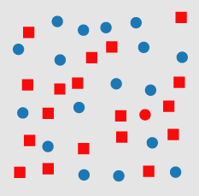
Both Hue and Shape
Diagram Healey
https://www.csc2.ncsu.edu/faculty/healey/PP/index.html
Notes:
combined attributes are not preattentive

Slide 11
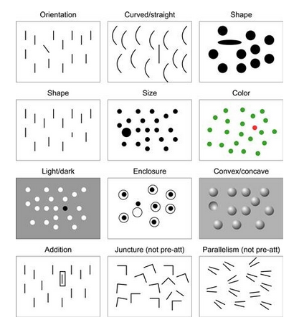
Ware, 1999

Slide 12
Preattentive Attributes [redo slide]
hue
Shape
orientation
Curvature
intersection
length
width
closure
size
density
color intensity
Terminators (Ts)
3D depth cues
stereoscopic depth
3D orientation
lighting direction
flicker
direction of motion
velocity of motion
number estimation
Artistic properties
Notes:
other things: length, width, closure, size, density, color intensity, terminators (Ts), depth cues, lighting direction, flicker, direction of motion, velocity of motion, number estimation

Slide 13
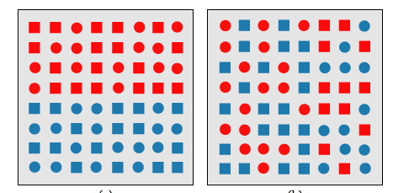
Feature Integration
Diagram Healey
https://www.csc2.ncsu.edu/faculty/healey/PP/index.html

Slide 14
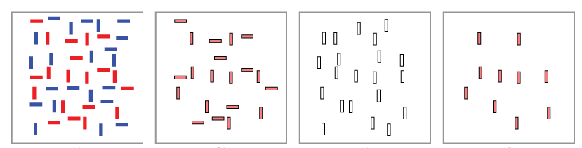
Boolean Map Theory
Diagram Healey
https://www.csc2.ncsu.edu/faculty/healey/PP/index.html

Slide 15
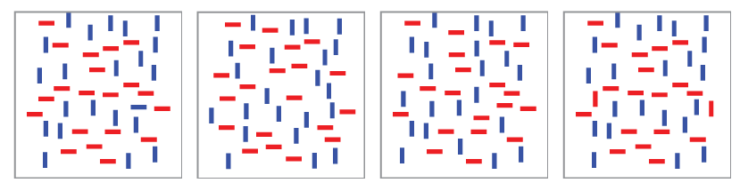
Boolean Map Theory
Diagram Healey
https://www.csc2.ncsu.edu/faculty/healey/PP/index.html
Notes:
The user can find one (color) then another (direction).

Slide 16
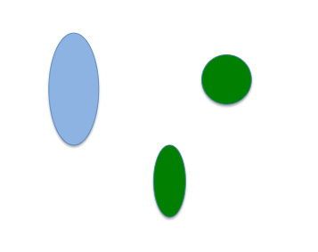
How would you group these?

Slide 17
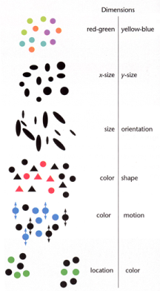
Integral and Separable Dimensions
Integral
separable
Notes:
example of separable: size and color
a hierarchy of separability

Slide 18


