Slide 1
Gestalt Principles

Slide 2
sum of its parts
a functional unit
Notes:
definition
\gǝ 's(h)tält\ n. 1. a structure or configuration of physical, biological, or psychological phenomena so integrated as to constitute a functional unit with properties not derivable from its parts in summation.
whole rather than sum of its parts probability that certain bits belong together aids to visual grouping, object percept, surface percept

Slide 3
Gestalt Principles
Proximity
Notes:
Proximity nearness

Slide 4
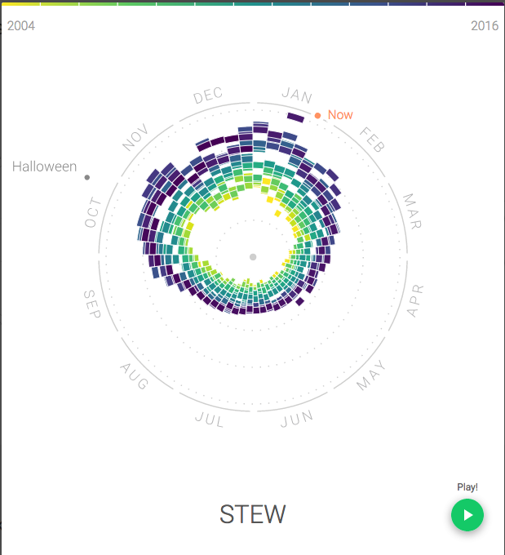
http://rhythm-of-food.net/stew

Slide 5
Gestalt Principles
Similarity
Notes:
Similarity shape, color, size, etc.

Slide 6
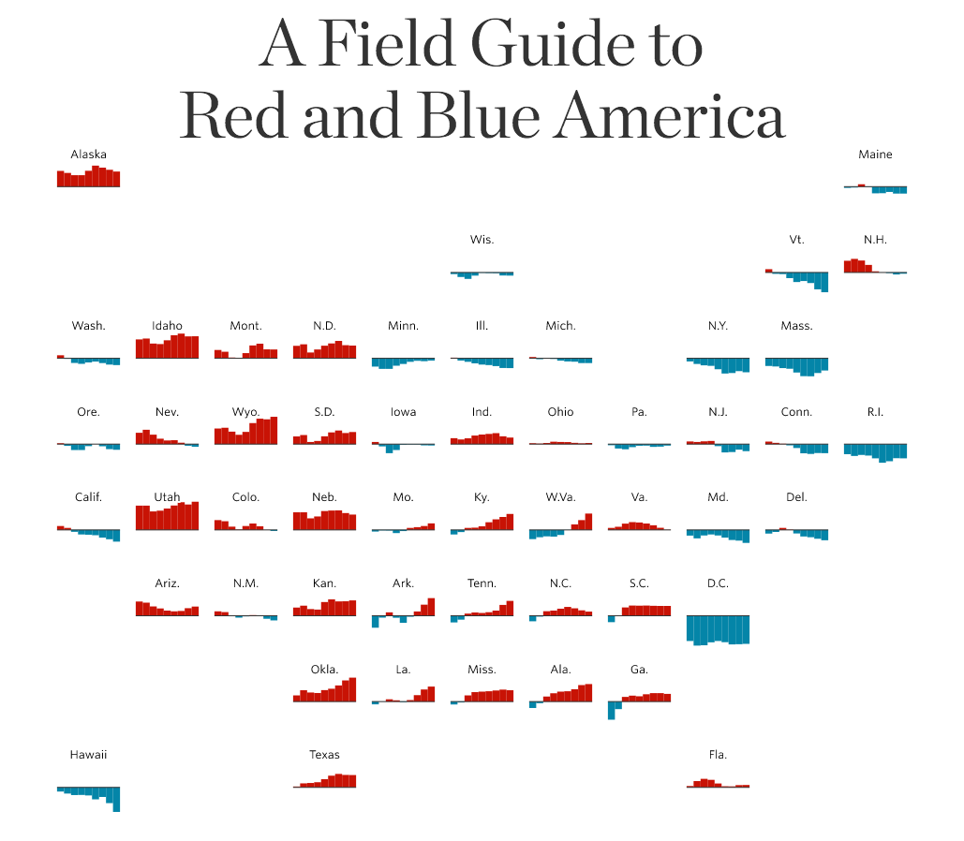
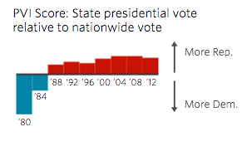
[Placeholder Example Vis]
http://graphics.wsj.com/elections/2016/field-guide-red-blue-america/
Notes:
Using color for similarity here

Slide 7
Gestalt Principles
Connectedness
Notes:
connectedness connecting lines, or enclosure

Slide 8
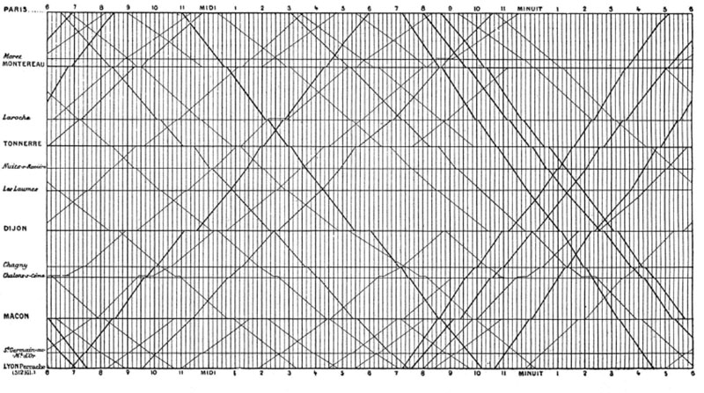
E.J. Marey

Slide 9
Gestalt Principles
Good continuation
Notes:
Good continuation smoothness, connection items along unseen line or curve seem connected

Slide 10
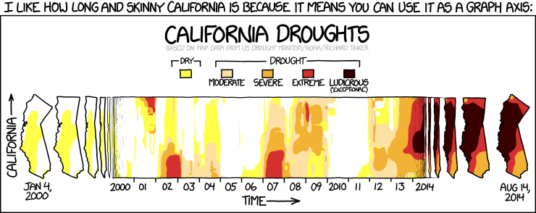
https://xkcd.com/1410/

Slide 11
Gestalt Principles
Good form
Notes:
Good form simplicity of shape

Slide 12
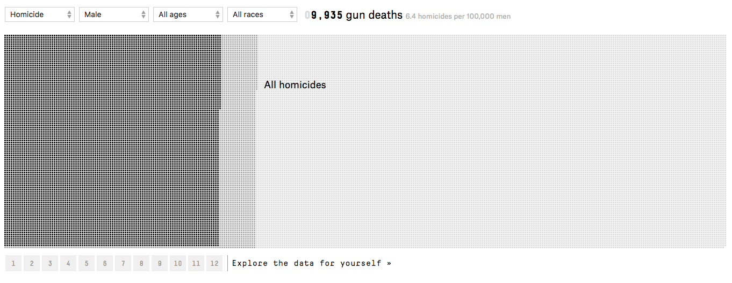
https://fivethirtyeight.com/features/gun-deaths/
Notes:
We see the sets of small squares as rectangles. One square per gun death, it’s easy to compare values when they make nice rectangular areas.

Slide 13
Gestalt Principles
Common fate
Notes:
Common fate common movement consider driving in traffic overrides most others

Slide 14
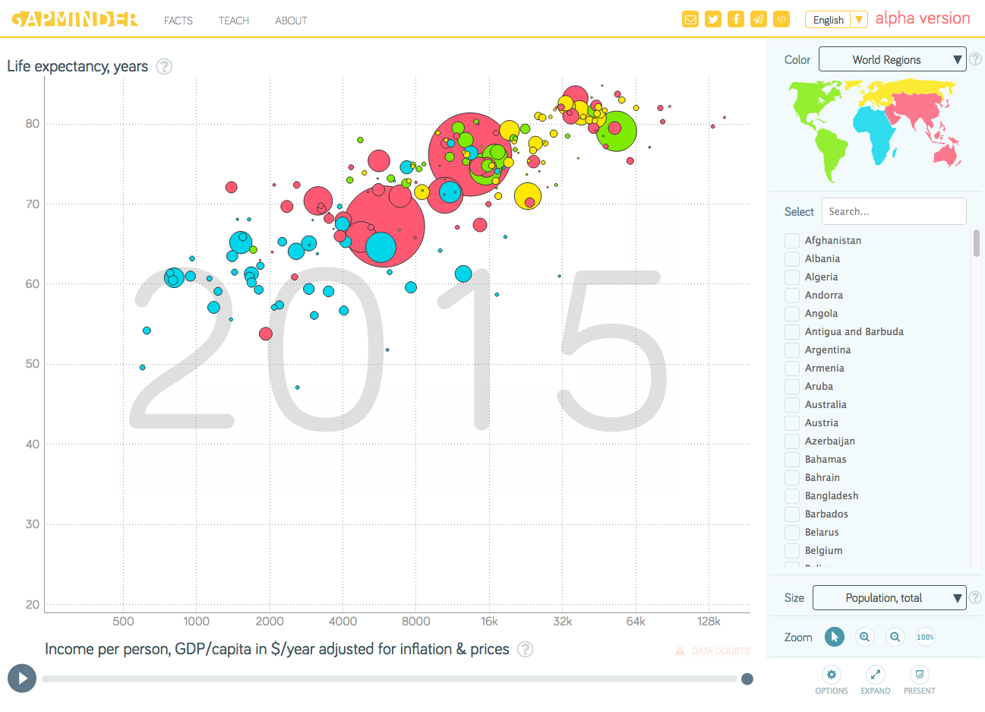
[Placeholder Example Vis]
http://www.gapminder.org/tools/#_chart-type=bubbles

Slide 15

Gestalt Principles
Figure/ground
Notes:
figure/ground what’s in front/back 1’s look related = 11

Slide 16
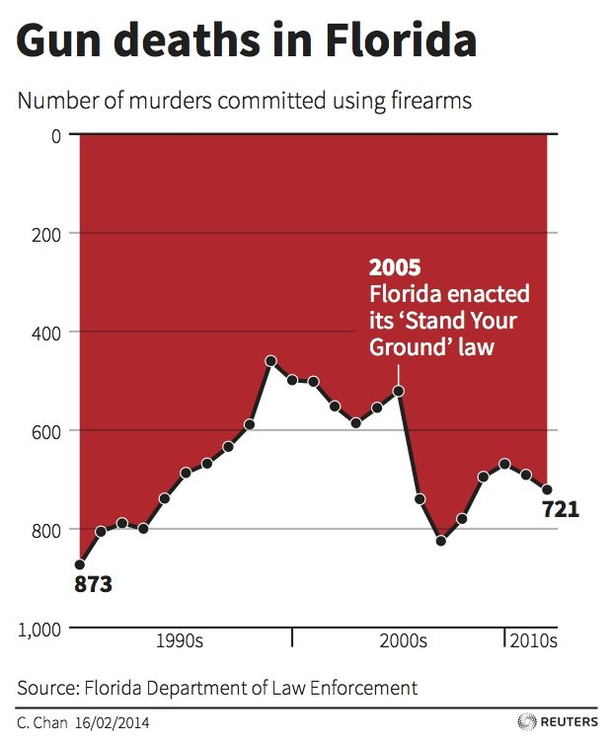
[Placeholder Example Vis]
Notes:
This graph is confusing because the use of figure and ground goes against convention (and it has lots of other problems.)

Slide 17
Gestalt Principles
Symmetry
Notes:
symmetry symmetric arrows look related

Slide 18
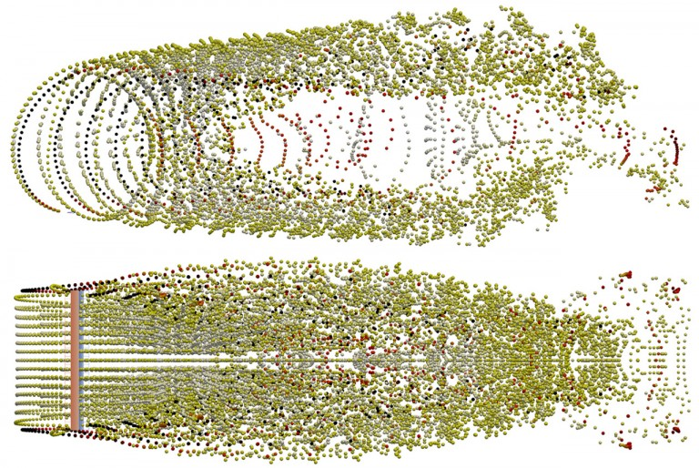
[Placeholder Example Vis]
http://robertwilliams.ca/engineering/
Notes:
Vortex particle wake of a straight-blade rotor

Slide 19
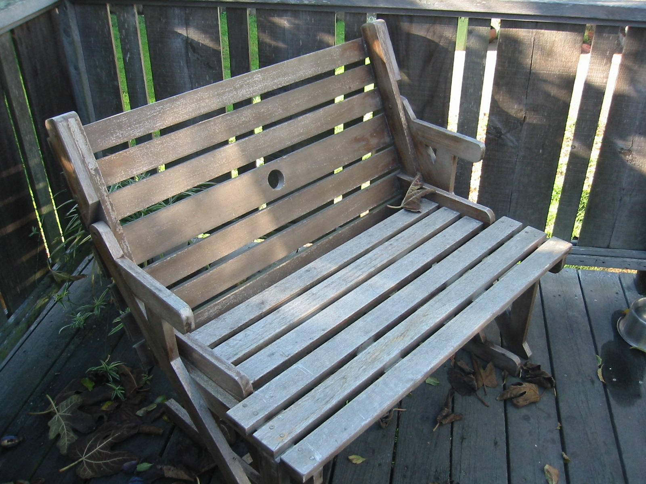
Gestalt Principles
Transparency
Notes:
transparency same change to background colors

Slide 20
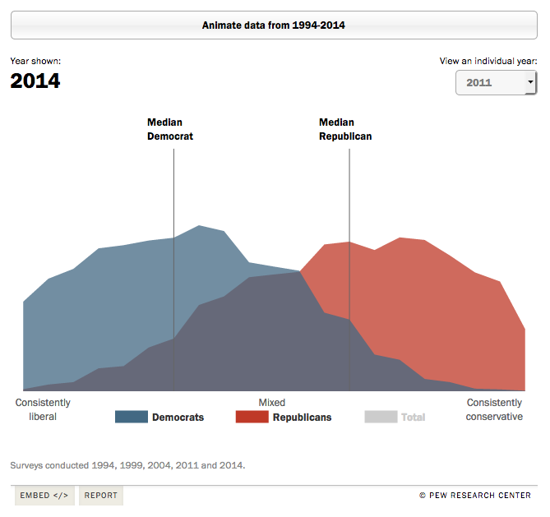
http://www.people-press.org/2014/06/12/section-1-growing-ideological-consistency/#interactive
Notes:
“red” area is two colors, but we see it as one area because it all has the same transparency.

Slide 21
Gestalt Principles
Closure
1 3 5 _ 9
Notes:
Closure modal completion – triangle in front of pacman amodal – rock behind person (blue circles) not just visual

Slide 22
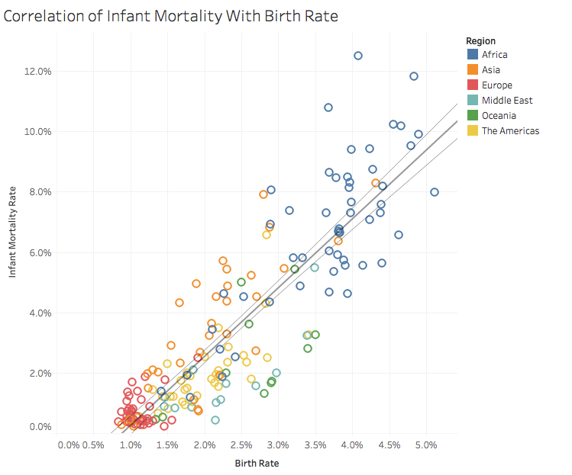
Notes:
Even with a simple scatter plot, we use closure to determine axis values and to perceive objects behind others as complete objects

Slide 23


