Slide 1

Occlusion & Depth
Notes:
Decisions about how to scale the data inform the context.

Slide 2
What’s hiding?
Notes:
TREE FOREST IMAGE

Slide 3
Techniques for clutter reduction
Notes:
Remember perceptual principles that apply here.
From Alan and Dix, 2007. A Taxonomy of Clutter Reduction for Information Visualization. https://core.ac.uk/download/pdf/70210.pdf Assign this paper.

Slide 4
Decrease Point Size

Slide 5
Opacity

Slide 6
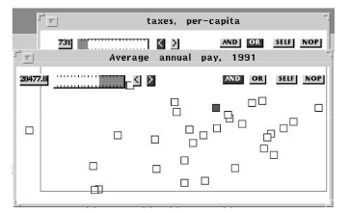
Sampling or Filtering
[Placeholder example image]

Slide 7
Clustering
[Placeholder for image]

Slide 8
Point/ Line Displacement
[Placeholder for image]
Notes:
Point or line displacement

Slide 9
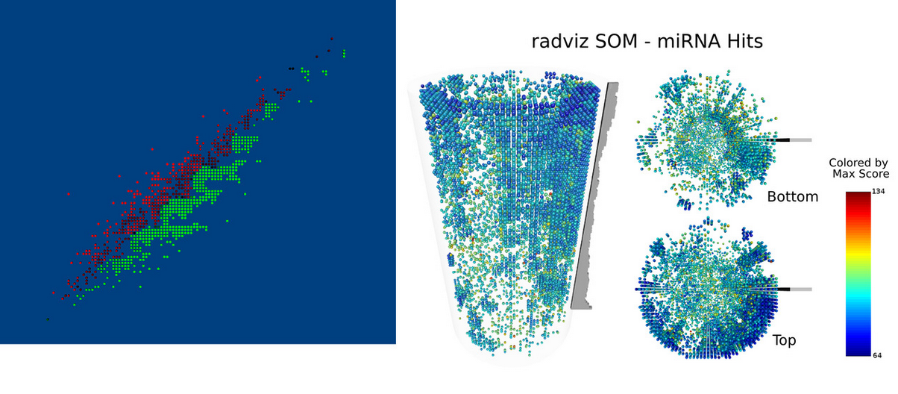
Smart Jitter
[Placeholder example image]
Trutschi et al., 2003. “Intelligently Resolving Point Occlusion”

Slide 10
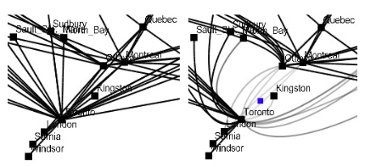
EdgeLens
[Placeholder example image]

Slide 11
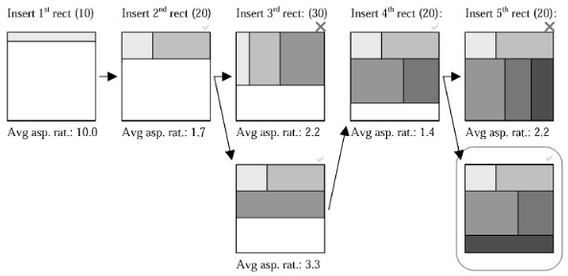
“Strip” Treemap Algorithm
[Placeholder example image]
Bederson, Shneiderman, Wattenberg, 2002. Ordered and Quantum Treemaps: Making Effective Use of 2D Space to Display Hierarchies
Notes:
https://www.cs.umd.edu/users/ben/papers/Bederson2002Ordered.pdf

Slide 12
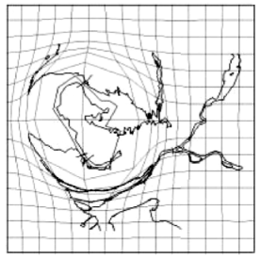
Topological Distortion
[Placeholder example image]

Slide 13
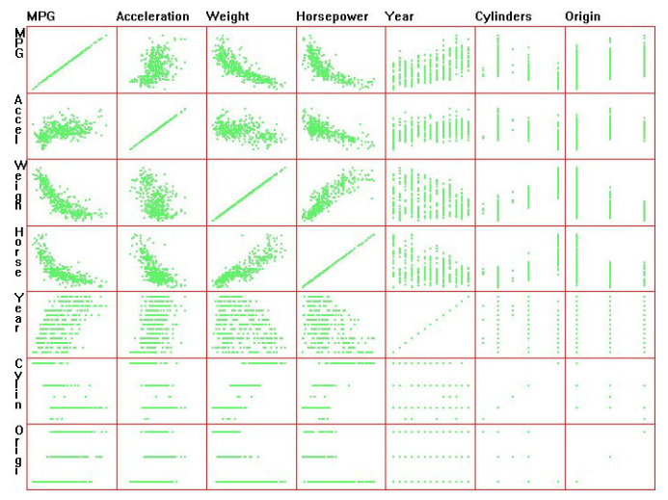
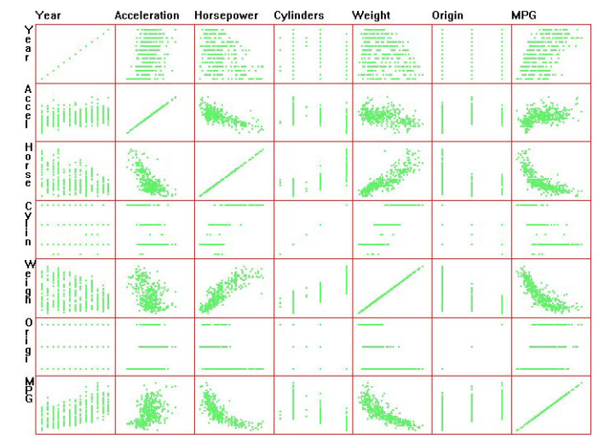
Dimensional Reordering
Peng, Ward, Rundensteiner, 2004. Clutter Reduction in Multi-Dimensional
Data Visualization Using Dimension Reordering.
Notes:
http://digitalcommons.wpi.edu/cgi/viewcontent.cgi?article=1071&context=computerscience-pubs

Slide 14
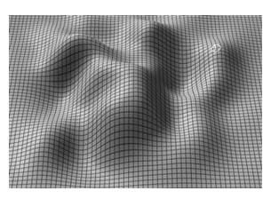
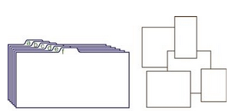
Spatial Depth Cues
Size
Gridlines
Surface shading & texture
Shadows
Ware, 2013. Information Visualization: Perception for Design.
Notes:
There are times where you want to

Slide 15
Use
CAUTION!

Slide 16
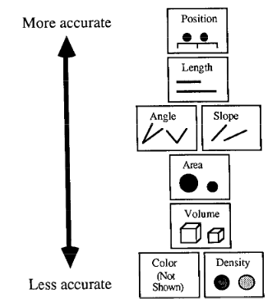
(from Mackinlay, 1987)

Slide 17
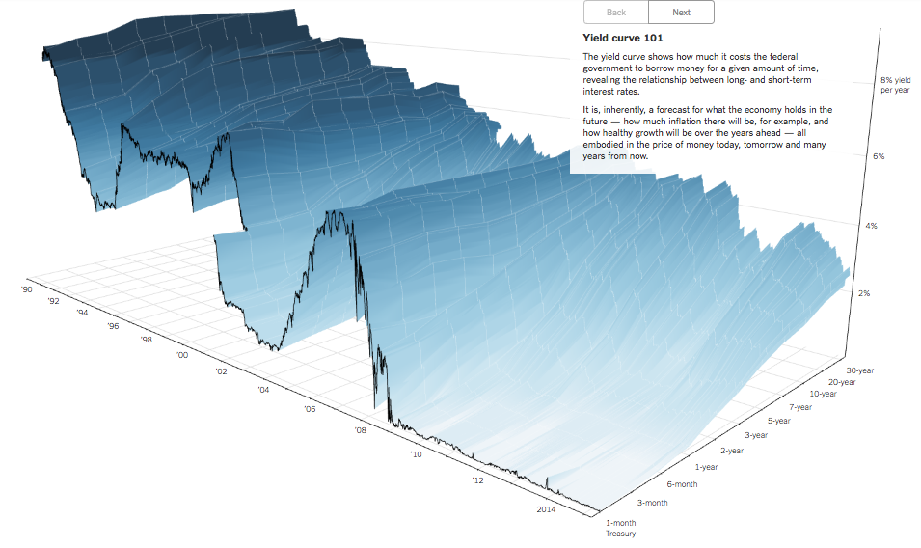
NYTimes 3D Economics View
http://www.nytimes.com/interactive/2015/03/19/upshot/3d-yield-curve-economic-growth.html
Notes:
http://www.nytimes.com/interactive/2015/03/19/upshot/3d-yield-curve-economic-growth.html

Slide 18
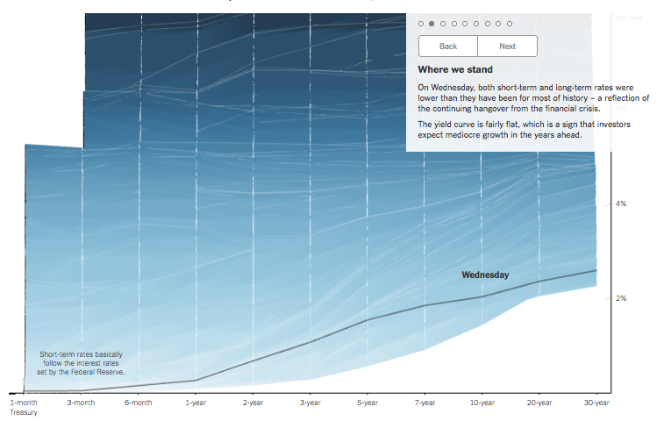

Slide 19
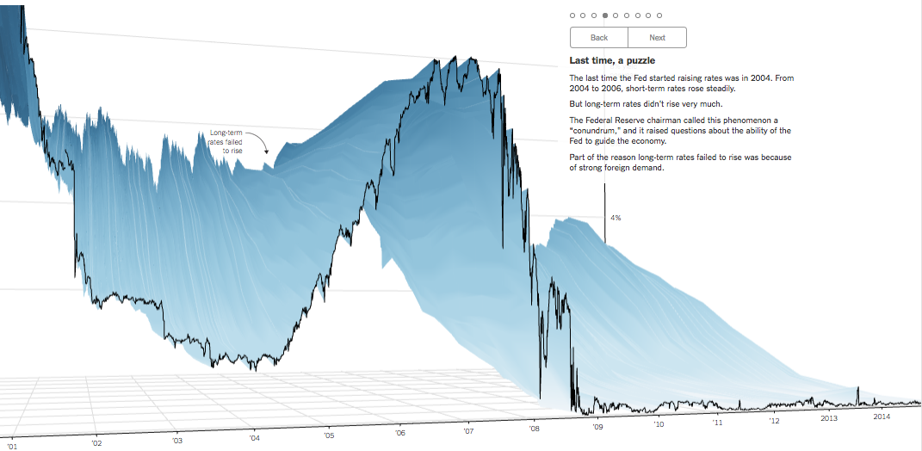

Slide 20


