Slide 1

Multiple Views

Slide 2
Why use 2+ distinct views?
Notes:
Two or more views to investigate data about the same conceptual entity.

Slide 3
Make comparisons to see new relationships
Improve user performance
Notes:
Multiple views, when used properly, have been shown to improve the users ability to make comparisons and also user performance without having to switch back and forth between views. But what types of data warrants a multiple view system? Baldonado et al. discuss some guidelines coming out of research at Xerox PARC and HP Labs.
https://www.researchgate.net/profile/Michelle_Baldonado/publication/2635114_Guidelines_for_Using_Multiple_Views_in_Information_Visualization/links/0912f512c4063132a1000000.pdf

Slide 4
Diverse Attributes
attributes (e.g. dates traveled, histogram of countries visited)
subsets or aggregate views shown simultaneously

Slide 5
Level of Abstraction
layers of detail (e.g., entire city vs. detail of streets)

Slide 6
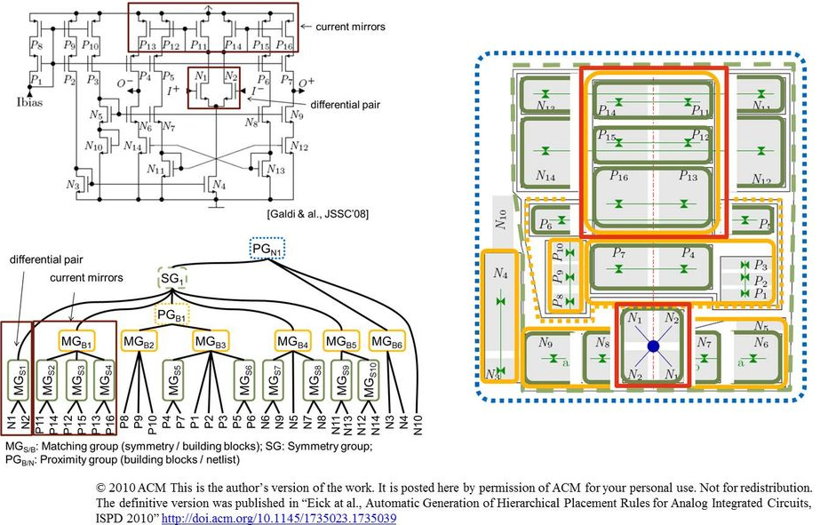
Multiple Data Models
Notes:
e.g., logical structure vs. a geometric layout of circuit. Or logical, physical, or conceptual data models of a business problem.
https://www.eda.ei.tum.de/fileadmin/_processed_/csm_AnLay.png_52a105866b.jpg

Slide 7
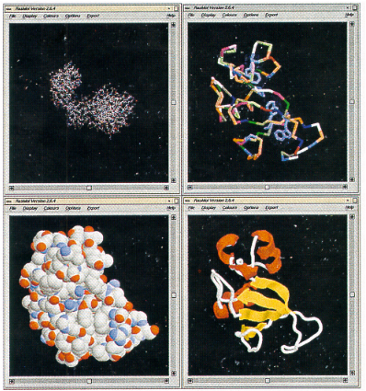
Correlations/ Disparities
[placeholder example image]
Notes:
Use multiple views to show correlations and disparities between data. Showing complementary views to correlate different aspects of the protein structure.

Slide 8
Design Considerations

Slide 9
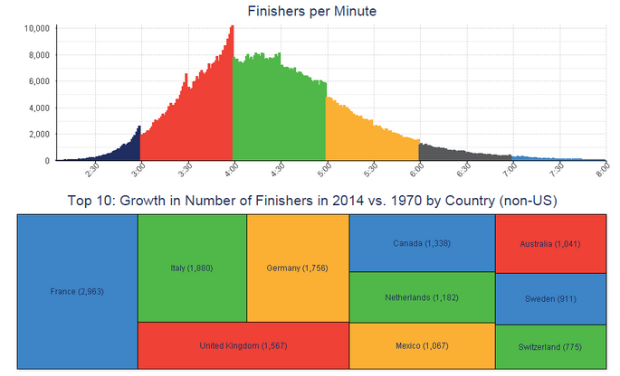
Consistent Encodings
Chart Source: http://dataremixed.com/2015/11/avoiding-data-pitfalls-part-3-confusing-colors/
Notes:
Don’t forget Gestalt principles that if you are showing the same data variables across multiple views use the same encodings and be careful of conflict. This chart showing NYC Marathoners uses the same color encoding for the different minutes and the country.

Slide 10
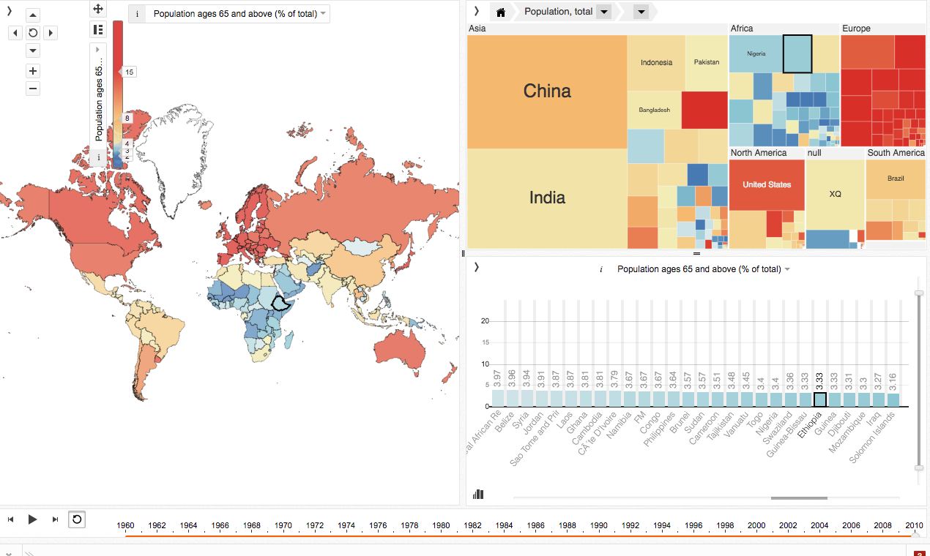
http://mitweb.itn.liu.se/GAV/dashboard/
Notes:
NEED BETTER IMAGE TO SHOW KEY?. Makes good use of a consistent color encoding across views. Also, if using different tools or libraries for the different views you’ll want to give them a cohesive look and feel.

Slide 11
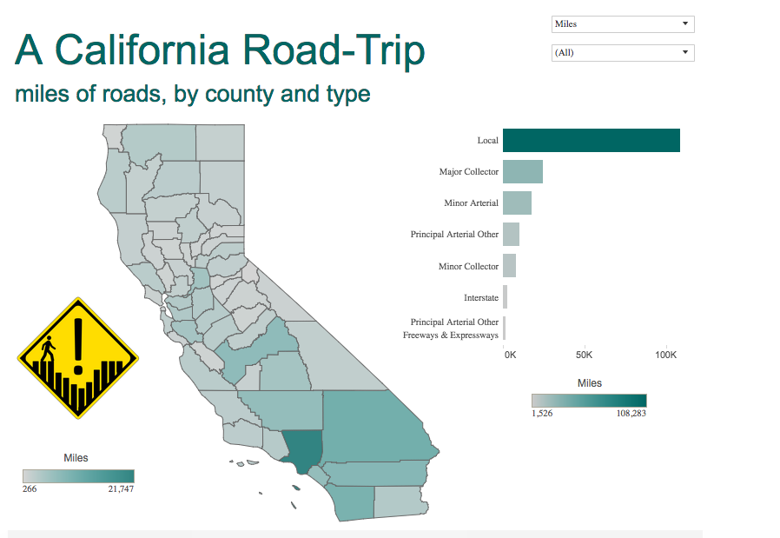
Chart Source: http://dataremixed.com/2015/11/avoiding-data-pitfalls-part-3-confusing-colors/

Slide 12
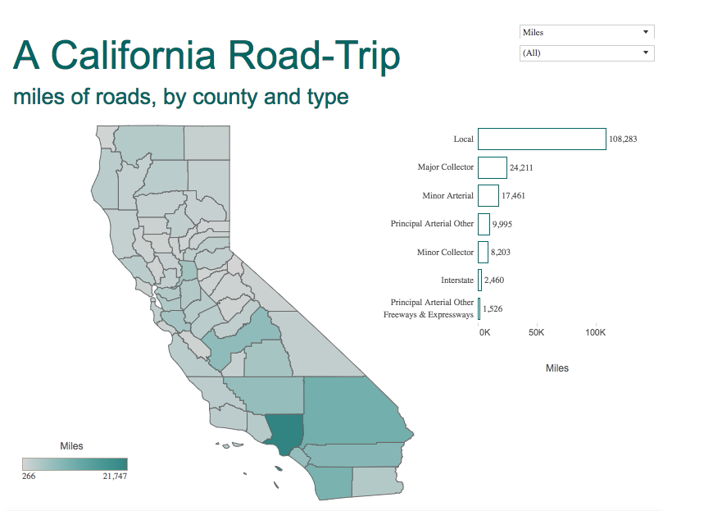
Chart Source: http://dataremixed.com/2015/11/avoiding-data-pitfalls-part-3-confusing-colors/

Slide 13
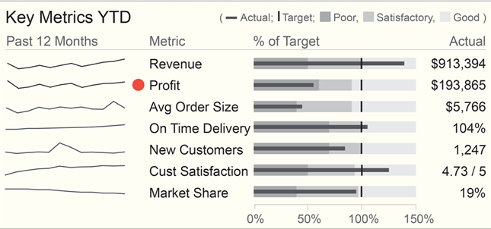
Perceptual Cues
Source: http://www.dashboardinsight.com/news/news-articles/interview-with-stephen-few-dashboard-design-challenges.aspx
Notes:
Remember that with more on the page, there’s more that needs to be attended to visually so help the use process what’s most important. Here actual profit is doing poorly and it’s been given greater visual salience with the addition of the red dot mark next to it.

Slide 14
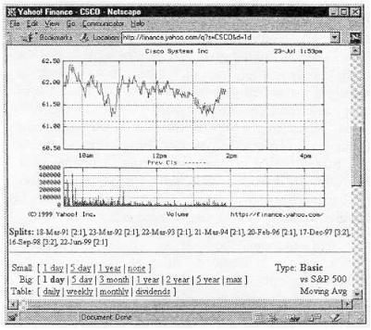
Space & Time Optimization
Notes:
Optimizing space and time for the user. Same axis maximizing space use. Therefore the views on top of each other makes sense. Be careful because this doesn’t always work, as with so many charts shown to the point where the x axis is no longer above the fold.

Slide 15
Development Considerations

Slide 16
Development Optimization
Making your code:
Reusable
Cleaner
Scalable
Modular
Notes:
Have discussed ways to optimize the users

Slide 17


