Slide 1

Perception of Color & Contrast
Notes:
How to use graphical elements to effectively label and draw the viewer’s

Slide 2
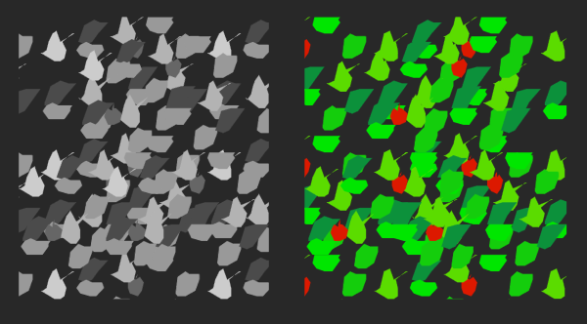
Image Source: Ware, C. (2012). Information visualization: perception for design. Elsevier.
Notes:
(Example opener – edit) Color vision isn’t critical to many day to day tasks as humans, in fat we can detect object shapes at the store, see movement of the bus coming, all without using color. But color perception does serve an evolutionary purpose such as quickly detecting which berries are might be poisonous, perhaps the red ones here, and it’s just this sort of capability that makes color detection quite useful for data vis.

Slide 3
Uses of color
Label
Measure
Represent / imitate reality
Enliven / decorate
[Tufte, 1990]
Notes:
Tufte offers 4 primary uses of color. To label (color as a noun), to measure (color as a quantity), to represent or imitate reality, and to enliven or decorate (color as beauty). We’ll be focused on first two for data vis encodings, but it’s good to keep in mind that representational and aesthetic properities do play a role in color interpretation.

Slide 4
Color Perception

Slide 5
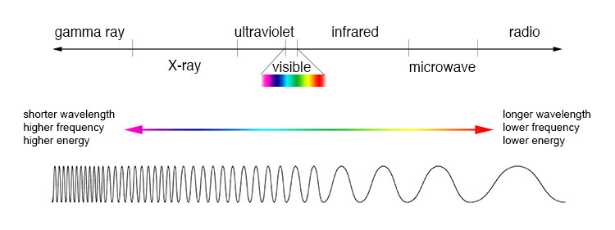
Electromagnetic Spectrum
Source: NASA
Notes:
EM spectrum light is just a small section
trichromatic theory make any color by combining 3

Slide 6
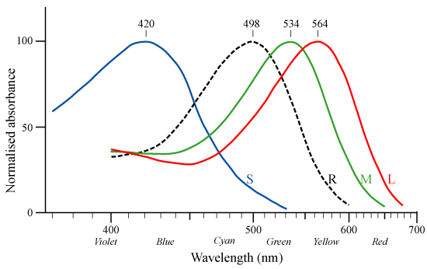
Rods and Cones
Source: Wikimedia Commons, after Bowmaker and Dartnall, 1980
Notes:
frequency response curves really short, medium, long wavelength normalized, usually more red and green than blue

Slide 7
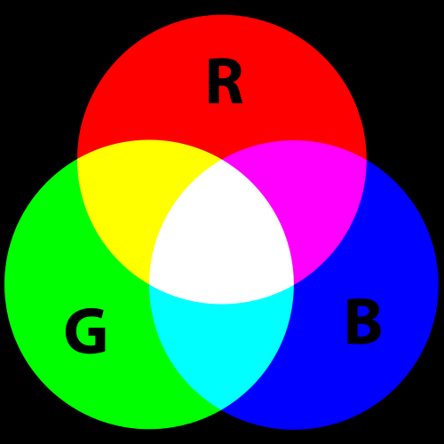
Additive Color
Source: Wikimedia Commons
Notes:
additive color – projector red + green = yellow
Addition of colors of light

Slide 8
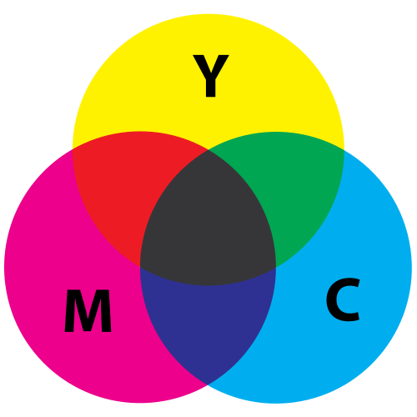
Subtractive Color
Source: Wikimedia Commons
Notes:
subtractive color – paint yellow + blue = green
Pigment absorbs wavelengths, subtracts them from what our eye receives.

Slide 9
Color Oppenency
Notes:
opponent colors hard to imagine a reddish green, bluish yellow specific neurons - ganglion cells R+ G- big response to red R- G+ big response to green also Yellow/Blue opponency
also Black/White opponency

Slide 10
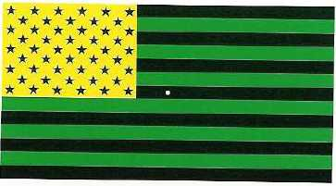
Color Oppenency
Notes:
American flag illusion stare for 30 sec

Slide 11
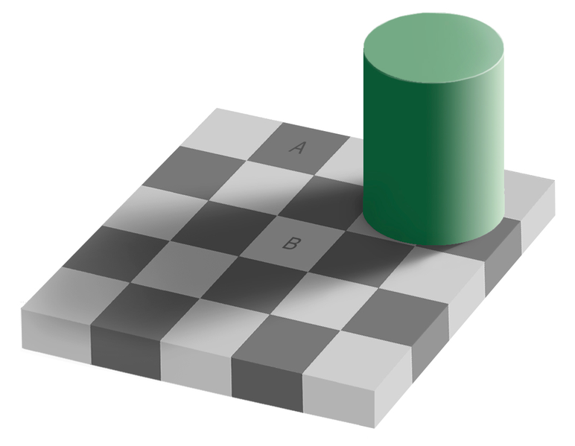
Color Constancy
Source: Wikimedia Commons
Notes:
color constancy checkerboard A and B squares same color we discount the illuminant

Slide 12
Color Models

Slide 13
Terminology
Hue Dominant wavelength, named color
Saturation Intensity or purity of color Distance from gray/white/black
Lightness Light to dark

Slide 14
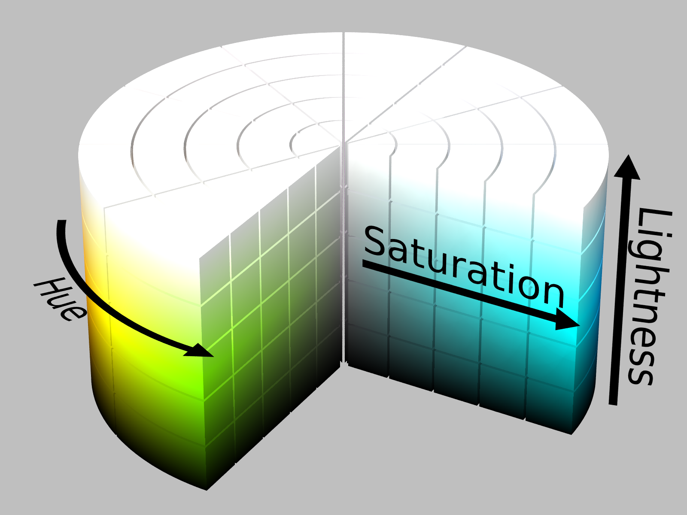
HSL Color Model
By SharkD, derivative work, CC BY-SA 3.0,
https://commons.wikimedia.org/w/index.php?curid=9801661
Notes:
There are many other color models, some turn lightness into brightness or turn hue into chroma.

Slide 15
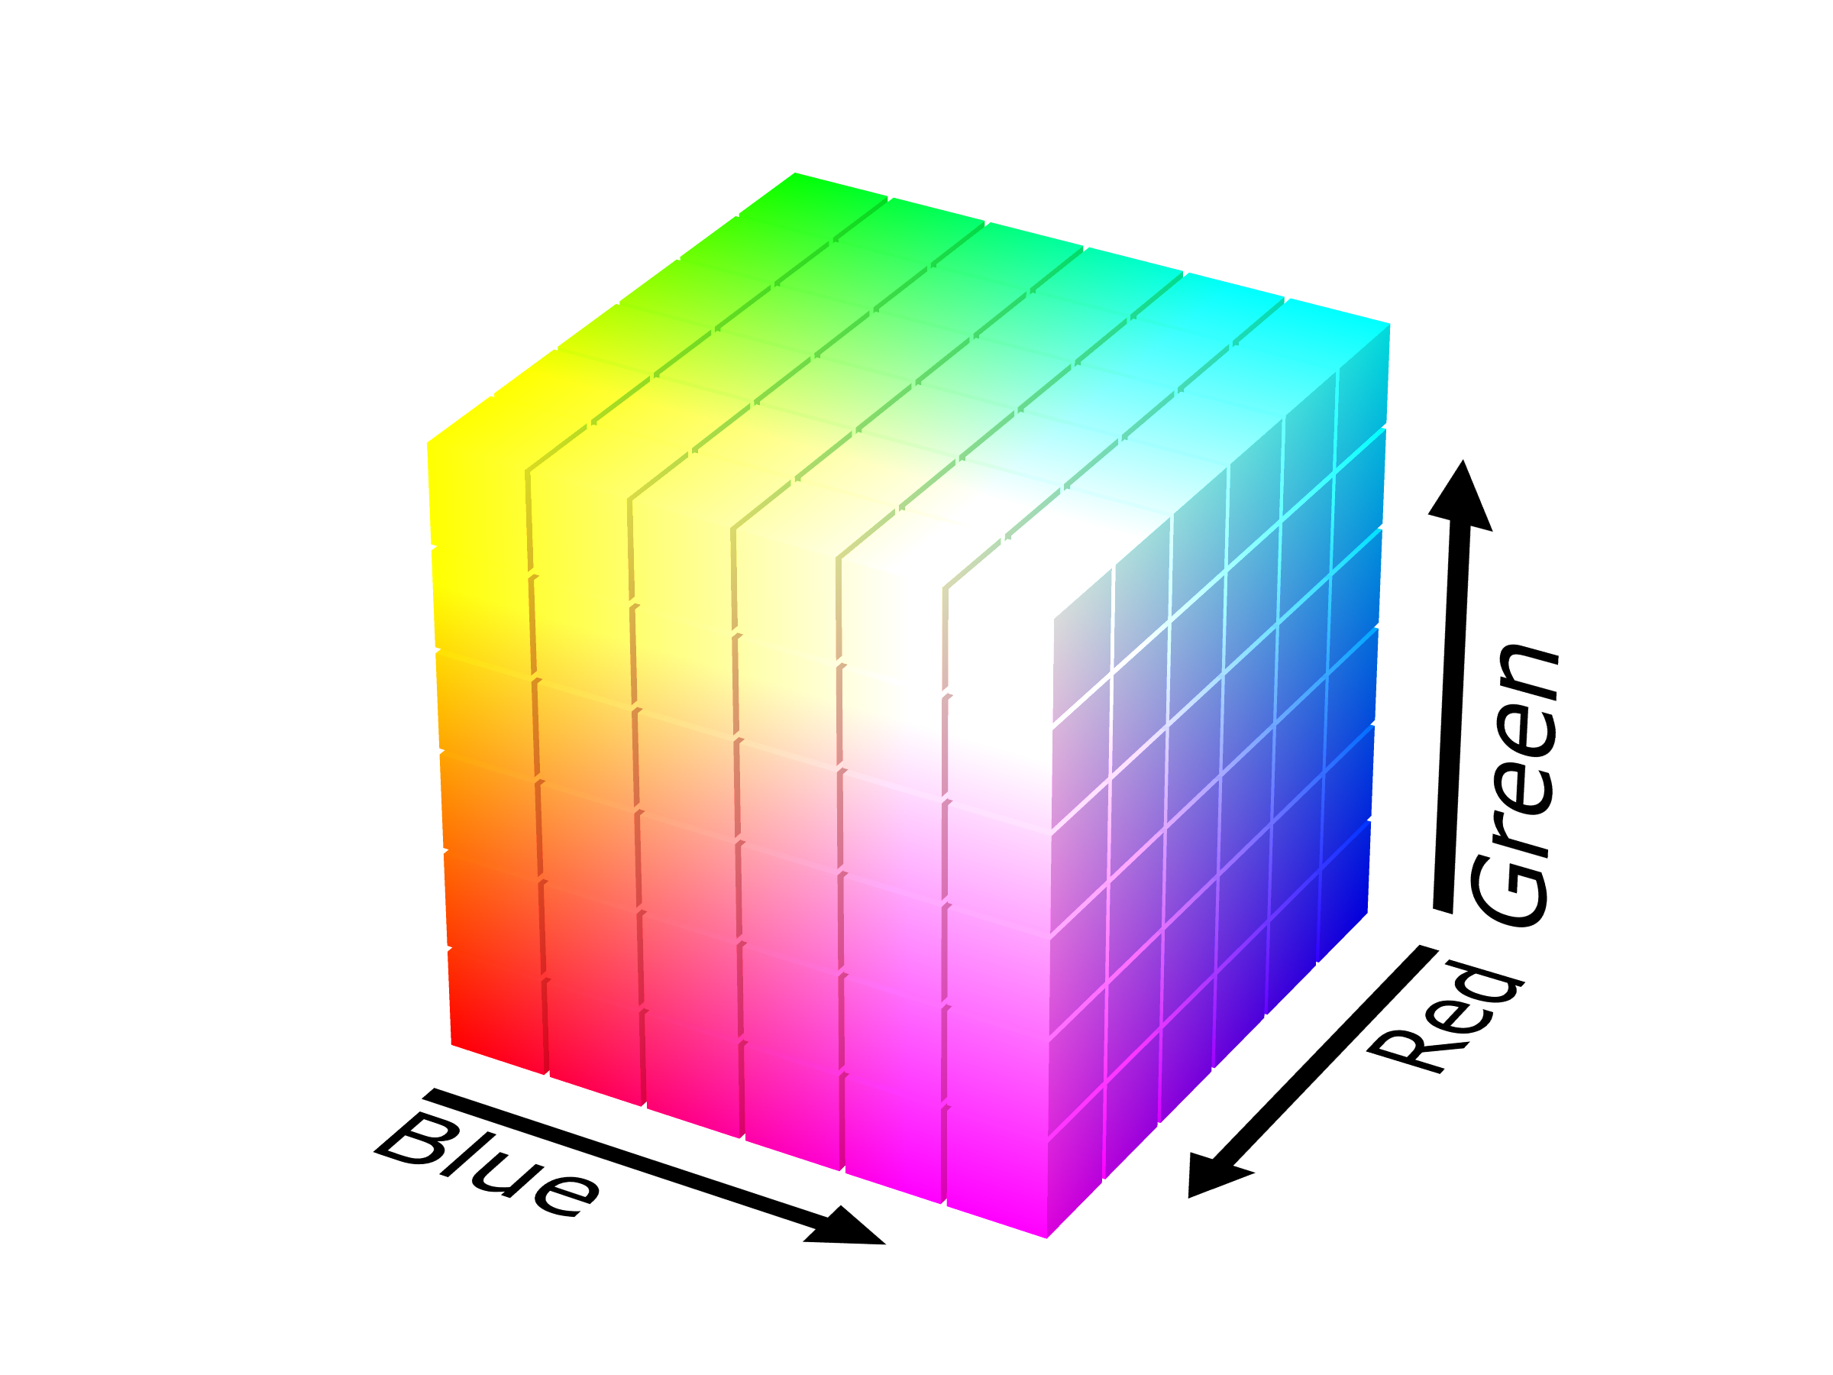
RGB Color Model
By SharkD - Own work, GFDL, https://commons.wikimedia.org/w/index.php?curid=3375025
Notes:
HSL is really the RGB color model, just made easier to work with
White = ffffff or 255, 255, 255
Black = 000000

Slide 16
Other Models
Designed for perceptual uniformity
HCL
CIE Lab
Munsel

Slide 17
Contrast

Slide 18
Brightness: the perceived amount of light results in a nonlinear function.

Slide 19
Just Noticeable Difference
144, 144, 144
132, 132, 132
12 units different
Notes:
just noticeable difference grey squares – which is darker? 12 RGB units different = same

Slide 20
Just Noticeable Difference
144, 144, 144
128, 128, 128
16 units different
Notes:
16 units different = different

Slide 21
Just Noticeable Difference
244, 244, 244
232, 232, 232
12 units different
Notes:
lighter squares (less stimulus) 12 units diff = diff

Slide 22
Just Noticeable Difference
244, 244, 244
236, 236, 236
8 units different
Notes:
even 8 units diff = diff

Slide 23
Weber’s Law
ΔS/S = k
Ratio of change in stimulus to magnitude of stimulus is roughly constant
Notes:
Weber’s law δελταS/S = k “stimulus” = darkness ratio of (change to make JND) to initial stimulus is ~constant ratios more important than magnitude

Slide 24
Just Noticeable Difference
244, 244, 244
236, 236, 236
8 units different
Notes:
what if we make background black? “stimulus” = lightness same light grey squares, hard to tell

Slide 25
Continuous Variation
Most continuous variations are perceived as discrete steps
Notes:
most continuous variation perceived as discrete steps

Slide 26
Color Contrast
After Josef Albers
Notes:
make 2 colors look like 1. Simultaneous contrast. Color is relative!

Slide 27
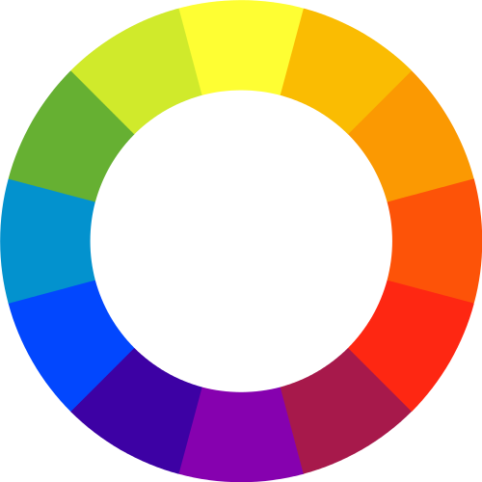
Complementary Colors
Notes:
complementary colors opposite on color wheel

Slide 28
Complements vibrate
Notes:
they vibrate!
Can be annoying, but can also be useful for getting attention (judiciously)

Slide 29
Color Differentiation
Rapidly identify data elements using color
Notes:
Color models are then sliced and diced for perceptual experiments to understand perceptual performance.
https://www.csc2.ncsu.edu/faculty/healey/PP/

Slide 30
Color Differentiation
Color distance: the Euclidian distance between colors in the model
Linear separation: ability to separate targets from non-targets when one can or cannot draw a straight line between the target and nontargets
Color Category: named color regions occupied by both target and non-target elements
Notes:
Healey identified and tested several effects to determine good color differentiation. Color distance, linear separation, and categories.
Healey, C. G. (1996, October). Choosing effective colours for data visualization. In Visualization'96. Proceedings. (pp. 263-270). IEEE.
https://pdfs.semanticscholar.org/1a61/cb125aed47bcbe4c2d95d107a2be750a631c.pdf

Slide 31
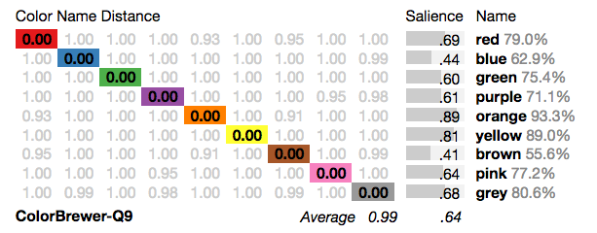
Distinct Nameable Colors
Source: http://vis.stanford.edu/color-names/analyzer/
Notes:
Takeaway distinct nameable colors are best, and are effective for nominal data as well. Here used the Color Pallette Analyzer to look at

Slide 32
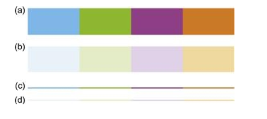
Saturation & Size
Source: Ware, C. Information Visualization, Perception for Design, 2013

Slide 33
Color Blindness - Cones
Notes:
missing usually high or medium frequency receptors “red-green” color blindness ~8% of men, ~0.5% of women
good to avoid dependence on color, esp. red vs. green

Slide 34
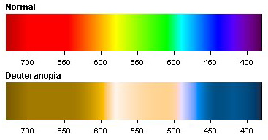
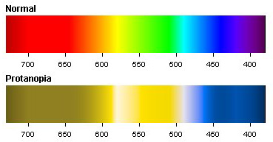
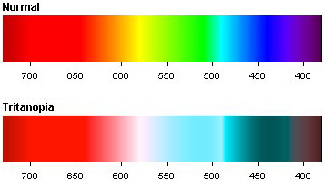
Color Blindness - Types
Notes:
deuteranopia most common missing “green” cones
protanopia missing “red” cones
tritanopia missing “blue” cones

Slide 35
"Traffic Light" Indicators
Notes:
“traffic light” indicators
avoid using hue alone for labeling
http://www.vischeck.com/examples/

Slide 36
Color Scales

Slide 37
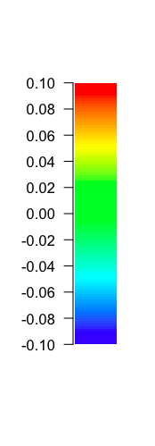
Typical Rainbow Color Scale
Notes:
rainbow scales are common bad: hard to distinguish fine detail not ordered by luminance bad: no inherent ordering in hue good: easy to read value from scale

Slide 38

Contrast Sensitivity Function
Decreasing Contrast
Increasing Spatial Frequency
Notes:
We're more sensitive to contrast in greyscale
But gray scales can be trouble too luminance values near each other interfere

Slide 39
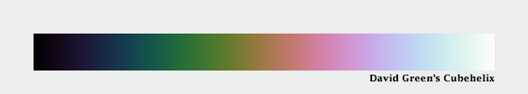
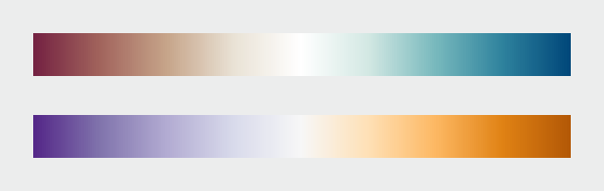
Alternatives
d3.cubehelix()
divergent scales
Notes:
alternatives spiral scales luminance varies evenly Cubehelix
diverging good for ratio data, with zero +/- (sea levels)

Slide 40
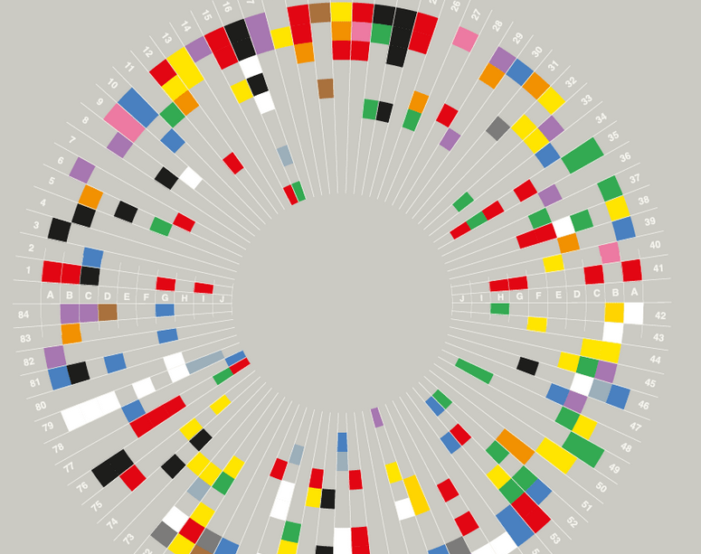
Culture & Emotion
Notes:
Discuss similarities: research suggests there is some universality in identifying 11 basic color terms/ categories e.g., Kay, Berlin, Merrifield 1991. However, there can be highly different cultural associations with those same terms. Research (E.g., Courtney, 1986) found that while American study participants associate red with stop and green with go, study participants from the Yunnan Provience in China did not.

Slide 41
Color Harmony
Difficult to study
Conflicting results
Confounding of preference and harmony
Notes:
Research on color harmony
Difficult – lots of questionable theories
Conflicting results
people prefer contrast
people prefer analogous colors
Confounding preference and harmony
sometimes people like unharmonious pairings

Slide 42
Individual Colors
Yellow < orange < purple < green < red < blue (Eysenck, 1941)
Color preference based on affective response to objects of that color (Palmer and Schloss, 2010)
Pairing of colors to emotions is consistent.
Hue is not the main influence on emotion;
saturation is (D'Andrade and Egan, 1974; Kieffer, 1974; Johnson, Johnson, and Baksh, 1986)
Notes:
What about individual colors?
Eysenck – found some regularities
General order of preference:
yellow, orange, purple, green, red, blue
High agreement between genders (except women preferred yellow to orange)
High agreement across races
Similar emotions linked with similar colors
Not hue as much as saturation and lightness
very bright, saturated = good, happy
pale = weak, frightened

Slide 43
Emotional Responses
Blue, Green, White: peaceful, gentle, calming (beautiful, pleasant in some countries)
Black, Brown: sad, stale (formal, masculine in some countries)
Gold, Orange, Yellow: no strong associations
Purple: similar to brown for Asian countries
Red: active, hot, vibrant, emotional, sharp (Pleasant in PRC and Taiwan) (Madden, Hewett, and Roth, 2000)
Notes:
Madden, Hewett, and Roth, 2000
Associations across 8 countries
Not all consistent, but pretty close!

Slide 44
Design Tips
First ask: is color necessary?
Use colors that are separable and nameable when possible
Scale appropriately
Beware of poor contrast effects
Design for color blindness
Account for cultural associations

Slide 45


