Slide 1

Challenges & Applications
Notes:
Application of color is not always a straight forward task. I’ll talk about a few applied considerations. Do a redesign for this!

Slide 2
“Color used well can enhance and clarify a presentation. Color used poorly will obscure, muddle and confuse.”
- Maureen Stone
Notes:
But how to know which is which sometimes the line is not clear, and depends on your data.

Slide 3
Many Categorical Variables

Slide 6
Multivariate Layering
Notes:
Thus far worked with univariate

Slide 7
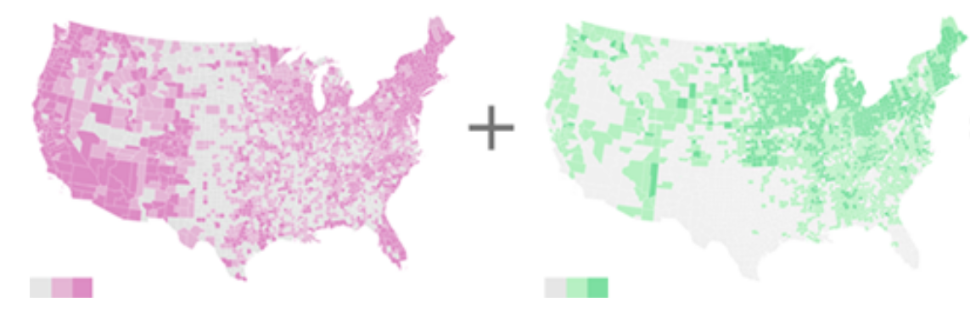
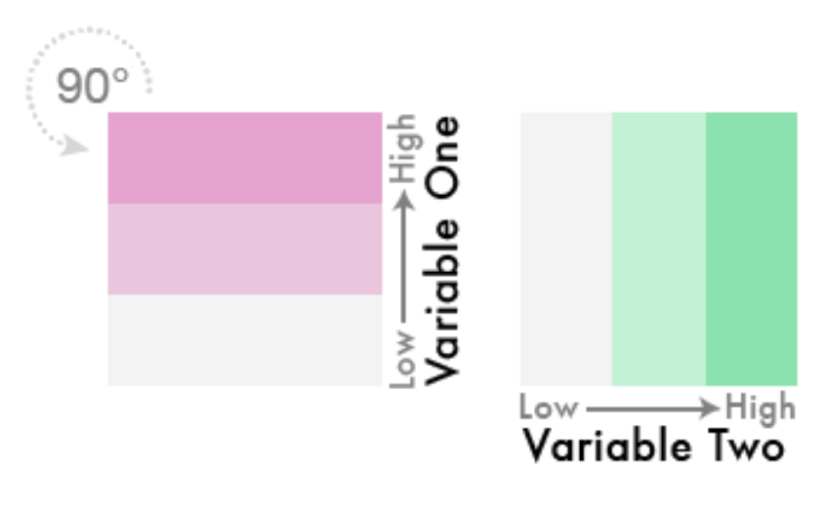
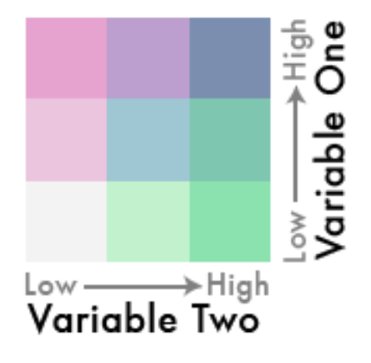
Diverging Bivariate
Source: http://www.joshuastevens.net/cartography/make-a-bivariate-choropleth-map/

Slide 8
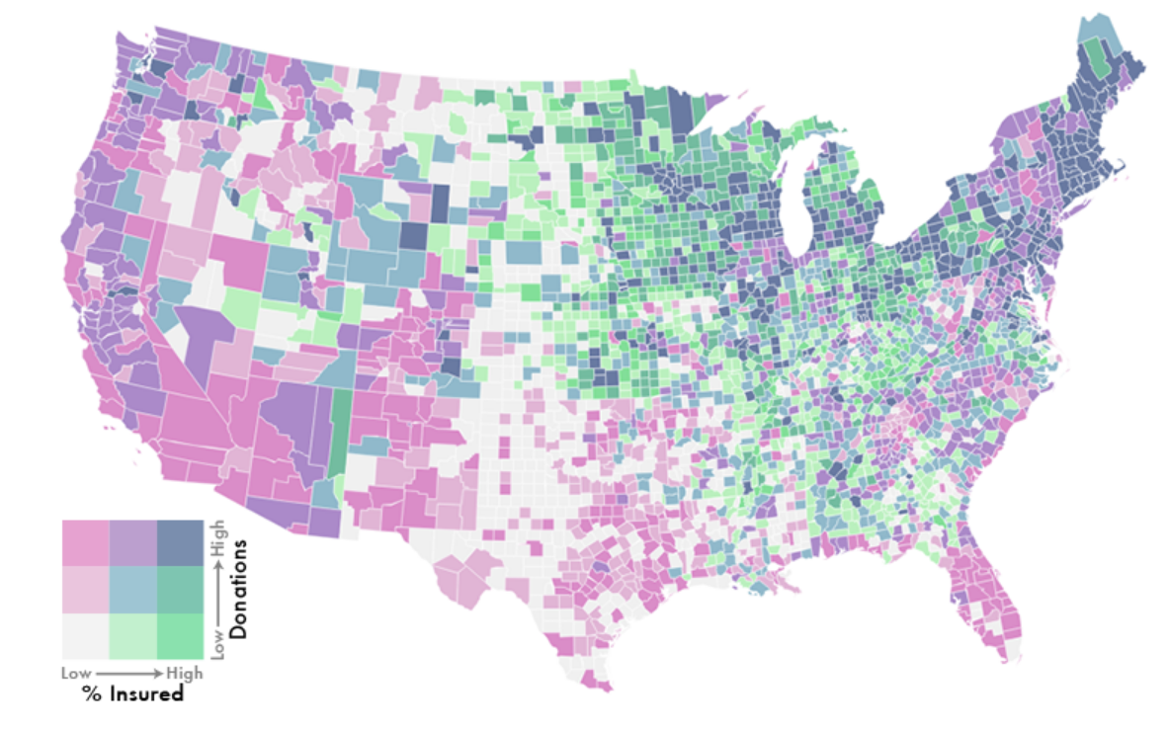
Diverging Bivariate
Source: http://www.joshuastevens.net/cartography/make-a-bivariate-choropleth-map/
Notes:
What happens when take off glasses and attentive?
http://www.joshuastevens.net/cartography/make-a-bivariate-choropleth-map/

Slide 9
Making the data resonate
Notes:
Thus far worked with univariate

Slide 10
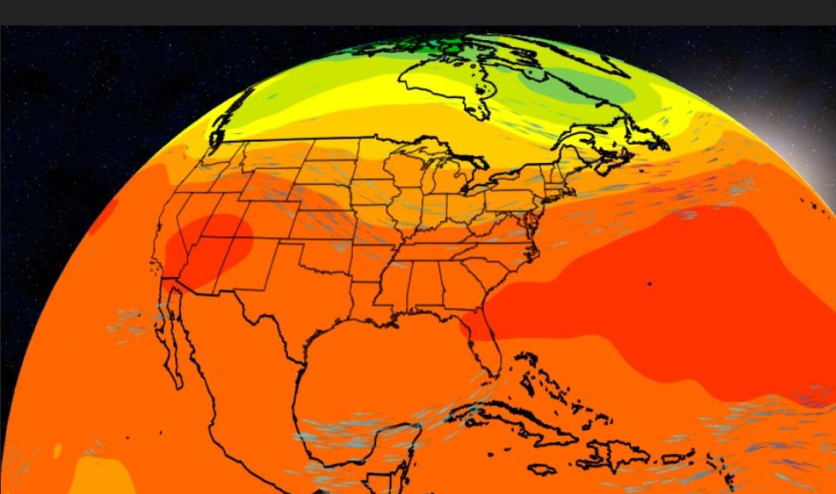

Slide 11
Notes:
Thus far worked with univariate

Slide 12


