Slide 1

Highlighting
Notes:
How to use graphical elements to effectively label and draw the viewer’s

Slide 2
What is highlighting?
brushing special color
[Becker & Cleveland, 1987]
a visual link across multiple views
[Seo & Shneiderman, 2004]
used in dynamic motion / interactive vis
[Ware & Borrow, 2004]
Notes:
Becker and Cleveland describe it as brushing special color to paint the object;

Slide 3
What is highlighting?
attract viewer’s attention within a view
for interactive vis, navigation control to reach a target
for visual analytics, part of an AI process making graphical recommendations for decision making
[Liang & Huang, 2010]
Notes:
Perhaps the most robust definition comes from Color and contrast provides one of the best effective means to highlight data.
Possibly assign: https://opus.lib.uts.edu.au/bitstream/10453/16114/1/2010001402.pdf

Slide 4
What is highlighting?
attract viewer’s attention within a view
for interactive vis, navigation control to reach a target
for visual analytics, part of an AI process making graphical recommendations for decision making
[Liang & Huang, 2010]
Notes:
Primarily be using the term to discuss this first concept, but helpful to be aware of the other term’s as way of thinking about highlighting as a tool not just to attract attention but in a broader sense as a way to help the analyst accomplish a task or make a decision.

Slide 5
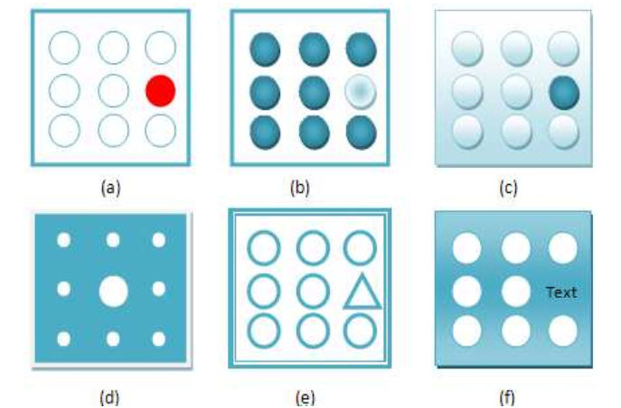
Liang, J., & Huang, M. L. (2010, July). Highlighting in information visualization: A survey. In Information Visualisation (IV), 2010 14th International Conference (pp. 79-85). IEEE.
Notes:
So how does one do it effectively? Color, light, size, shape, motion, and presentation.

Slide 6
Use a graphical dimension not used elsewhere in the design
[Ware, 2013]
Notes:
Making certain data stand out from the rest.

Slide 7
Behold, the power of gray.
Notes:
Data visualization Data Visualisation: a Handbook for Data Driven Design talks about ‘make gray your best friend’. I know many designers love using gray to soften the look and feel – but in this case, when it comes to highlighting it’s actually quite effective. Here we can see the shape pop out.

Slide 8
Behold, the power of gray.
Notes:
Data visualization Data Visualisation: a Handbook for Data Driven Design talks about ‘make gray your best friend’. I know many designers love using gray to soften the look and feel – but in this case, when it comes to highlighting it’s actually quite effective. Here we can see the shape pop out.
http://www.visualisingdata.com/2015/01/make-grey-best-friend/

Slide 9
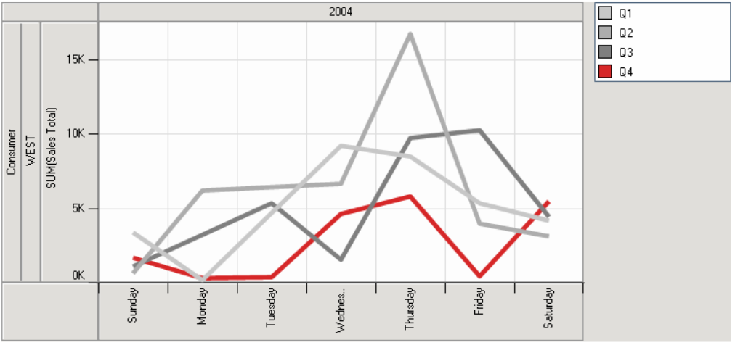
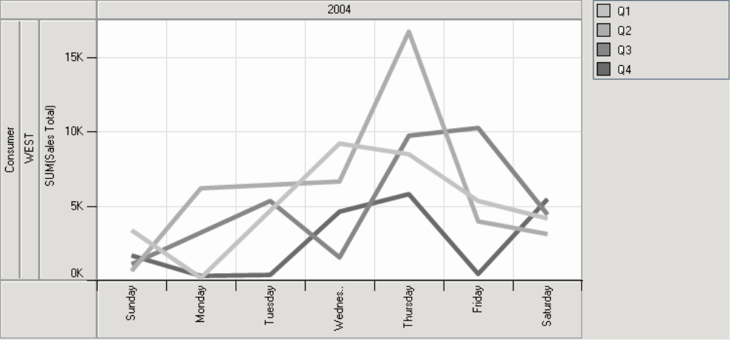
Source: Stone, M. (2006). Choosing colors for data visualization. Business Intelligence Network, 2.

Slide 10
Source: Stone, M. (2006). Choosing colors for data visualization. Business Intelligence Network, 2.

Slide 11
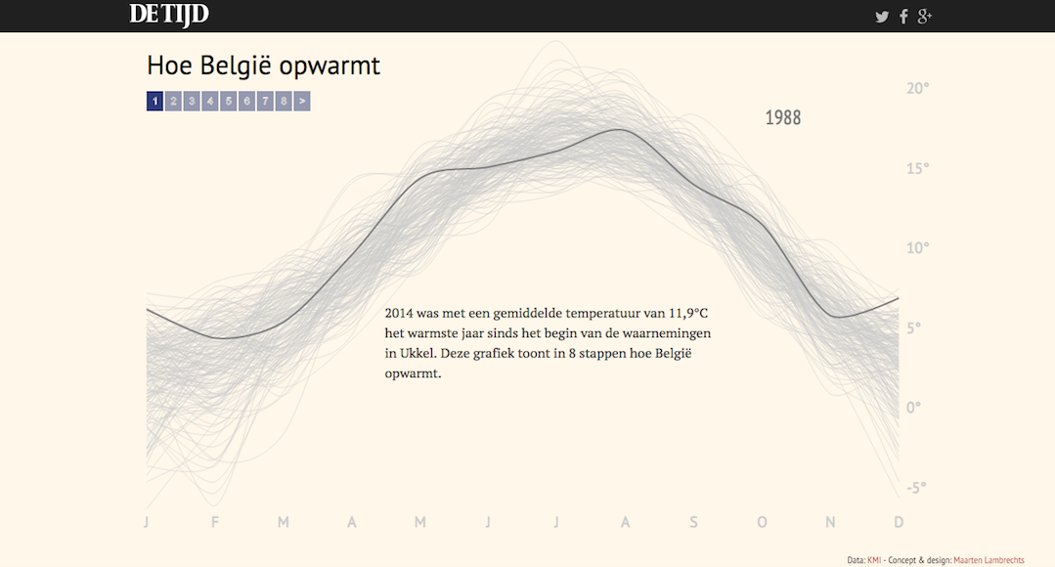
http://multimedia.tijd.be/warm/
Notes:
2014 was an average temperature of 11.9 ° C, the warmest year since the beginning of the observations in Uccle. This graph shows, in 8 steps how warming Belgium. Brush over year

Slide 12
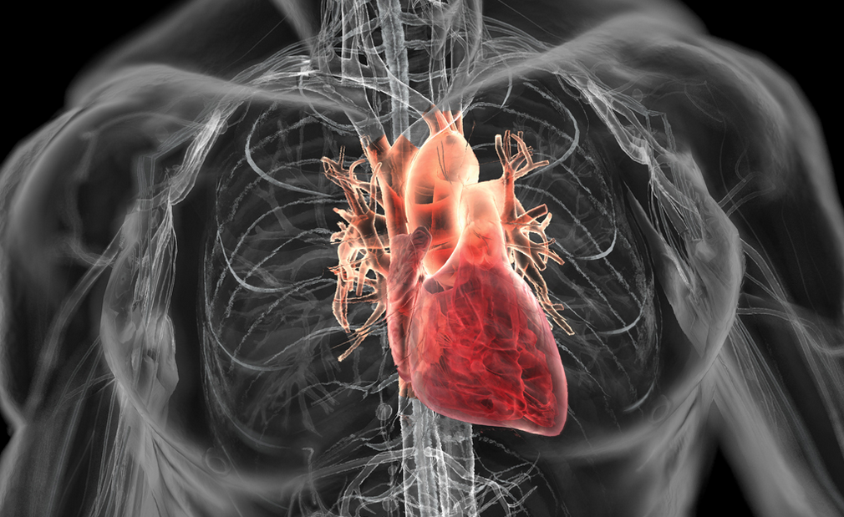
Source: http://bryanchristiedesign.com/heart-in-figure

Slide 13
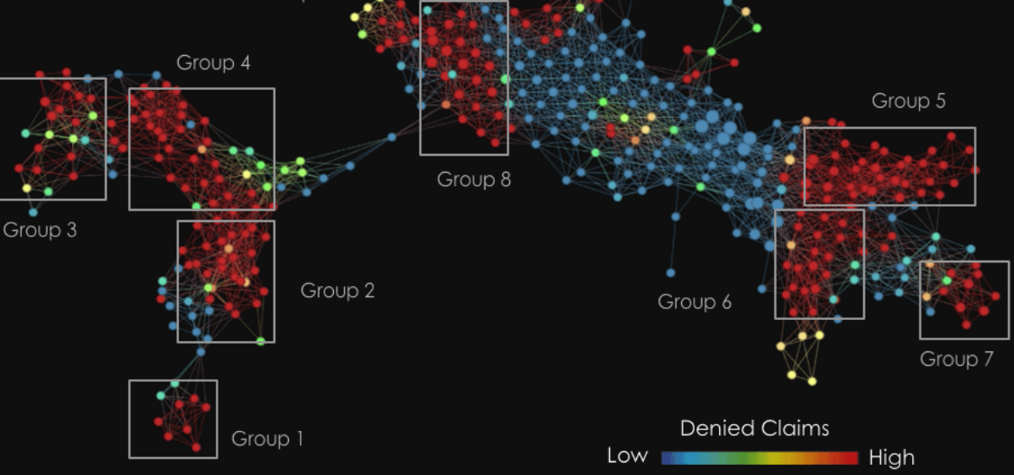
https://www.ayasdi.com/platform/
Notes:
https://www.ayasdi.com/platform/
Company using automated methods of detecting patterns – can see here that color, brightness and shape are used. Now it is using the rainbow color scheme here!?

Slide 14
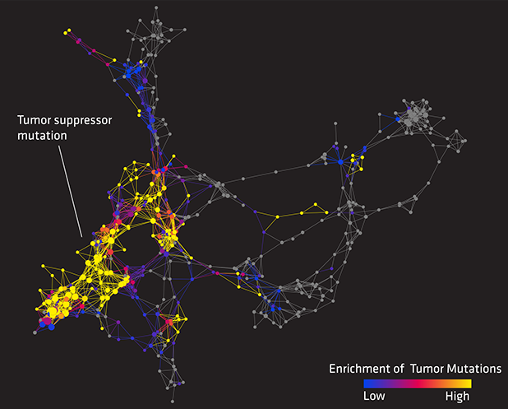
Image Source: https://gigaom.com/2013/05/13/visualization-is-the-future-6-startups-re-imagining-how-we-consume-data/
Notes:
Refined color scheme with brightness. Discuss yellow as a special case highlighter ….

Slide 15
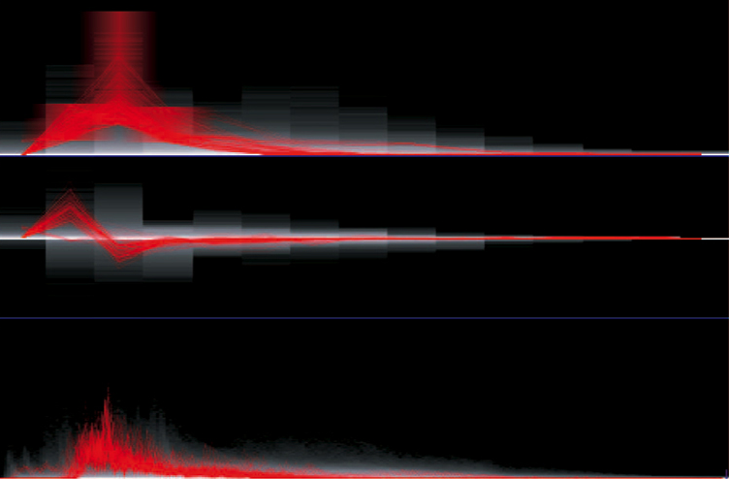
Woodring, J., & Shen, H. W. (2009). Multiscale time activity data exploration via temporal clustering visualization spreadsheet. IEEE Transactions on Visualization and Computer Graphics, 15(1), 123-137.
Notes:
Brushing and linking
Selected time histograms from a 227 time-step earthquake data
set, featuring brushing and linking. In (a), the time histogram, which is
15.13 time-step low coefficient trends, the user has brushed a trend of
interest, and the time curves that pass through the brushed area are
highlighted. The same time curves or data points are linked in the other
time histograms. (b) The same data at the same frequency band but is
showing high wavelet coefficients. (c) The original data time histogram.
The user is able to brush and alter the selection in all of the linked time
histogram cells.
http://citeseerx.ist.psu.edu/viewdoc/download?doi=10.1.1.162.2257&rep=rep1&type=pdf

Slide 16
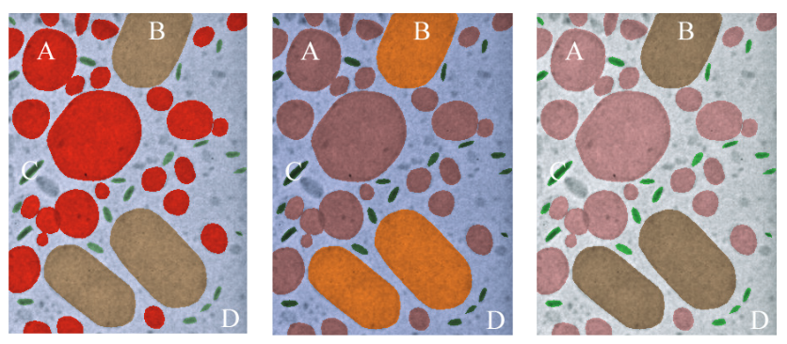
Hue & Vividness
Wang, L., Giesen, J., McDonnell, K. T., Zolliker, P., & Mueller, K. (2008). Color design for illustrative visualization. IEEE Transactions on Visualization and Computer Graphics, 14(6), 1739-1754.
Notes:
Colorizations of Transmission Electron Microscopy (TEM)
data.
http://citeseerx.ist.psu.edu/viewdoc/download?doi=10.1.1.295.6550&rep=rep1&type=pdf

Slide 17
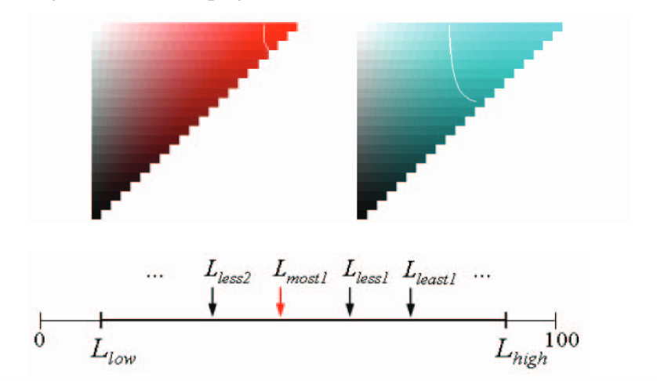
Hue & Vividness
Wang, L., Giesen, J., McDonnell, K. T., Zolliker, P., & Mueller, K. (2008). Color design for illustrative visualization. IEEE Transactions on Visualization and Computer Graphics, 14(6), 1739-1754.
Notes:
What color to use?
Colorizations of Transmission Electron Microscopy (TEM)
data.
http://citeseerx.ist.psu.edu/viewdoc/download?doi=10.1.1.295.6550&rep=rep1&type=pdf

Slide 18
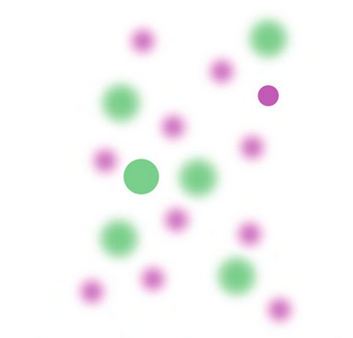
Blur
Source: Ware, C. Information Visualization, Perception for Design, 2013
Notes:
Kodara et al. 2002 called semantic depth of field (See this reference) offers a visual technique similar to a photograph.

Slide 19
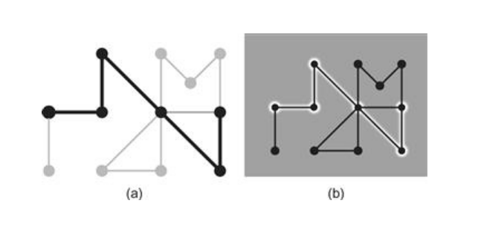
‘Haloing’
Source: Ware, C. Information Visualization, Perception for Design, 2013
Notes:
Enhancement of edges, here against a darker background

Slide 20
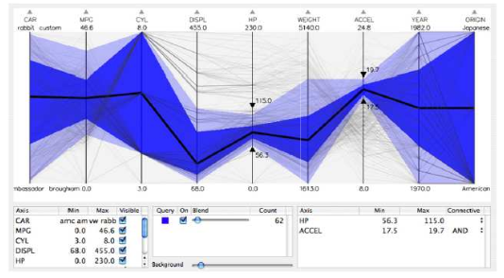
Don’t forget contrast effects
Source: Siirtola, H. & KJ, R. 2006, 'Interacting with parallel coordinates', interacting with Computers, vol. 18, no. 6,
pp. 1278-1309.

Slide 21
Information Search Highlighting

Slide 22
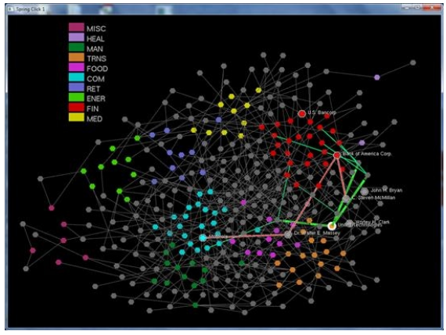
Degree of Relevance Highlighting
Source: Ware, C. Information Visualization, Perception for Design, 2013

Slide 23
Degree of Relevance Highlighting
Visual query
Select a symbol / data attribute
Algorithm highlights all similar symbols / attributes with high relevance
analyst queries all highlighted (information scent)
If relevance found – drill down
Repeat as needed
[Ware, 2013]
Notes:
In degree-of-relevance highlighting , we are interested in displaying all of the information on the screen at once, but because of its density it cannot all be made legible. A simple interaction solves the problem; touching an object causes both it and other task-relevant data objects to be highlighted, and the highlighted objects may also reveal additional detail. Degree of relevance is calculated using a computer algorithm designed to rate the task relevance of other entities in the database based on interaction history. The simplest version of this involves only the most recent selection.
Construct a visual query to find a symbol that may lead to useful information (information scent). 2. Execute an epistemic action by selecting a symbol. 3. Computer highlights all symbols with a high degree of relevance to selected symbol. 4. Execute a visual pattern query among highlighted symbols for additional information scent. 5. If a very high relevance symbol is found, execute an epistemic action to drill down for additional information. Usually this will be presented in a different display window. 6. Repeat from 1 as needed, cognitively marking visited symbols.
MEgraph used Fortune 500 companies as a test example, illustrated in Figure 11.20 . This graph is actually a kind of social network, showing links between companies (colored dots) via members of the boards of directors (gray dots) for those companies. When board members are on the boards of more than one company, they form a high-level social link between the companies. In MEgraph, touching a node causes motion highlighting of the social links between nodes and the labels of the companies to appear.

Slide 24
Design Guidelines
Use hue / luminance, size, shape, presentation, motion …
Remember contrast effects
Use to connect across views
Support tasks & analysis
(e.g., automated additional views)
Notes:
First two, then make highlighting part of a larger process that supports the analyst exploration and decision making process.

Slide 25


