Slide 1
Navigation
Notes:
Providing the user with context is important in any interactions, yet in several techniques the context in visually maintained.
Brushing and linking
great combo for maintaining context across views
extra great for dashboards

Slide 2
Navigate
Manipulate the viewport
onto the data space
Notes:
Fundamental problem: show detail but also show everything

Slide 3
Three Techniques
Zooming and panning
Overview plus detail
Focus plus context

Slide 4
Zooming and Panning

Slide 5
Types of Zooming
Standard (geometric) – see more detail
Semantic – see different representations
Intelligent, Fisheye – focus plus context
Notes:
Standard – like Google Earth– changes size and details visible
Semantic – different representation at different zoom resolution (good maps do this)
Intelligent = Fisheye = focus plus context, zoom within fixed overview, distort edges of zoomed area, like hypertree

Slide 6
Standard vs. Semantic Zooming
Standard
View depends on physical properties of object
Zoom out: see smaller version
Zoom in: see larger version
Semantic
View depends on semantic meaning of object at that scale
Zoom out or in: see different representation
Notes:
Standard vs. semantic zooming
Standard – fixed representation based on physics
zooming makes things bigger/smaller
Semantic – representation is allowed to vary
zooming changes view of things substantially
Powers of Ten movie outbound is standard, inbound is semantic

Slide 7
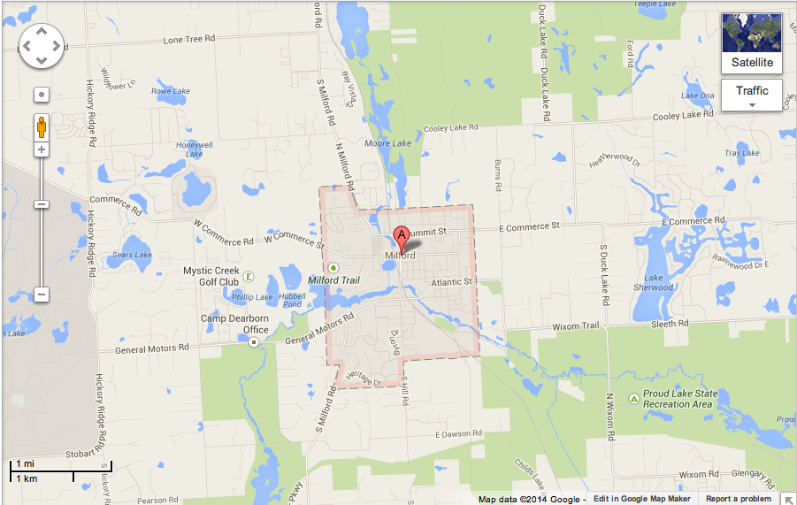
Semantic Zooming in Maps
Notes:
My home town
Notice A marker
Almost nothing there, just a couple street labels

Slide 8
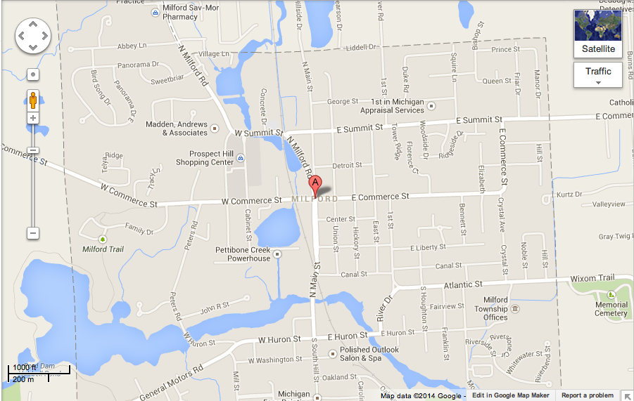
Semantic Zooming in Maps
Notes:
Lots of new detail that wasn't there before

Slide 9
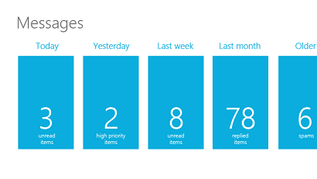
Semantic Zoom in Windows
Zoomed out view
Notes:
Message UI for Windows 8
Zoomed out, see a summary of messages for each day

Slide 10
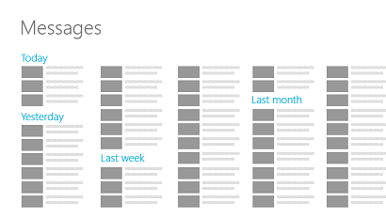
Semantic Zoom in Windows
Zoomed in view
Notes:
Zoomed in, you get details for each day

Slide 11
Zooming and Panning Together
Zooming is logarithmic
Panning is linear
If calculated separately, panning can't keep up with zooming
Notes:
If you calculate them separately from each other, pan target runs away
Panning can't keep up with zooming

Slide 12
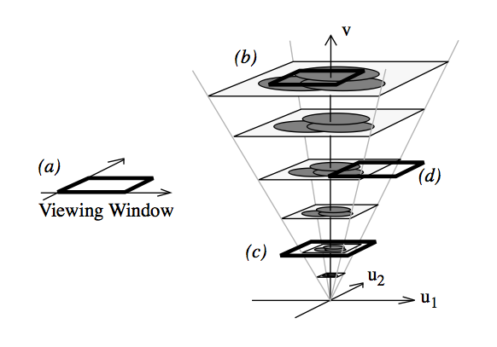
Space-Scale Diagrams
Furnas and Bederson, 1995
Notes:
Furnas and Bederson – space scale diagrams
one way to think about zooming and panning
up along v = zoom in
down along v = zoom out
moving in u = panning
(a) = user's viewport
(b) = zoomed in view
(c) = zoomed out view
(d) = panned view

Slide 13
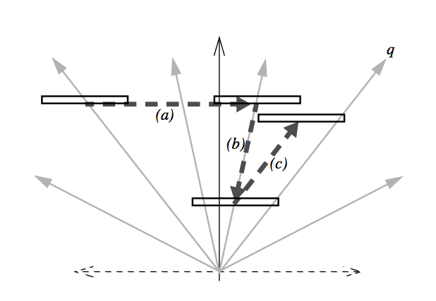
Space-Scale Diagrams
Furnas and Bederson, 1995
Notes:
Sideways view
= panning
= zooming out
= zooming in and panning a little

Slide 14
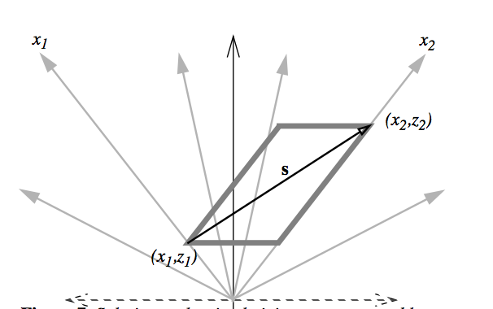
Space-Scale Diagrams
Notes:
Nice zooming keeps pan target in view
Stay within parallelogram

Slide 15
Zooming and Panning Together
What if you pan from one zoomed in spot to another near the same zoom?
How do you keep it smooth and efficient?
Notes:
What if the start and finish are near the same zoom factor but far apart by panning?
Can't just interpolate
Too much optic flow

Slide 16
One Possibility
Pan waaaaaaay over
Start
Finish
Really Big Map
Notes:
Move dominated by pan, can seem to take forever

Slide 17
Another Possibility
Zoom out, pan, then zoom back in
Start
Really Big Map
Finish
Notes:
Zoom out, pan a little, zoom back in is better

Slide 18
Better Possibility
Zoom out, pan, then zoom back in smoothly
Start
Really Big Map
Finish
Notes:
But we want a smooth experience
How do you figure out the best trajectory?

Slide 19
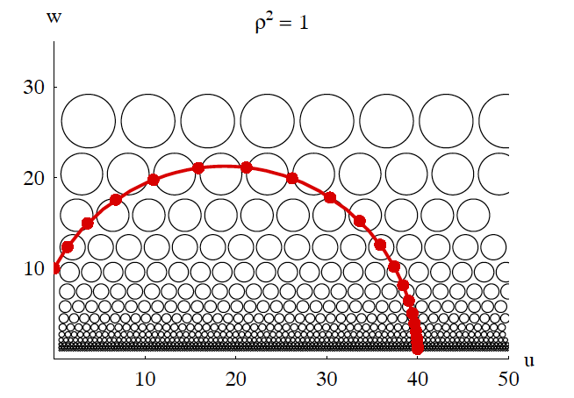
van Wijk and Nuij, 2003
Notes:
Van Wijk and Nuij studied what users prefer
u, w space
U is panning, w is zooming
Red dots represent viewing position: Think of camera above map
white bubbles indicate perceived optic flow, we want to minimize that
Curved space

Slide 20
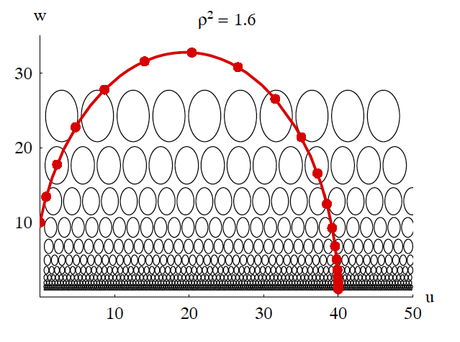
ρ Metric
Start
Finish
Notes:
Change in rho
Trade-off between zooming and panning
Corrects for perception
Here, the impact of panning (horizontal) is greater than the impact of zooming (vertical)
You pass through more bubbles horizontally, more optic flow
Average preferred value for rho squared ~2.0, analogous to even taller ellipses (but not precise!)

Slide 21
Zoom in D3
automatic transitions for zoom behavior
transition.call
Notes:
D3 3.3 has automatic transitions for zoom behavior using transition.call applies Wijk and Nuij’s zooming
https://bl.ocks.org/mbostock/6238040

Slide 22
Pan/Zoom vs. Overview/Detail
Why not do both?
Pietriga et al. (2007)
Notes:
Research suggests adding overview + detail to pan and zoom is best.
Pietriga et al. 2007 compared
zoom + pan,
fisheye distortion lens
overview + detail lens – "dragmag" (second best)
overview + detail with zoom + pan (best)

Slide 23
Overview Plus Detail

Slide 24
Overview Plus Detail
Overview and detail shown simultaneously
Two separate views
No distortion
Notes:
One solution to the problem
Overview plus detail =
overview and detail both shown at once
separate views, no distortion

Slide 25
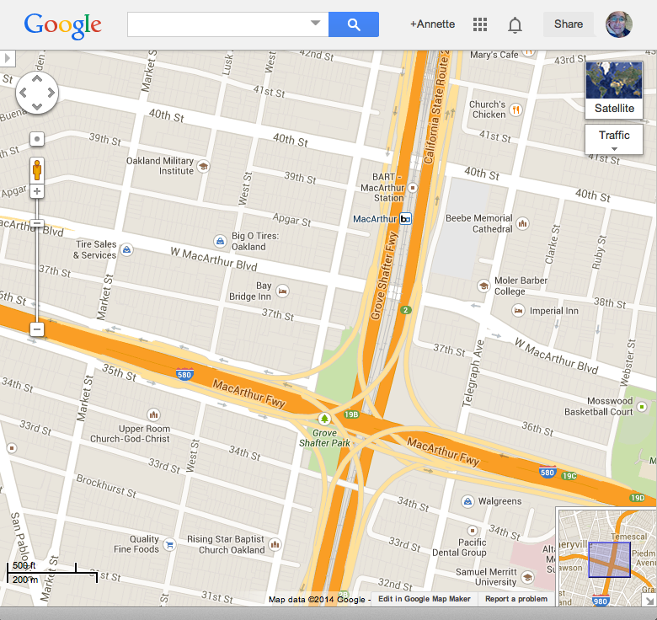
Google Maps
Detail
} Overview

Slide 26
Drawbacks
User has to shift attention
Both views take up space
You lose some context in overview
Notes:
drawbacks: user has to shift attention
two windows to take up space
lose some context in overview

Slide 27
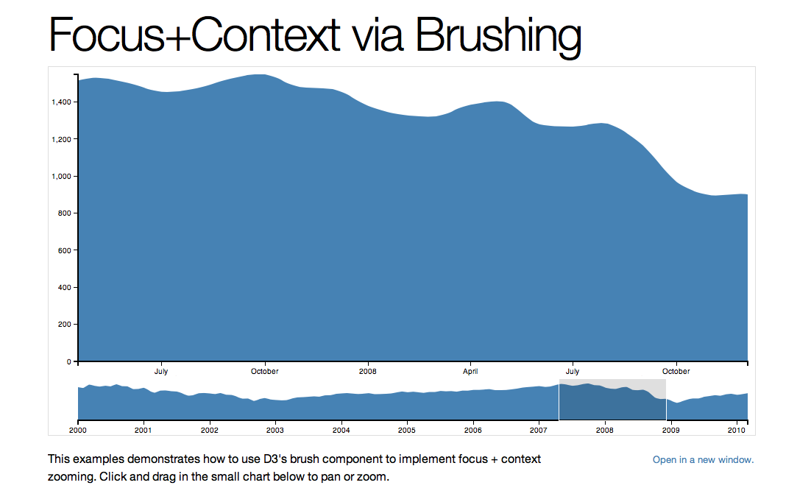
http://bl.ocks.org/mbostock/1667367
Overview + Detail
^
Notes:
D3 has sample code, but gives it the wrong name

Slide 28
Focus Plus Context

Slide 29
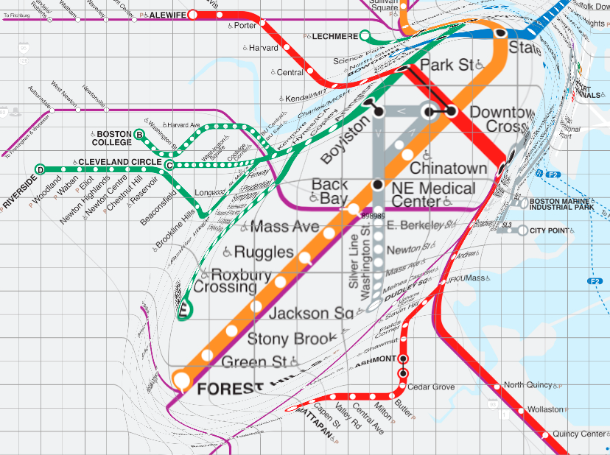
Focus Plus Context
Shows overview and detail
No separate view
Often uses distortion to show context
http://www.olivierbau.com

Slide 30
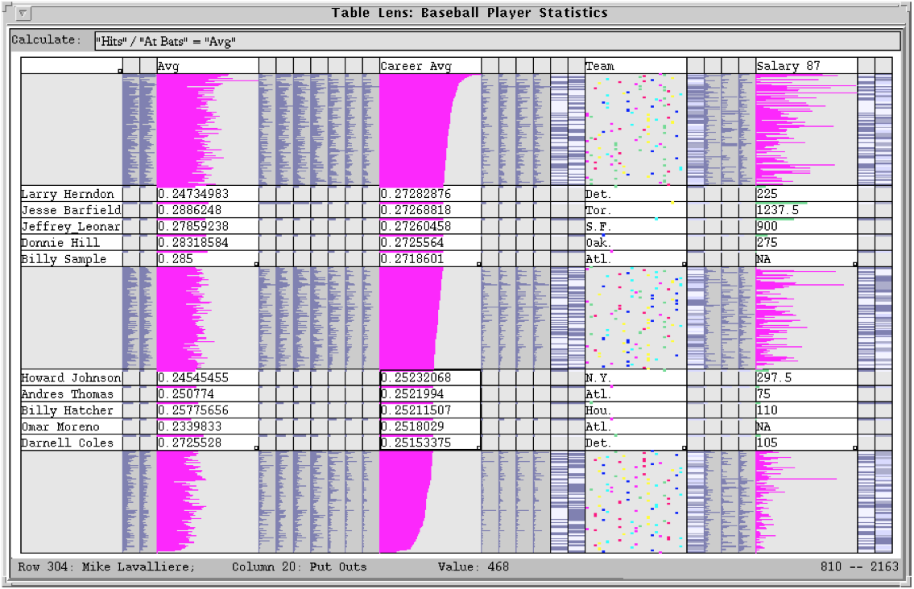
TableLens
Ramana Rao and Stuart Card, PARC, 1994
Notes:
essentially a table of small multiples
zoomed rows, columns show detail
applies spatial concept to graphs

Slide 31
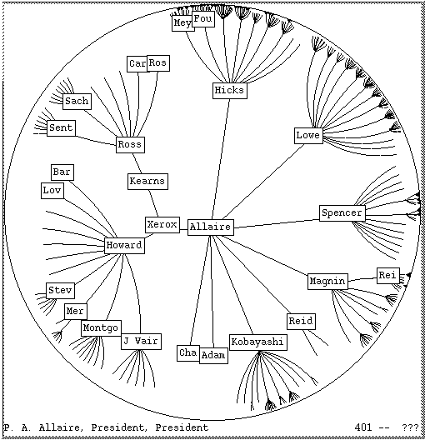
Hyperbolic Tree
John Lamping, Ramana Rao, and Peter Pirolli, PARC, 1995
Notes:
tree diagram, not network
also called hypertree
selected node centered
farther away branches are more compressed

Slide 32
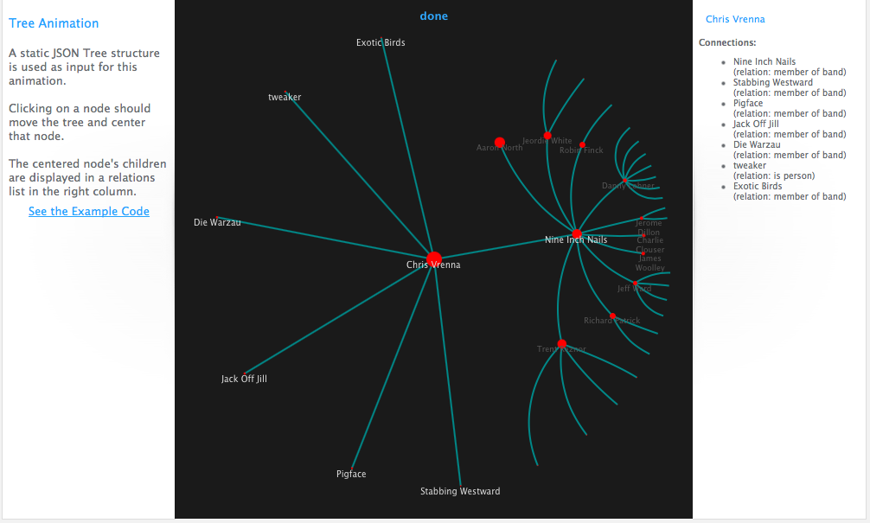
Javascript Infovis Toolkit Hypertree
http://philogb.github.io/jit/static/v20/Jit/Examples/Hypertree/example1.html
Notes:
JIT library includes a hypertree

Slide 33
Drawbacks
Distorted data can be hard to interpret
Distorted labels can be hard to read

Slide 34
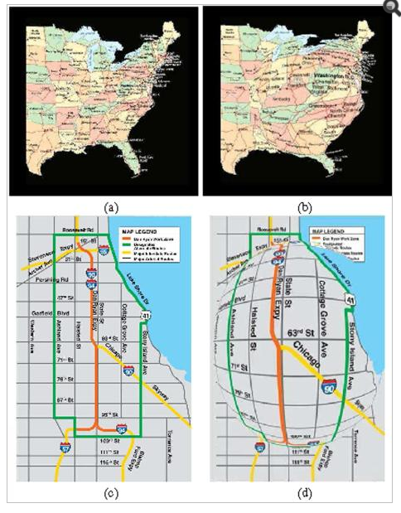
Conformal Magnifier
[Zhao et al., 2012]
Notes:
Techniques for minimizing distortion. https://www.ncbi.nlm.nih.gov/pmc/articles/PMC4536825/

Slide 35
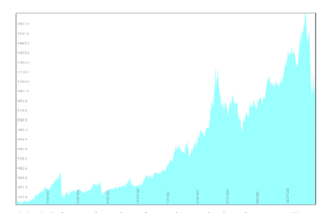
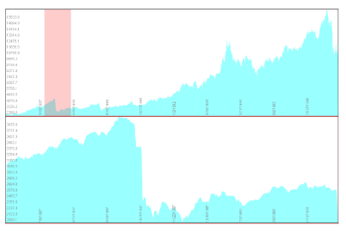
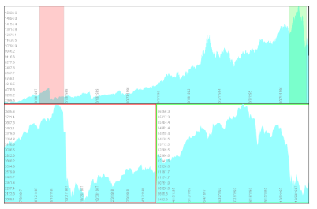
Stacked Zoom
Diagram Source: Javed, W., & Elmqvist, N. (2010, March). Stack zooming for multi-focus interaction in time-series data visualization. In Visualization Symposium (PacificVis), 2010 IEEE Pacific (pp. 33-40). IEEE.
Notes:
http://citeseerx.ist.psu.edu/viewdoc/download?doi=10.1.1.443.1483&rep=rep1&type=pdf

Slide 36
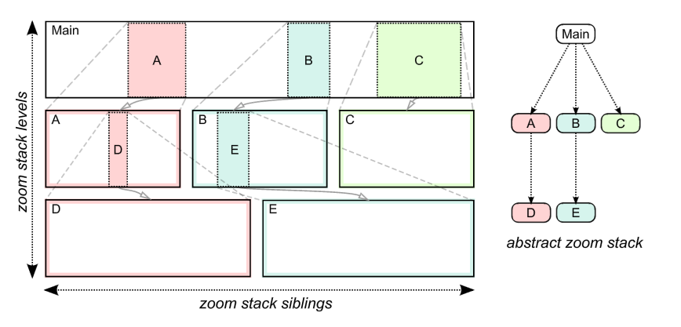
Stacked Zoom
Diagram Source: Javed, W., & Elmqvist, N. (2010, March). Stack zooming for multi-focus interaction in time-series data visualization. In Visualization Symposium (PacificVis), 2010 IEEE Pacific (pp. 33-40). IEEE.
Notes:
http://citeseerx.ist.psu.edu/viewdoc/download?doi=10.1.1.443.1483&rep=rep1&type=pdf

Slide 37


