Slide 1
Manipulating Multiple Views

Slide 2
Coordinate multiple views to see data from different perspectives

Slide 3
Brushing and Linking
Select data of interest
Update all elements to highlight selected data
Notes:
select data of interest
Update e;ements to highlight selected data

Slide 4
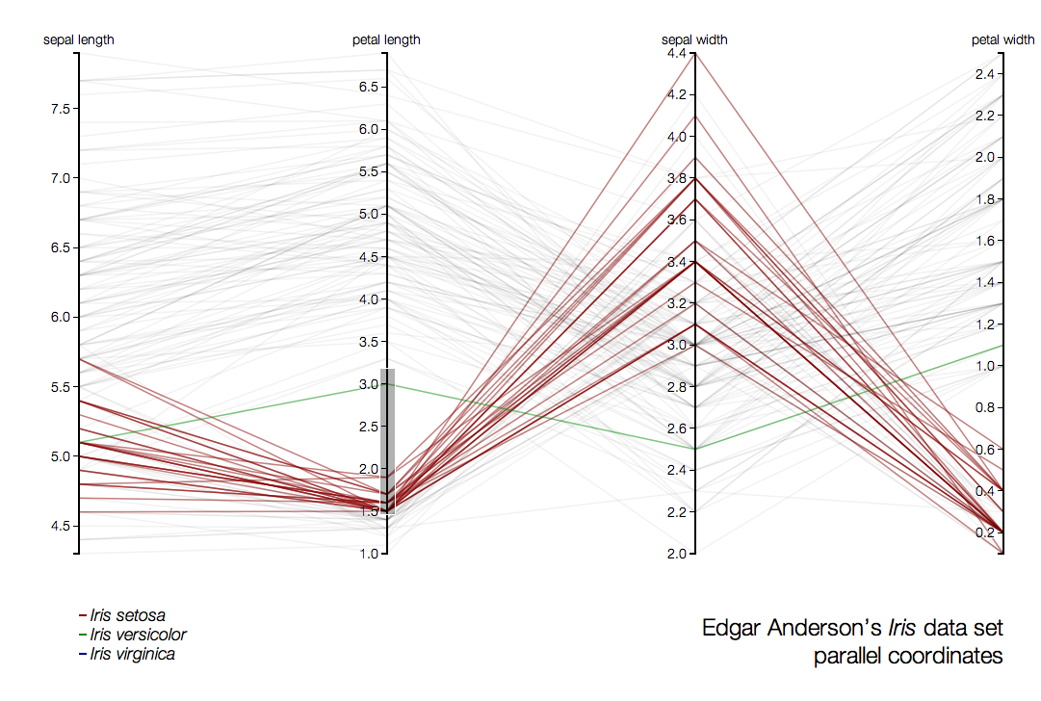
Highlighting and Brushing
http://mbostock.github.com/d3/talk/20111116/iris-parallel.html
Notes:
The brushing part
drag along an axis to highlight data
selection is important for parallel coords plots
Static versions of this – hard to read, use
Intended for interactive use – takes a little effort, but fine to use
Excellent for high dimensional data

Slide 5
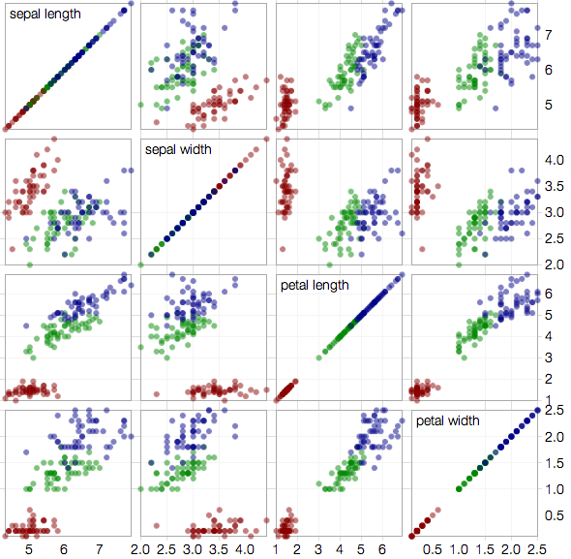
Brushing and Linking
http://mbostock.github.io/d3/talk/20111116/iris-splom.html
Notes:
Here’s the linking bit
If I select an area in upper left…

Slide 6
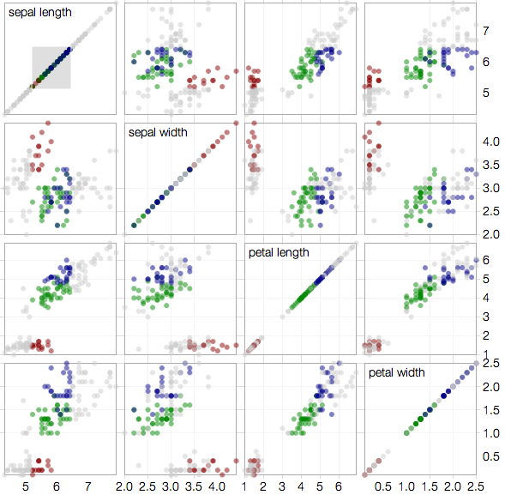
Brushing and Linking
http://mbostock.github.io/d3/talk/20111116/iris-splom.html
Notes:
Other views show same selection
Great for keeping context across views
Great for dashboards

Slide 7
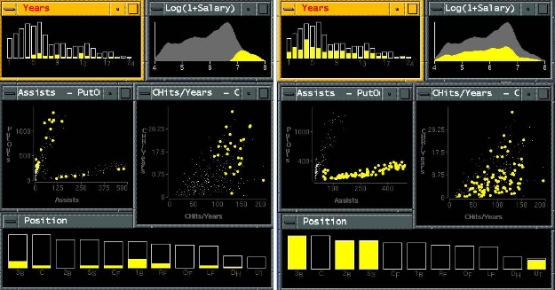
Notes:
GGOBI

Slide 8
Organize multiple views

Slide 9
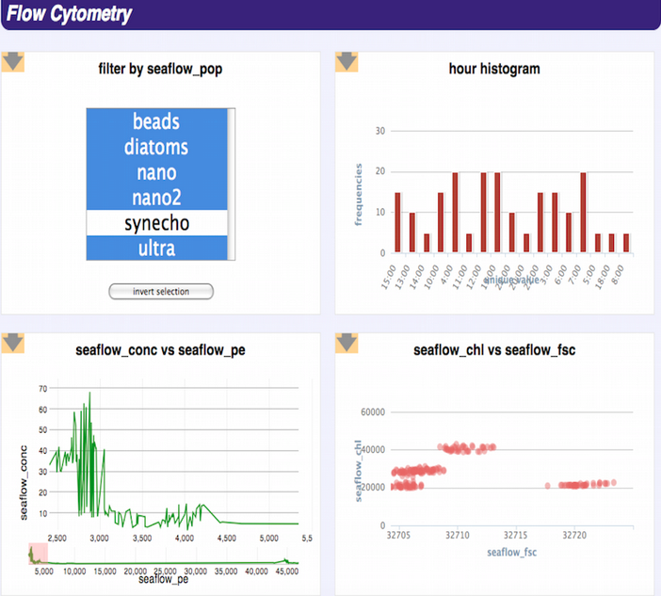
Perry et al., 2013. VizDeck

Slide 10
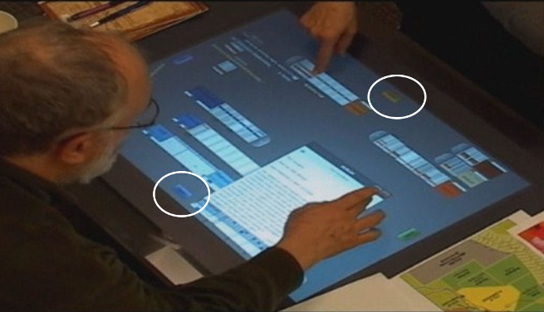
Organizing Views
[Isenberg et al., 2012]
Notes:
https://www.semanticscholar.org/paper/Co-Located-Collaborative-Visual-Analytics-around-a-Isenberg-Fisher/9dad2e0d52a12cffbe84693fe985cfe58389caec

Slide 11


