Slide 1

Exploring Uncertainty
Subtitle goes here

Slide 2
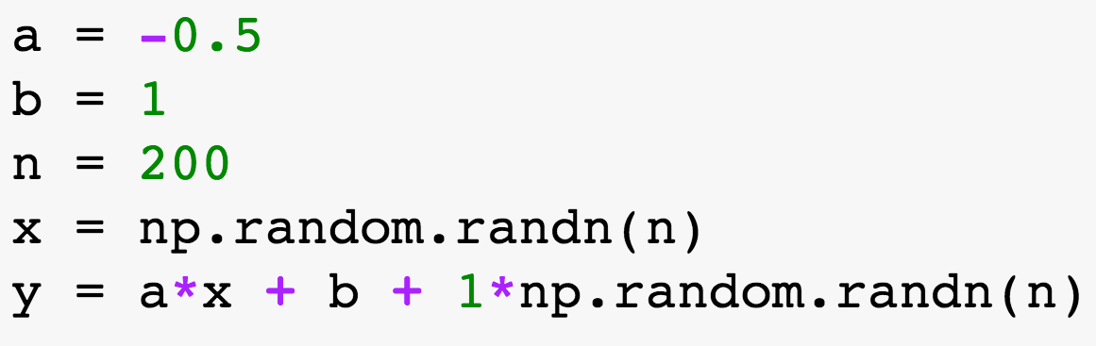
Data
Notes:
http://matplotlib.org/1.2.1/examples/pylab_examples/errorbar_demo.html

Slide 3
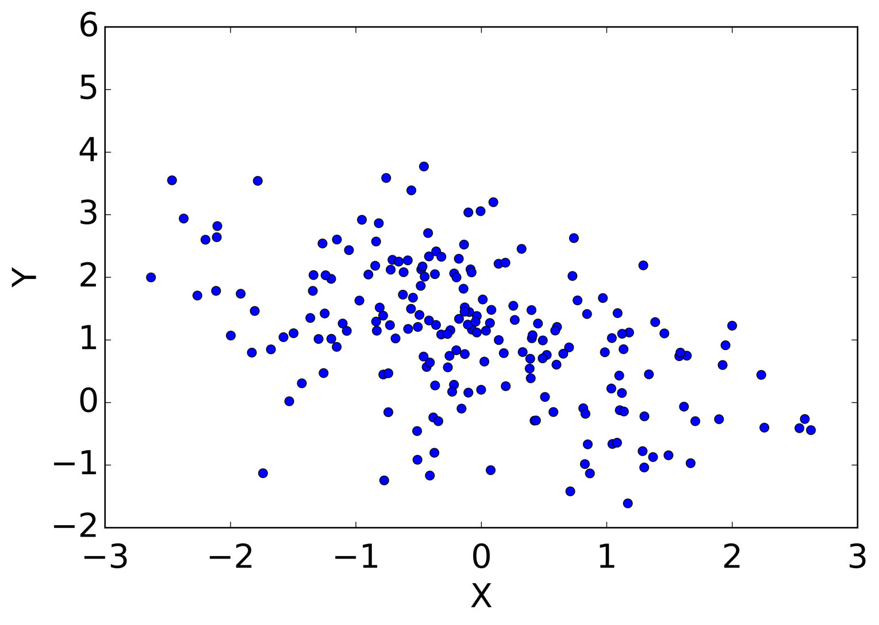
Data
Notes:
http://matplotlib.org/1.2.1/examples/pylab_examples/errorbar_demo.html

Slide 4
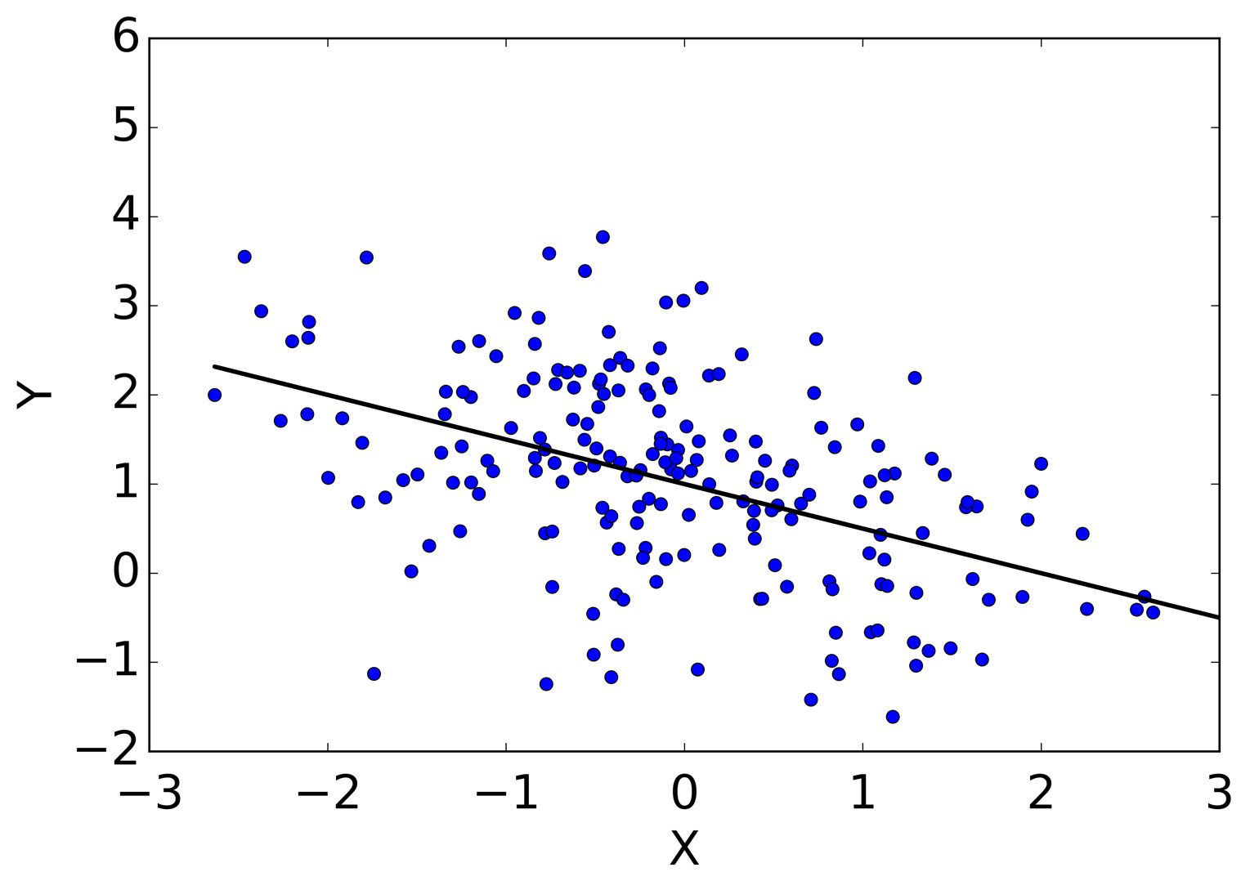
Better

Slide 5
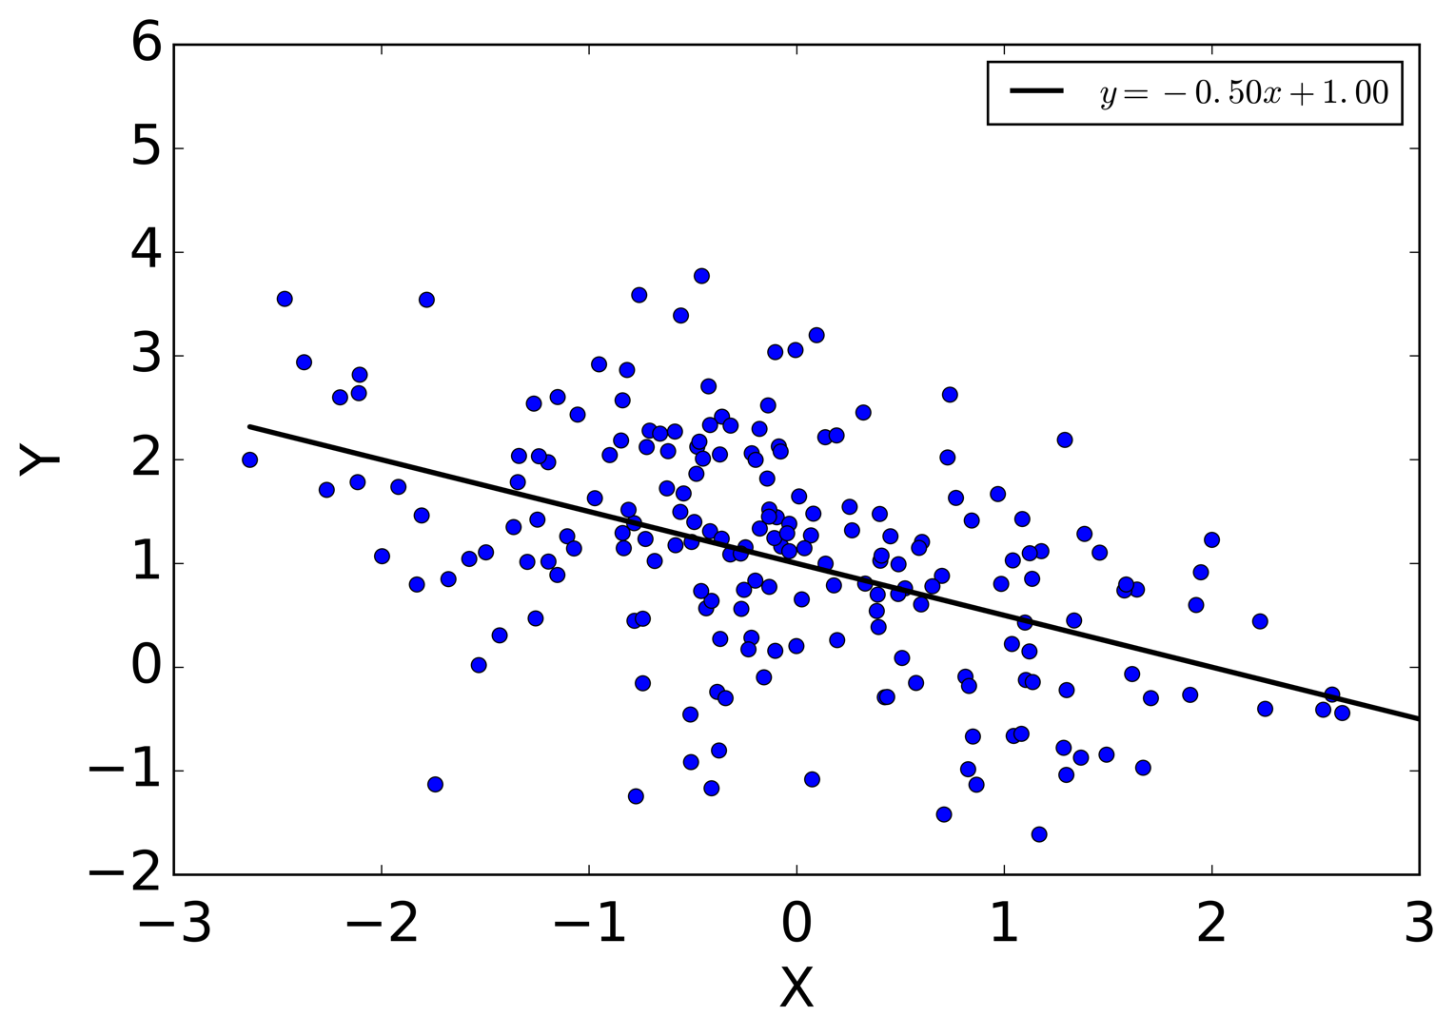
Better yet

Slide 6
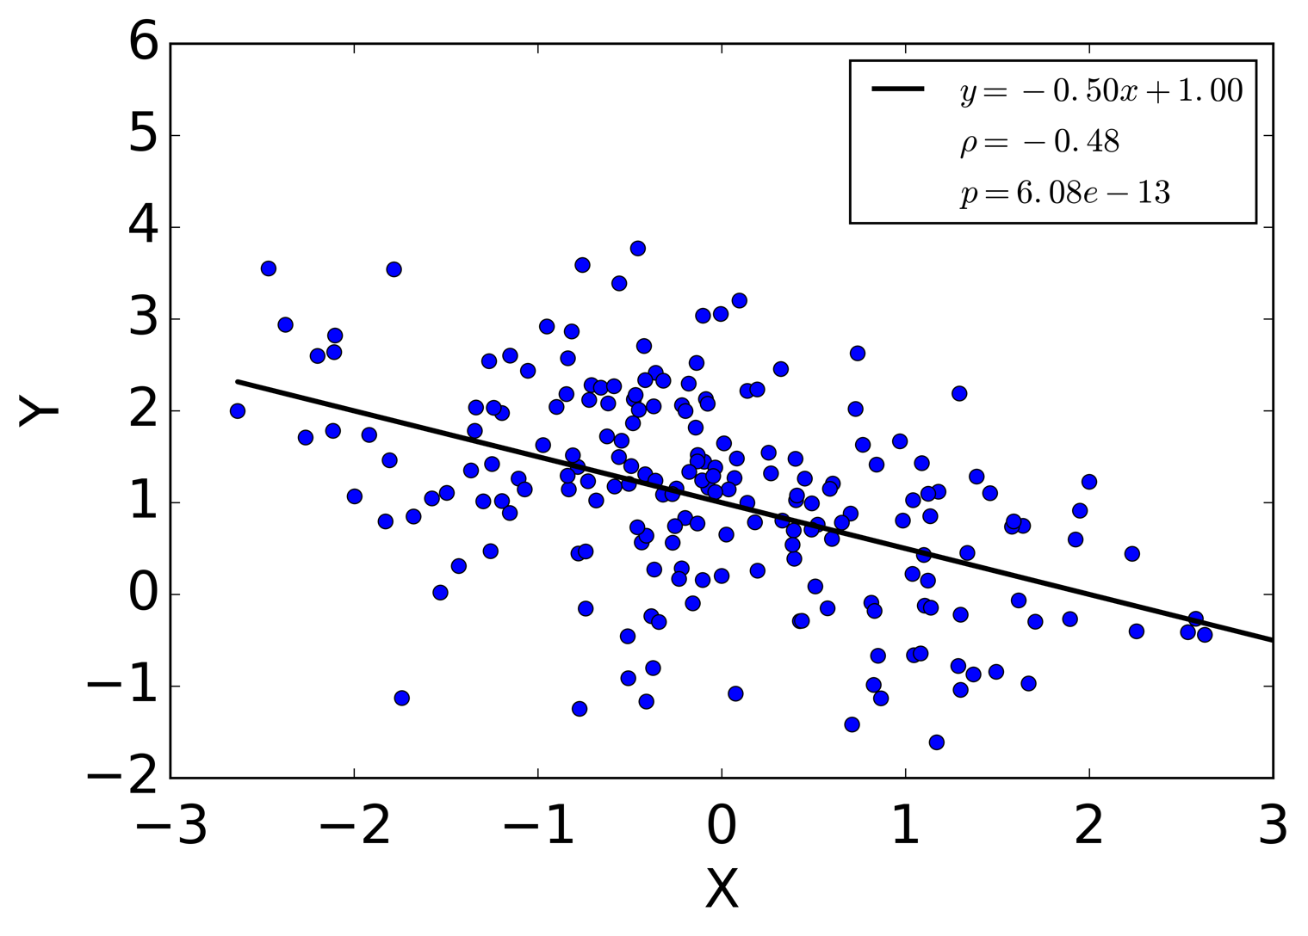
Good

Slide 7
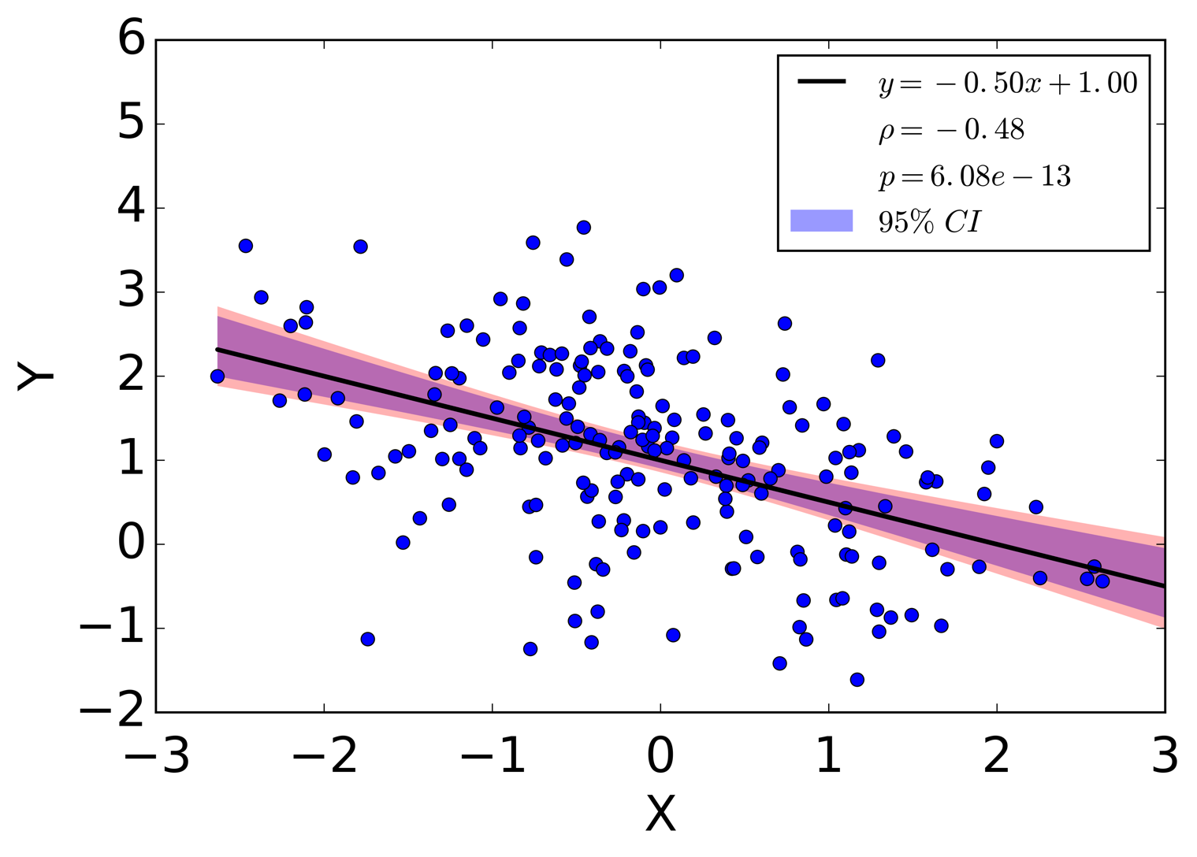
Best!

Slide 8
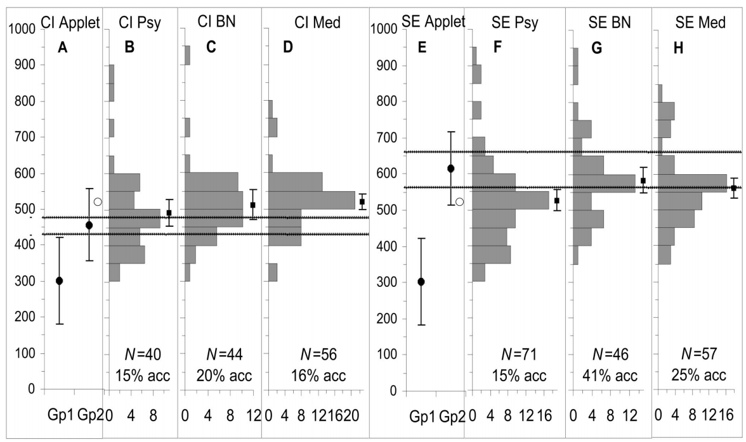
Communicating uncertainty is hard
“Confidence intervals considered harmful”
-Belia, 2005
Notes:
https://isites.harvard.edu/fs/docs/icb.topic477909.files/misunderstood_confidence.pdf
tasked to play Gp2 at a p=.05 significance difference from Gp1, most researchers fail!
CI and SE are misleading
Labels are pysch, behaiv neuroscience, medicine

Slide 9
A different attempt
http://www.nytimes.com, 2016
http://vis4.net/blog/posts/jittery-gauges-election-forecast/
Notes:
also see http://vis4.net/blog/posts/jittery-gauges-election-forecast/#more-4952

Slide 10


