Slide 1

Additional Tools for Exploration
Subtitle goes here

Slide 2
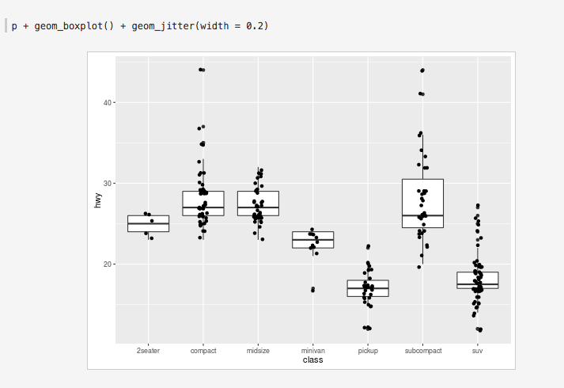
ggplot2
Plotting system in R: ggplot2.org

Slide 3
ggplot - python
based on ggplot2 but for python: https://github.com/yhat/ggplot

Slide 4


