Slide 1

Designing Exploratory Visualization Tools
Subtitle goes here

Slide 2
Header
What makes for a good visual eda tool?
Notes:
Stephen Few suggests that the following features are essential for good visual eda tools.
https://www.perceptualedge.com/articles/visual_business_intelligence/evaluating_visual_eda_tools.pdf

Slide 3
Basic charts for eda
Table
Bar Graph, Dot Plot
Histogram, Frequency Polygon, Strip Plot
Line Graph
Scatter Plot, Bubble (size for 3rd variable)
Box Plot
Heatmap Matrix
Bar/Line or Bar/Dot Combination

Slide 4
seamless data interaction
Notes:
Get to that next view easily and rapidly.

Slide 5
rich data comparison

Slide 6
multifaceted views

Slide 7
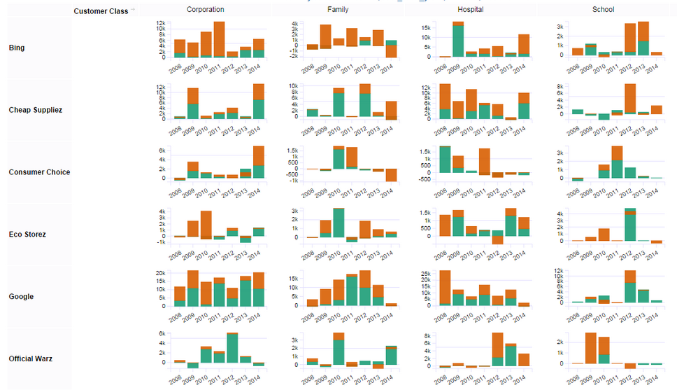
[example image]

Slide 8
integrated statistical calculations

Slide 9
lithe data access & integration

Slide 10


