Slide 1

Usability & User Studies
Notes:
Why do user studies?

Slide 2
Validity Checks
Earlier Stages
Observe and interview target users (needs assessment)
Design data abstraction / operation (data types, transformation, operations)
Justify encoding/ interaction design (design heuristics, perception research)
Informal analysis / qualitative analysis of prototypes (task-based)
Algorithm complexity analysis / evaluation
Mid & Later Stages
Qualitative analysis of system (task-based)
Algorithm performance analysis
Lab or crowdsourced user study
Field study of the deployed system
Notes:
There

Slide 3
Validity Checks
Earlier Stages
Observe and interview target users (needs assessment)
Design data abstraction / operation (data types, transformation, operations)
Justify encoding/ interaction design (design heuristics, perception research)
Informal analysis / qualitative analysis of prototypes (task-based)
Algorithm complexity analysis / evaluation
Mid & Later Stages
Qualitative analysis of system (task-based)
Algorithm performance analysis
Lab or online user study
Field study of the deployed system
Notes:
Sorts of checks and balances to strengthen validity for your visualization tool.

Slide 4
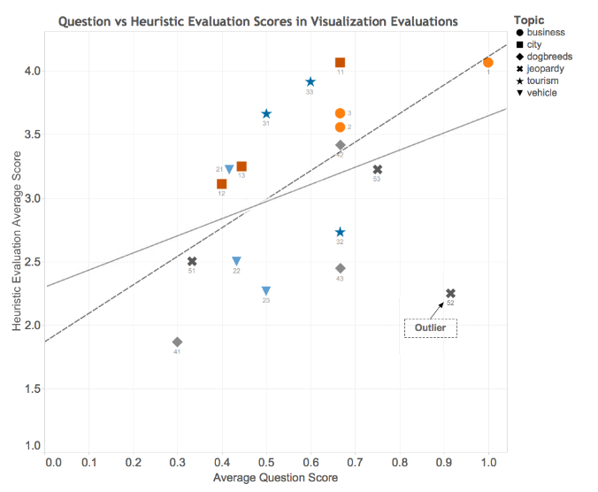
Design Heuristics + Usability
Hearst et al., 2016: Correlation between design heuristic score & usability question score
Notes:
Job is to take that to the next

Slide 5
Formal Usability Study
Goal: Does the visualization allow the user/ analyst to perform key tasks?
Notes:
This should sound familiar since we’ve already been

Slide 6
Task Oriented Visual Insights
Basic insights:
Read a value
Identify Extrema
Characterize Distribution
Describe Correlation
Comparative Insights:
Compare Values
Compare Extrema
Compare Distribution
Compare Correlation
[Yang et al., 2014]
Notes:
Give examples from paper. Not a complete list of course but provides some areas.
https://www.researchgate.net/profile/Huahai_Yang/publication/262310059_Understand_Users%27_Comprehension_and_Preferences_for_Composing_Information_Visualizations/links/00b49539104ed214c9000000/Understand-Users-Comprehension-and-Preferences-for-Composing-Information-Visualizations.pdf

Slide 7
Usability Study - Logistics
You will need:
Visualization with test data loaded
Consent form (if required)
Task list
Protocol (study procedures & debrief questions)
Surveys/ interviews and any additional data collection instruments
Audio or video recorder, notepad

Slide 8
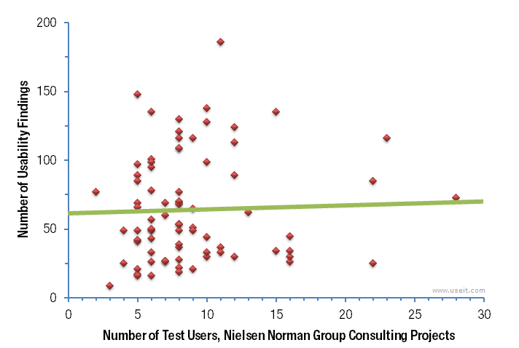
How many people do you need?
Notes:
It depends 5 +- for getting bigger issues, but for statistical sign twenty to thirty.

Slide 9
‘Lab’ doesn’t need to mean a formal lab
Notes:
Think of it more the method conducting the study and handling the results. Do need some thought into.

Slide 10
Software for Collecting Audio/Video
Video of user
Screen capture of user actions
Audio of entire session

Slide 11
Online Tools
Surveys
Mouse tracking/navigation tracking
Crowdsourced study (e.g., MechTurk)
Notes:
Note there are limitations to the type of data that can be robustly collected online dependent on the tool.

Slide 12
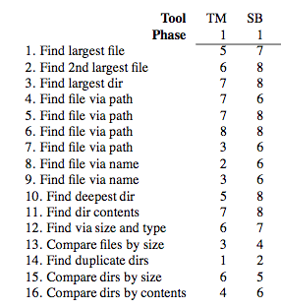
You’ve Collected Data
Task completion
Time on task
Notes
Interview responses
Survey responses
… then what?
Table Source: Stasko, J., Catrambone, R., Guzdial, M., & McDonald, K. (2000). An evaluation of space-filling information visualizations for depicting hierarchical structures
Notes:
How is the task completion recorded, does the analyst note it themsleves, do they write something down.

Slide 13
What is the analyst’s information scent?
Notes:
A term originating from Peter Pirolli and Stuart Card PARC looking at meaning
Accounts for not just completion but also situating WHAT the person was doing, may wish to do think aloud as well. It’s not always obvious what leads to the challenge. Like a detective, not always obvious. Transating to design.

Slide 14
MoSCoW Prioritization
Must
Should
Could
Won’t
Notes:
Discuss brief history, came from the dynamic software development method.

Slide 15
Severity Ratings
0 Not a real problem
1 Cosmetic
2 Minor usability issue
3 Major usability issue
4 Critical issue

Slide 16
Limitations
Ecological validity
Are performance oriented tasks the complete story?
Notes:
Ithere are some limitations

Slide 17
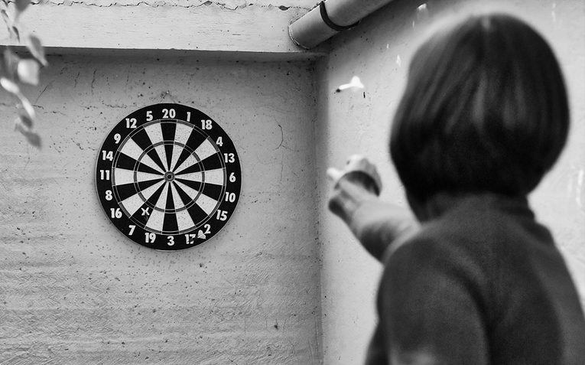
Iterate
Flickr CC by zolakoma
Notes:
https://www.flickr.com/photos/zolakoma/4118276928/sizes/l/

Slide 18


