Slide 1

Introducing Tableau

Slide 2
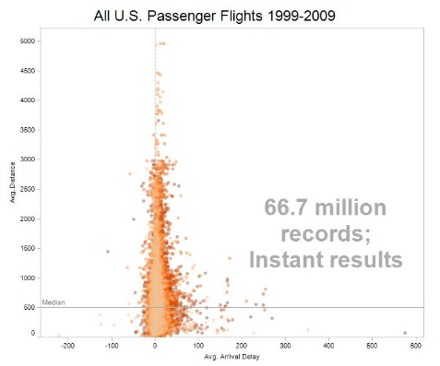
About Tableau
VizQL graphical query language
exploration & visual analysis
Variety of data formats, good with large data

Slide 3
Data Source Connections
Excel
Text
JSON
Spatial for geo
Statistical
(SPSS, R)
Tableau Server
SQL Server
MySQL
Redshift
Oracle
and 100s of other data sources!

Slide 4
Combining Data
Joining: Combine data tables from the same source (e.g., Oracle DB)
Blending: Combine data from different sources (e.g., Excel and Oracle DB)

Slide 5
Other Language Integrations
SQL
R
Python API (TabPy beta)
JavaScript API

Slide 6
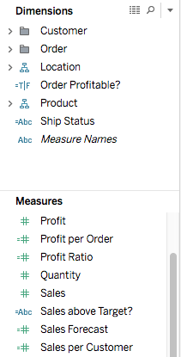
Data in Tableau
Dimension: Discrete variables such as dates and categories (names, geographical locations, etc.)
Measure: Data values that can be aggregated (average, sum, count, etc.). Tableau transforms these by default!
Notes:
In Tableau when you initially connect to the data source the system gives it’s best guess at assigning data this way, so fields that have strings or boolean values are assigned dimension, and any data that has numerical information are assigned as Measures. How the data is assigned in this way can change how you’re able to work with it. We’ll come back to that.

Slide 7

Data in Tableau
Dimension: Discrete variables such as dates and categories (names, geographical locations, etc.)
Measure: Data values that can be aggregated (average, sum, count, etc.). Tableau transforms these by default!
Notes:
In Tableau when you initially connect to the data source the system gives it’s best guess at assigning data this way, so fields that have strings or boolean values are assigned dimension, and any data that has numerical information are assigned as Measures. How the data is assigned in this way can change how you’re able to work with it. We’ll come back to that.

Slide 8
Data in Tableau
Dimensions are NOT aggregated, default as Discrete (blue)
Discrete fields become row or column headings
Measures are aggregated, default as Continuous (green)
Continuous fields become axes

Slide 9
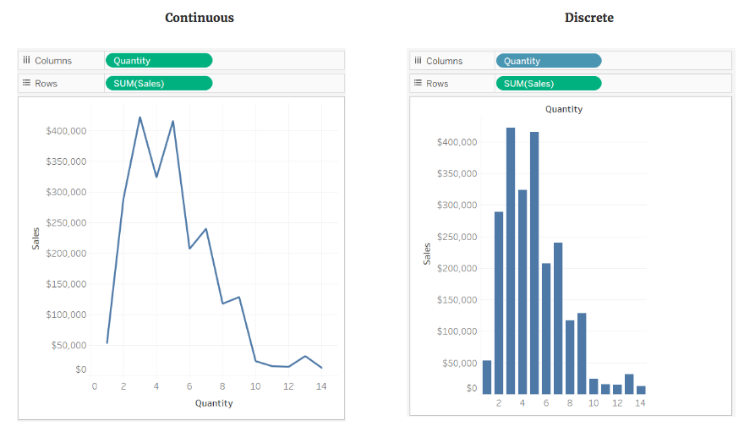
Data in Tableau
Continuous
Discrete

Slide 10
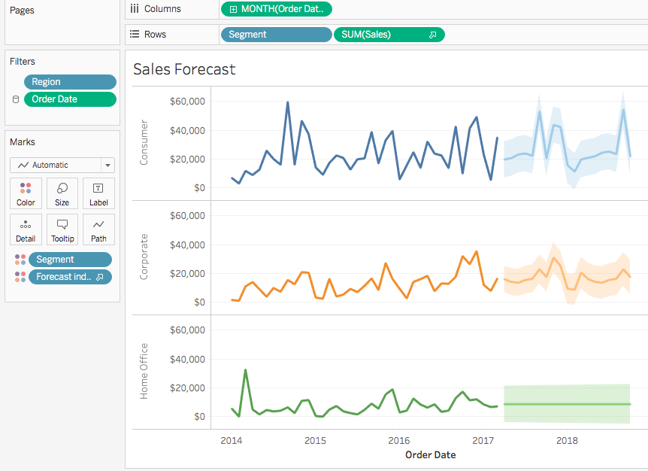

Slide 11
Exploration Mantras
Be skeptical: What assumptions have been made?
Explore iteratively: Start simple, keep asking questions.
Avoid fixation: Use a variety of graphics to inspect more angles.

Slide 12


