Slide 1

Bokeh
High-level, interactive plotting in Python

Slide 2
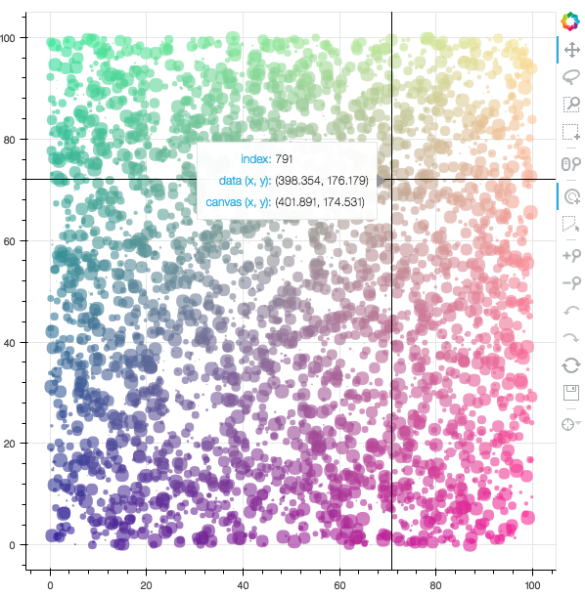
Examples

Slide 3
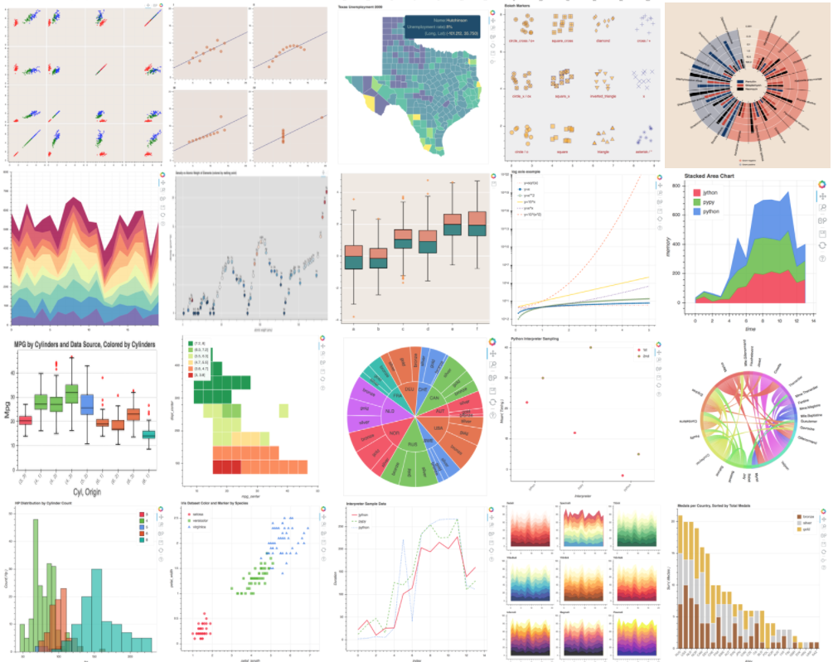
Examples

Slide 4
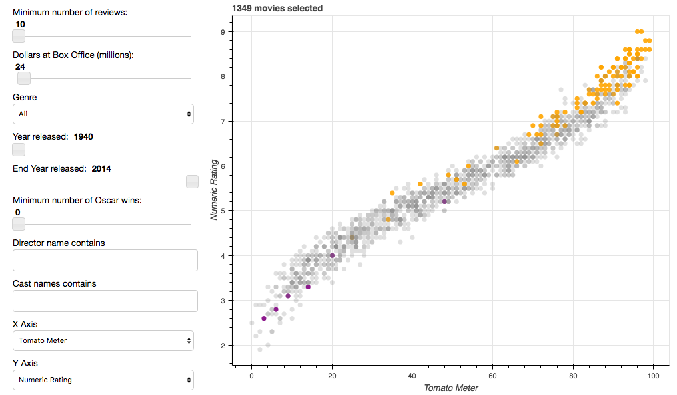
Examples

Slide 5
bokeh.charts
bokeh.plotting
boken.models

Slide 6
Python
bokeh.charts
bokeh.plotting
boken.models

Slide 7
Python
Browser
bokeh.charts
BokehJS
bokeh.plotting
Backbone
boken.models

Slide 8
Python
Browser
bokeh.charts
BokehJS
bokeh.plotting
Backbone
boken.models
JSON
Notes:
plot need to be viewed with a browser

Slide 9
Where to use it
Running a Bokeh Server (akin to Shiny).

Slide 10
Where to use it
Running a Bokeh Server (akin to Shiny).
Inside Jupyter notebook.

Slide 11
Where to use it
Running a Bokeh Server (akin to Shiny).
Inside Jupyter notebook.
Standalone (generate HTML -> PNG).
*requires user interaction

Slide 12


