Slide 1

Design Applications: Dashboards

Slide 2
"A dashboard is a visual display of the most important information needed to achieve one or more objectives that has been consolidated on a single computer screen so it can be monitored at a glance"
–Stephen Few, Information Dashboard Design
Notes:
Stephen Few – wrote THE book on dashboard design

Slide 3
"A dashboard is a visual display of the most important information needed to achieve one or more objectives that has been consolidated on a single computer screen so it can be monitored at a glance"
Implies understanding of
Audience
Objectives
Notes:
Breaking it down
You need to understand
audience
their objectives
Needs assessment is important!

Slide 4
"A dashboard is a visual display of the most important information needed to achieve one or more objectives that has been consolidated on a single computer screen so it can be monitored at a glance"
How big?
What is the context of use?
Notes:
"single computer screen"
Size matters
mobile, HD TV, web
Context: where?

Slide 5
"A dashboard is a visual display of the most important information needed to achieve one or more objectives that has been consolidated on a single computer screen so it can be monitored at a glance"
Perceptually simple, fast
Avoid distraction
Notes:
"at a glance"
Perceptually simple, fast
Avoid distraction

Slide 6
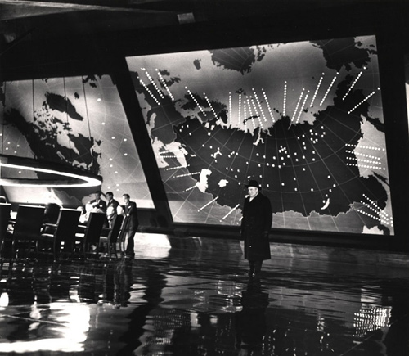
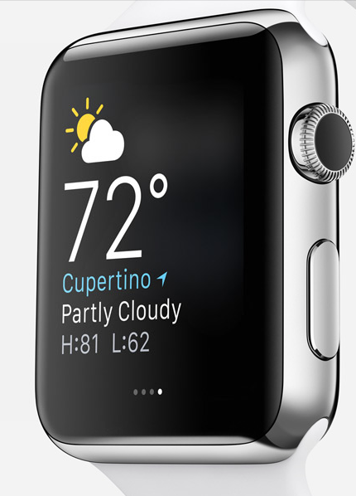
Does this definition cover all dashboards?
Apple, Inc.
Doctor Strangelove, Columbia Pictures, 1964
Notes:
What might be missing?

Slide 7
Needs Assessment
Who is your audience?
What are their goals?
What questions do they want to find answers to?
Notes:
Start with a needs assessment
Be able to answer these questions

Slide 8
Selecting Forms
Dashboards call for
Multiple graphs
Updates over time
Choosing among text, tables, graphs
Notes:
Extra levels of form: chart to chart, update over time, text vs. tables vs. graphs
Don't forget the value of tables.

Slide 9
Selecting Forms
In designing dashboards,
Facilitate quick perception
Facilitate comparison across charts
Use consistent scales & encodings
Use space & show hierarchy of importance
Include interactivity if possible
Allow drill down when needed
Notes:
comparisons across graphs
Consistent scales over time
Hierarchy among elements
Space between elements
Interactivity helps with space limitations

Slide 10
[Placeholder Example Image]

Slide 11
[Placeholder Example Image]

Slide 12
Updating Data
Speed requirements dependent on domain and data frame
Streaming or periodic updates
Consider server architecture, use of framework
Notes:
Want to allow fast updates to facilitate perception, this need can depend on domain, stock analyst and IT performance. Embed Bokeh in flask?

Slide 13


