Slide 1

Plotly
Subtitle goes here

Slide 2
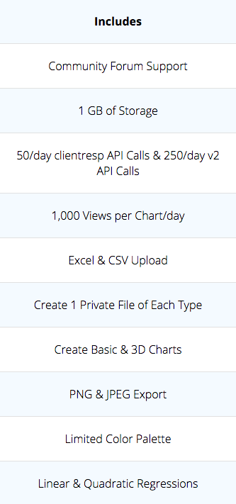
Disclaimer
Free version is limited

Slide 3
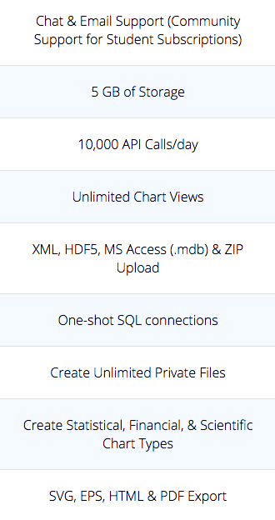
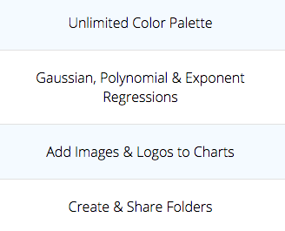
Disclaimer
$396/year

Slide 4
Capabilities
Many examples in documentation.

Slide 5
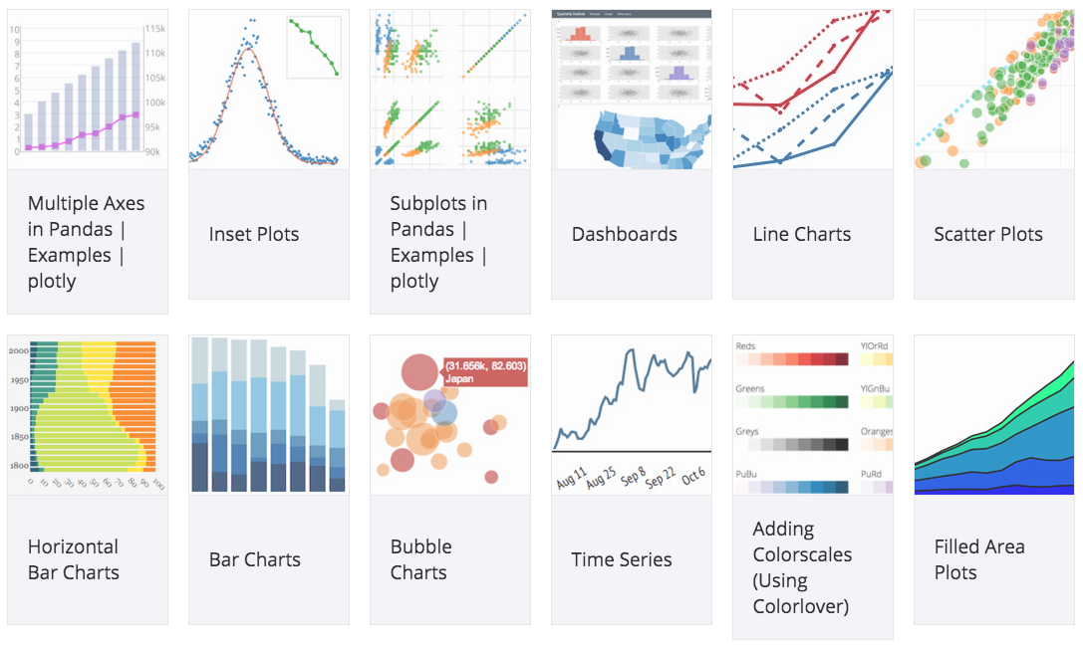
Capabilities
Many examples in documentation.

Slide 6
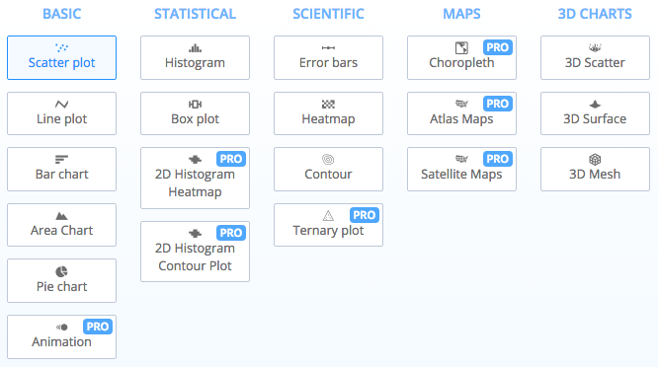
Capabilities
Many examples in documentation.

Slide 7
Capabilities
Many examples in documentation.
Interactive plots (hosted and “offline”).

Slide 8
Capabilities
Many examples in documentation.
Interactive plots (hosted and “offline”).
Libraries for Python, R, nodeJS, Matlab, etc (reads from matplotlib or ggplot figures).

Slide 9
Capabilities
Many examples in documentation.
Interactive plots (hosted and “offline”).
Libraries for Python, R, nodeJS, Matlab, etc (reads from matplotlib or ggplot figures).
Streaming (built on D3 and stackGL).

Slide 10
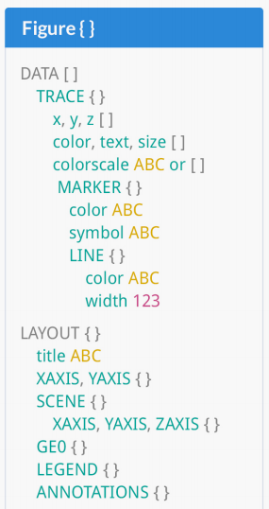
Grammar
Communicated to JS library via JSON (i.e., akin to Vega and Vega-Lite).

Slide 11
How it works
Matplotlib (Artist objects)
OR
Plotly.py plot() command
Plotly.py read from MPL
Plotly.py JSON generation
Plotly.js Figure() call
SVG/WebGL in NB

Slide 12


