Slide 1

Geospatial Maps

Slide 2
graph/
chart
map
Notes:
One of the first considerations is, do you actually need a geospatial representation for the data? Or would another chart type be more suitable?

Slide 3
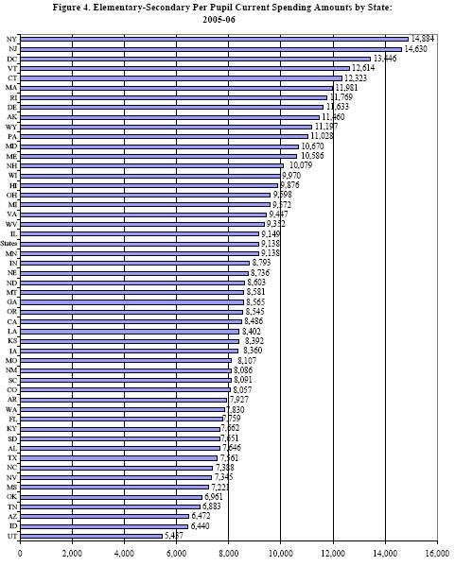
http://blog.timesunion.com/capitol/files/2008/04/perpup.JPG

Slide 4
What is a Map?: a representation or abstraction of geographic reality
[Board, 1990]
Notes:
Quote from Kraak’s Cartography

Slide 5
Which reality?
Notes:
Quote from page 41 of Kraak

Slide 6
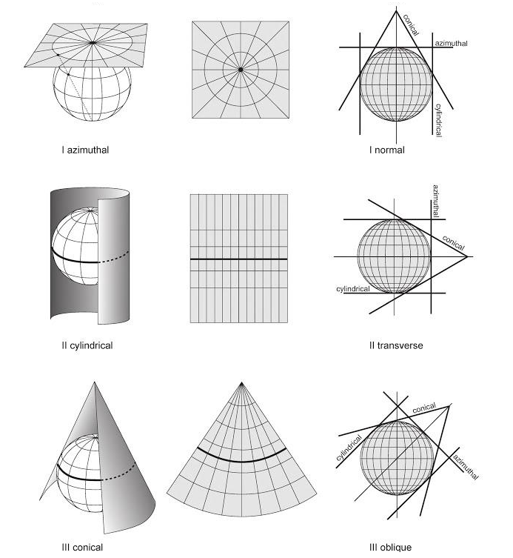
[Placeholder Image]

Slide 7
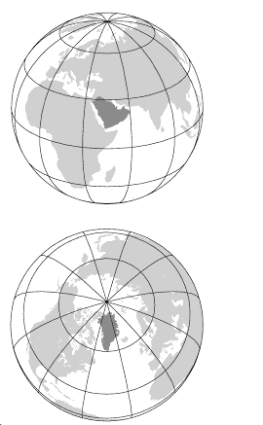

Slide 8
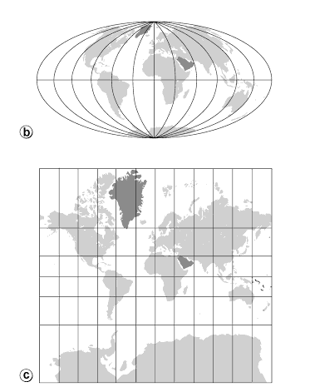
Projections

Slide 9
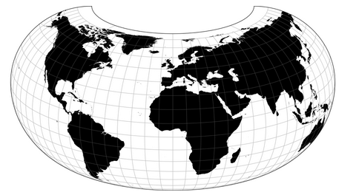
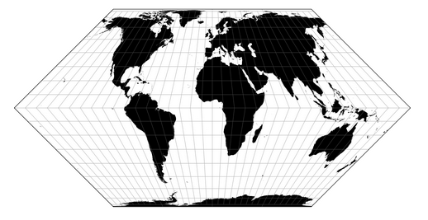
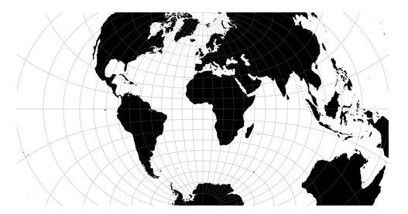
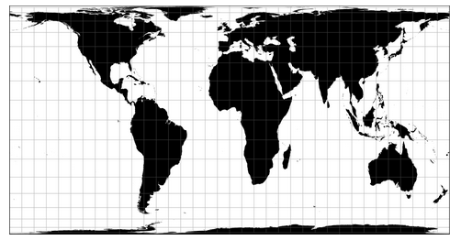
?
https://github.com/d3/d3-geo-projection
Notes:
The choices can be dizzying, and you want to provide the right one to show the data. Which projection to use?

Slide 10
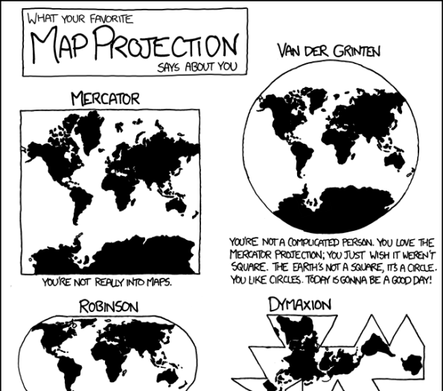
[Placeholder for xkcd comic image]
http://xkcd.com/977/

Slide 11
Projection Guidelines
Government organization / contract check local governing body
Thematic or distribution maps: equal area
Presentation maps : conformal
Navigational maps: mercator, true direction, equidistant
Notes:
Check local governing body. The state of California uses the Albers (check)
Source: http://resources.esri.com/help/9.3/arcgisengine/java/gp_toolref/coverage_toolbox/choosing_a_map_projection.htm

Slide 12
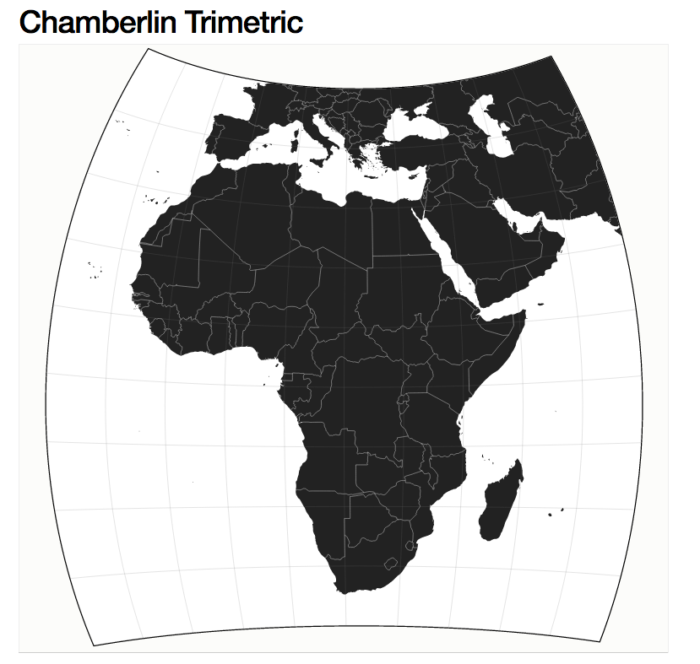
http://bl.ocks.org/mbostock/5625053
Notes:
Compromises between distortions of area, direction, and distance

Slide 13
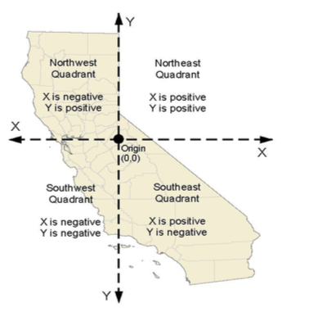
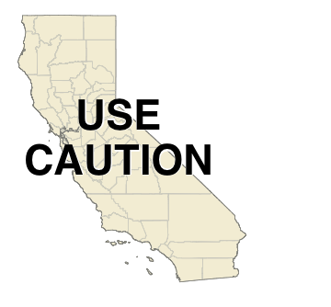
California Albers
Web Mercator
Notes:
From the California department of fish and wildlife website

Slide 14
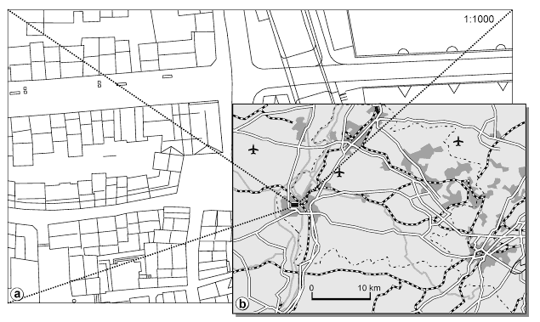
Scales
Kraak & Ormeling, 2010. Cartography, Third Edition, Visualization of Spatial Data.

Slide 15
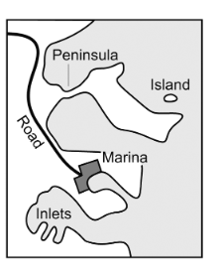

Geometry / Display Modifications
Brewer & Buttenfield, 2007
Notes:
Show the original a 200 percent reduction to a smaller scale.
http://php.scripts.psu.edu/users/c/a/cab38/ScaleMaster/Brewer_Buttenfield_ScaleMaster_CaGIS_paper_Jan07.pdf

Slide 16
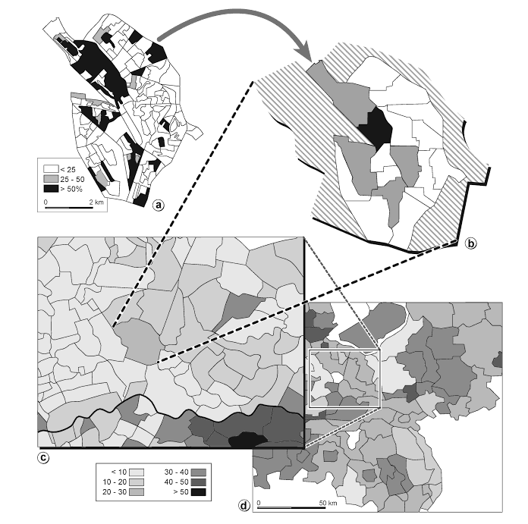
Kraak & Ormeling, 2010. Cartography, Third Edition, Visualization of Spatial Data.
Notes:
Aggregation by scale matters in how data is perceived! Thematic maps and the influence of scale on socio-economic phenomena: the percentage of Labour votes in part of the Netherlands (a) Utrecht’s voting districts; (b) neighbourhoods; (c) municipalities; (d) regions

Slide 17


