Slide 1

Data Considerations

Slide 2
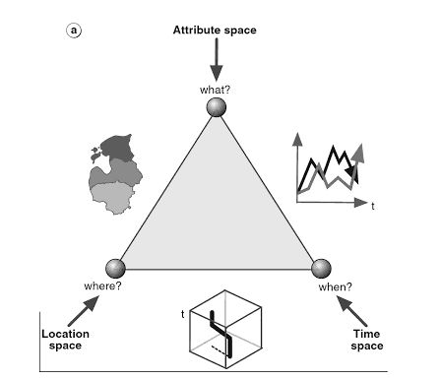
Kraak & Ormeling, 2010. Cartography, Third Edition, Visualization of Spatial Data.
Notes:
Characteristics of geospatial data, the location, attribute and time – can think of as where, what when.

Slide 3
Discrete vs Continuous
[Placeholder for example images]
Notes:
Type of data for the attributes that you’re mapping.

Slide 4
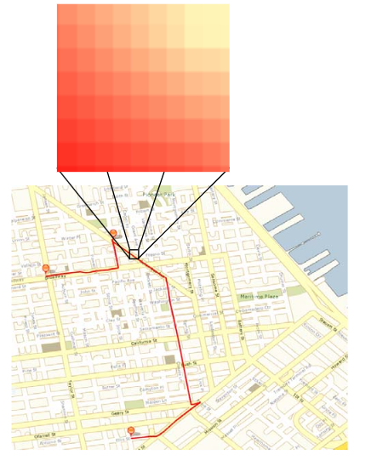
Raster vs Vector
[Placeholder image]
Notes:
http://downloads.esri.com/support/whitepapers/ws_/AWSvector-raster-mapping_0307.pdf

Slide 5
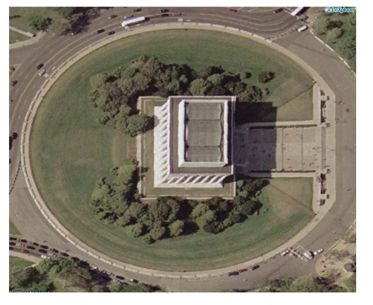
Raster vs Vector
[Placeholder image]
Notes:
Satellite Imagery

Slide 6
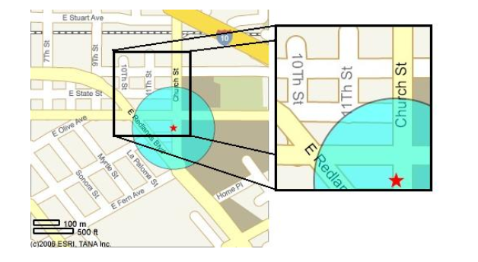
Raster vs Vector
[Placeholder image]
Notes:
ArcWeb services SVG

Slide 7
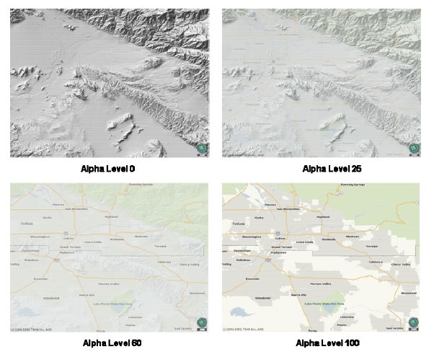
Raster vs Vector
[Placeholder image]
Notes:
Vector is good for quick transition of layers and zooming

Slide 8
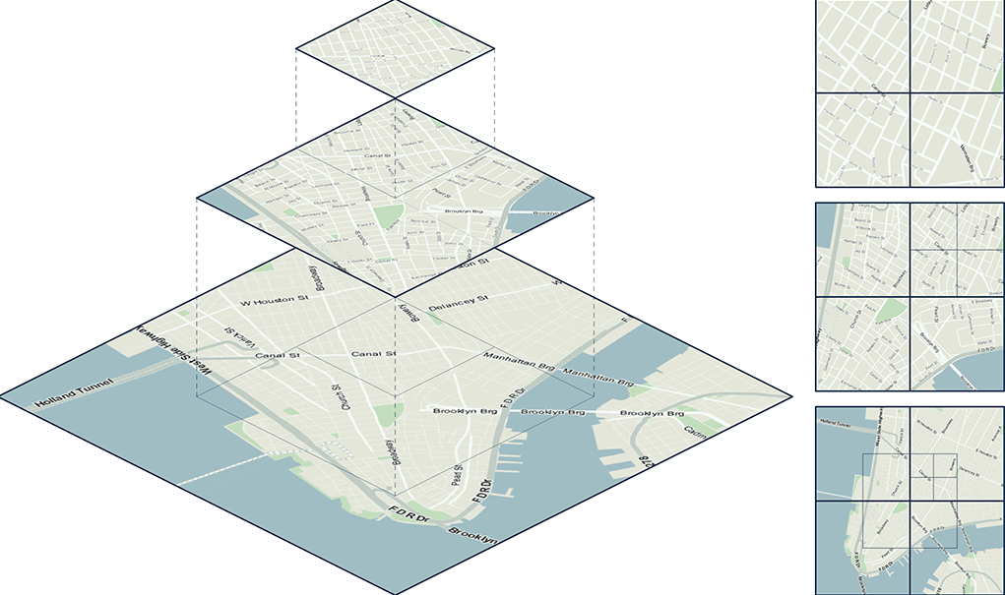
Tiling
[Placeholder image]

Slide 9
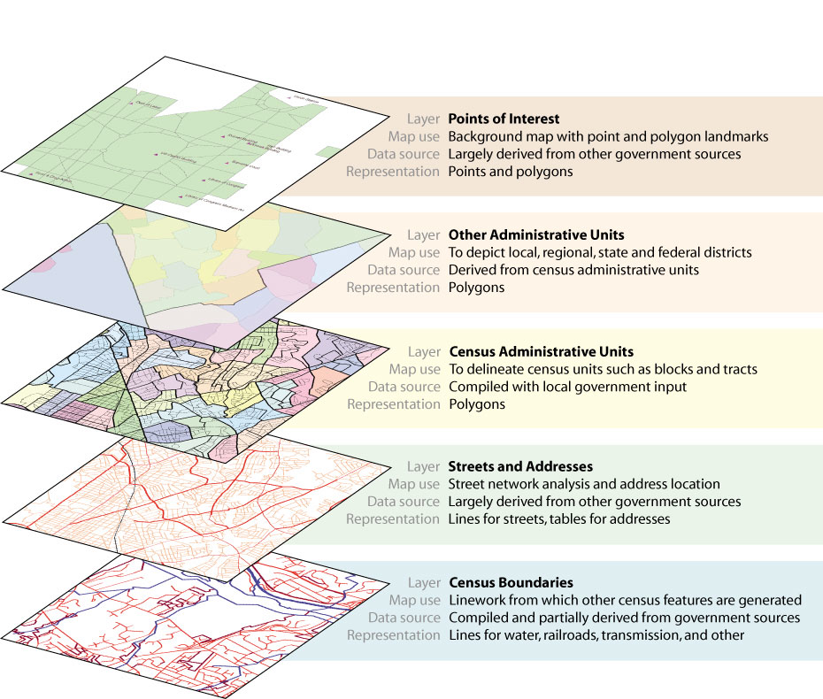
Layers of Detail
http://www.esri.com/news/arcnews/summer03articles/summer03gifs/p29p1-lg.jpg
Notes:
What attributes to include and to what level of detail?

Slide 10
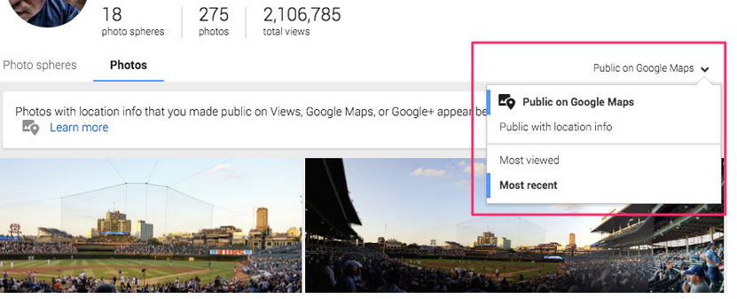
Public vs Private
Source: http://www.androidcentral.com/your-public-google-images-might-now-show-google-maps

Slide 11
Attribute Encoding

Slide 12
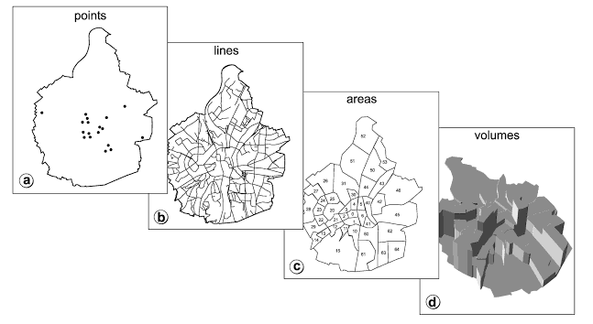
Kraak & Ormeling, 2010. Cartography, Third Edition, Visualization of Spatial Data.

Slide 13
Don’t Forget
Measurement Scales
Categorical
Ordinal
Interval
Ratio
Notes:
Talk through some examples of these for maps from Kraak

Slide 14
Clustering & Aggregating

Slide 15
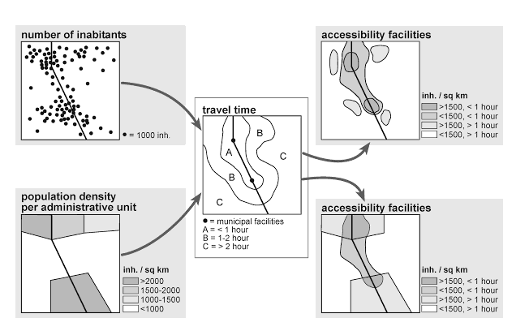
Kraak & Ormeling, 2010. Cartography, Third Edition, Visualization of Spatial Data.

Slide 16


