Slide 1
Tools & Libraries

Slide 2
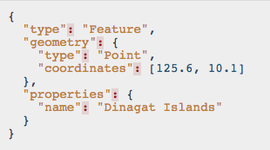
GeoJSON http://www.geojson.org

Slide 3
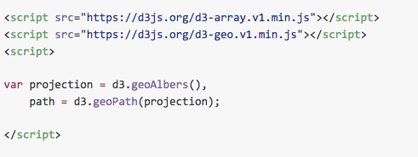
D3.geo https://github.com/d3/d3-geo

Slide 4
Tools & Libraries
Leaflet http://leafletjs.com/
MapBox https://www.mapbox.com/
PostGIS http://www.postgis.net/
Mapnik http://mapnik.org/

Slide 5


