Slide 1

Animation
Notes:
Powerful way to add dimension

Slide 2
Theory
Notes:
Theory, then practicalities

Slide 3
What Is Animation?
Animation: creating the illusion of change or movement
Not the same as interaction (which is user controlled)
Notes:
Interaction can trigger animation

Slide 4
Uses
Show dynamic process in real time
Show variation of a value over time
Navigate a virtual space
Draw user’s attention
Indicate UI activity (folder opening, waiting)

Slide 5
Reasons to Use
It’s engaging
It can represent another dimension (time)
It focuses attention powerfully
It can help the user retain context

Slide 6
Reasons Not to Use
It's flashy
It requires replaying for analysis
It draws attention powerfully
It may add to cognitive load
Notes:
Avoid using for flashiness alone

Slide 7
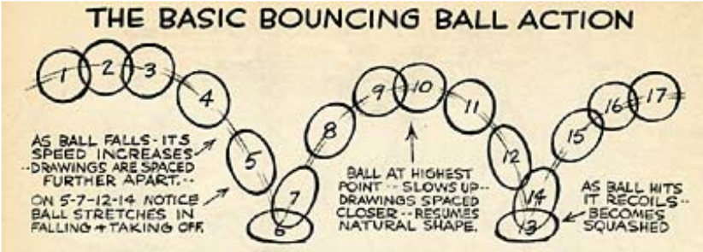
Animation Principles
Replace sudden transitions with smooth ones. (d3.transition() does this well.)
Fiddle with solidity
Exaggerate change (d3’s .ease() options)
Cartoon
by
Preston
Blair
Play with these examples of easing in d3!:

Slide 8
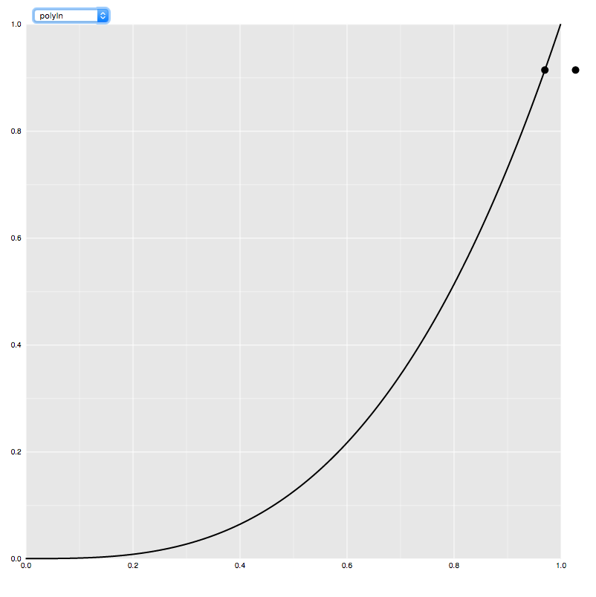
Try it Out
Play with these examples of easing in d3 to get a feel for what they do.

Slide 9
A Few Principles
Change one thing at a time
use staging if need to change more at once
Avoid radical changes
don’t animate hard-to-follow changes
Avoid unnecessary motion
excess motion is confusing
what is constant shouldn’t move
Modified from Fisher, in Beautiful Visualization

Slide 10
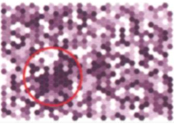
Does Animation Help?
No clear advantage over series of stills (Twersky, Morrison, and Betrancourt, 2002)
Compared to static maps, can help with time or attribute properties more than spatial ones (Lobben, 2008)
Can help users find correct answers faster (Griffin et al., 2006)
Notes:
Twersky, Morrison, and Betrancourt, 2002
reviewed 20+ studies comparing animation vs. sequences of stills
Studies showing an advantage for animation
didn’t compare animation to stills fairly, or
differed in procedure (e.g., use of interaction)
when comparison was fair, animation didn’t help or hurt
Lobben, 2008
Clusters of questions about geographic data learned via static maps or animated maps
Higher percent correct with animation
Significant differences between clusters
less improvement in spatial properties
More improvement in time or attribute properties
Concluded that data properties matter in which is more effective
Griffin et al., 2006, A Comparison of Animated Maps with Static Small-Multiple Maps for Visually Identifying Space-Time Clusters
Showed users randomly generated clusters of dots moving over time
Found higher % correct for animation
but not significant for women alone
Users found correct answers faster w/animation
both men and women were faster

Slide 11


