Slide 1

Utilizing interaction

Slide 2
When is interaction warranted?

Slide 3
Choosing interaction as an encoding

Slide 4
Data encoding constancy
Notes:
(gestalt)

Slide 5
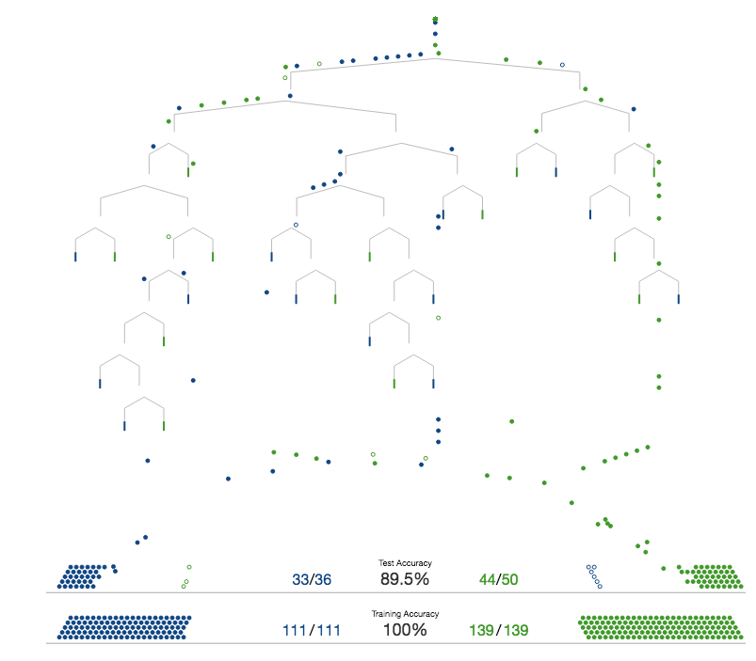
http://www.r2d3.us

Slide 6
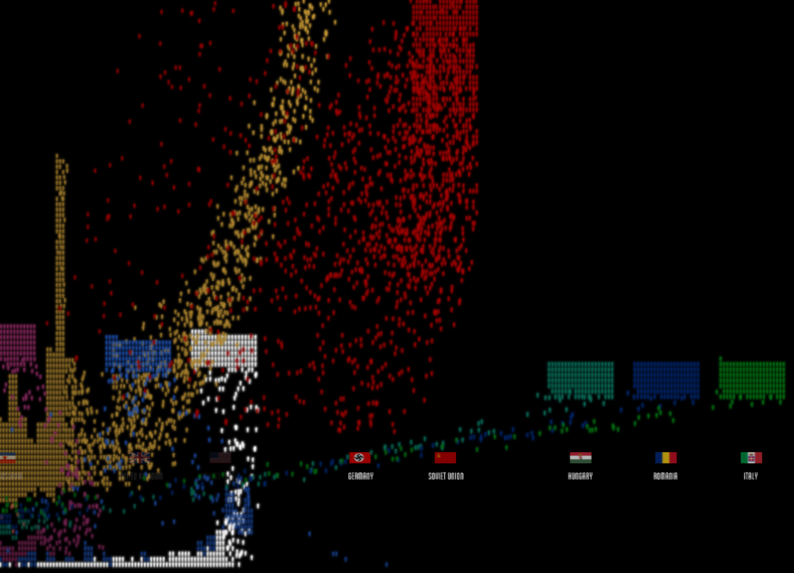
http://www.fallen.io/

Slide 7
How-to
Notes:
(gestalt)

Slide 8
Jupyter + matplotlib
https://blog.dominodatalab.com/interactive-dashboards-in-jupyter/
Notes:
Use the jupyter functionality for

Slide 9
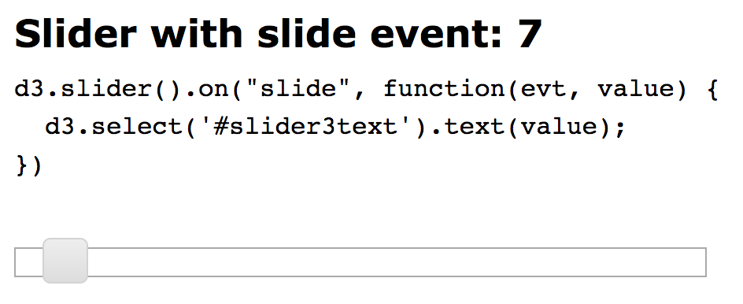
d3-slider
http://thematicmapping.org/playground/d3/d3.slider/

Slide 10


