Slide 1

Dimensionality reduction

Slide 2
Goals of dimensionality reduction
Notes:
high dimensional data, and you want to reduce dimension…perhaps some are redundant
increase ability to draw insight from data

Slide 3
Covariance and independence
Notes:
some things co-vary, and aren’t independent. in this case, the dimension can be hidden

Slide 4
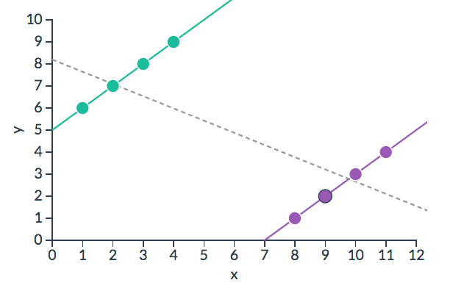
Missing dimensions
http://vudlab.com/simpsons/
Notes:
this is called simpson’s paradox!

Slide 5
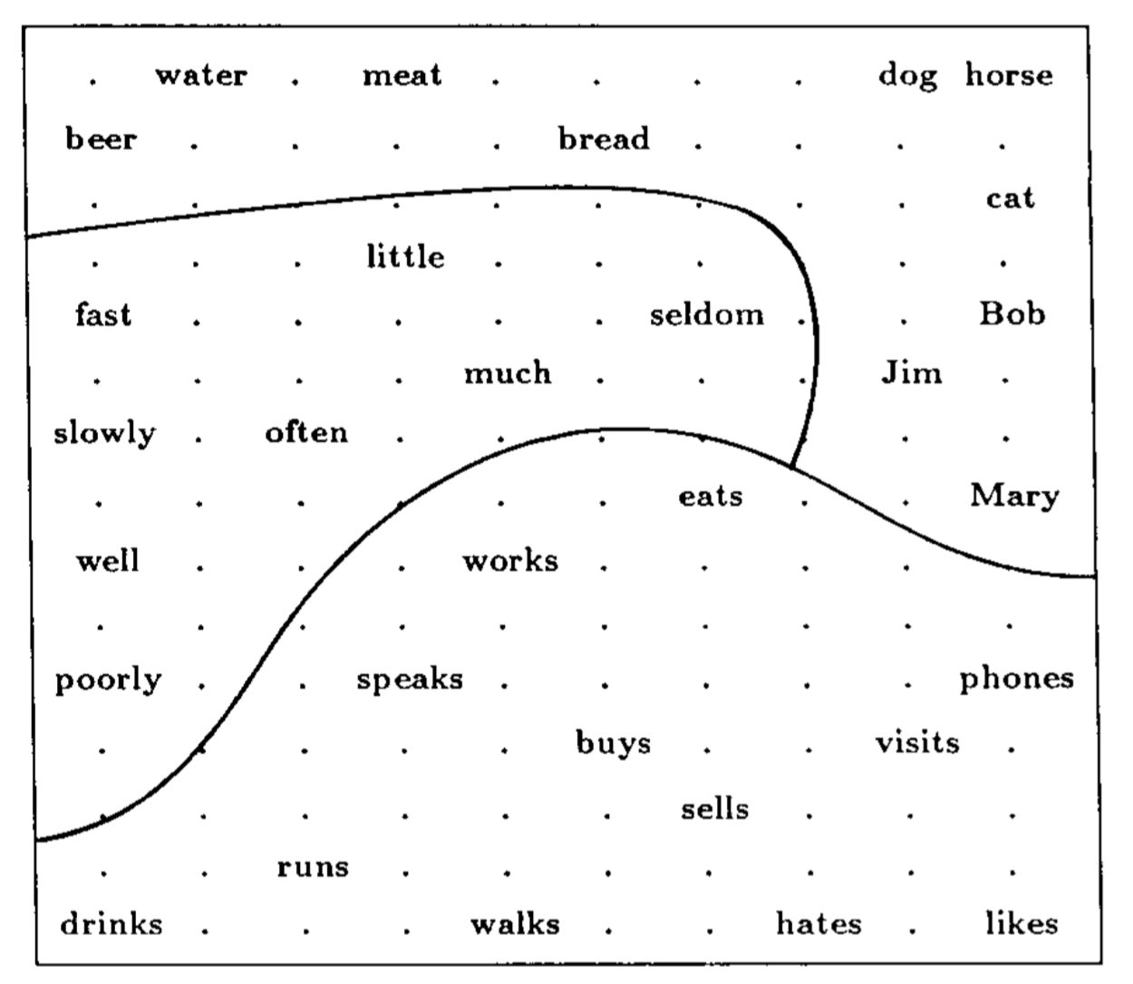
Self-Organizing Maps
Kohonen (1990)
Notes:
old, kohonen

Slide 6


