Slide 1
Animation

Slide 2
Theory

Slide 3
Animation: creating the illusion of change or movement
Not the same as interaction (which is user controlled)

Slide 4
Uses
Show dynamic process in real time
Show variation of a value over time
Navigate a virtual space
Draw user’s attention
Indicate UI activity (folder opening, waiting)

Slide 5
Reasons to Use
It’s engaging
It can represent another dimension (time)
It draws attention powerfully
It helps user retain context

Slide 6
Reasons Not to Use
"It’s cool"
It requires replaying for analysis
It draws attention powerfully
It may add to cognitive load

Slide 7
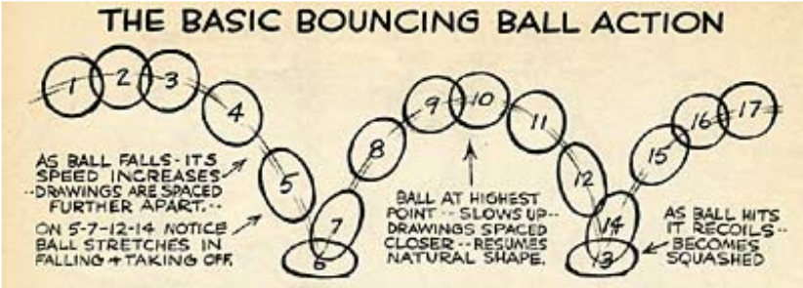
Animation Principles
Replace sudden transitions with smooth ones.
Fiddle with solidity
Exaggerate change

Slide 8
A Few Principles
Change one thing at a time
use staging if need to change more at once
Avoid radical changes
don’t animate hard-to-follow changes
Avoid unnecessary motion
excess motion is confusing
what is constant shouldn’t move
Modified from Fisher, in Beautiful Visualization

Slide 9
Examples

Slide 10
Studies

Slide 11
Animation: Can it Facilitate?
Twersky, Morrison, and Betrancourt, 2002
reviewed 20+ studies comparing animation vs. sequences of stills
Studies showing an advantage for animation
didn’t compare animation to stills fairly, or
differed in procedure (e.g., use of interaction)
when comparison was fair, animation didn’t help or hurt

Slide 12
Influence of Data Properties on Animated Maps
Lobben, 2008
Clusters of questions about geographic data learned via static maps or animated maps
Higher percent correct with animation
Significant differences between clusters
less improvement in spatial properties
More improvement in time or attribute properties
Concluded that data properties matter in which is more effective

Slide 13
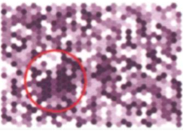
A Comparison of Animated Maps with Static Small-Multiple Maps
Griffin et al., 2006, A Comparison of Animated Maps with Static Small-Multiple Maps for Visually Identifying Space-Time Clusters
Showed users randomly generated clusters of dots moving over time
Found higher % correct for animation
but not significant for women alone
Users found correct answers faster w/animation
both men and women were faster

