Slide 1

Connecting to Data

Slide 2
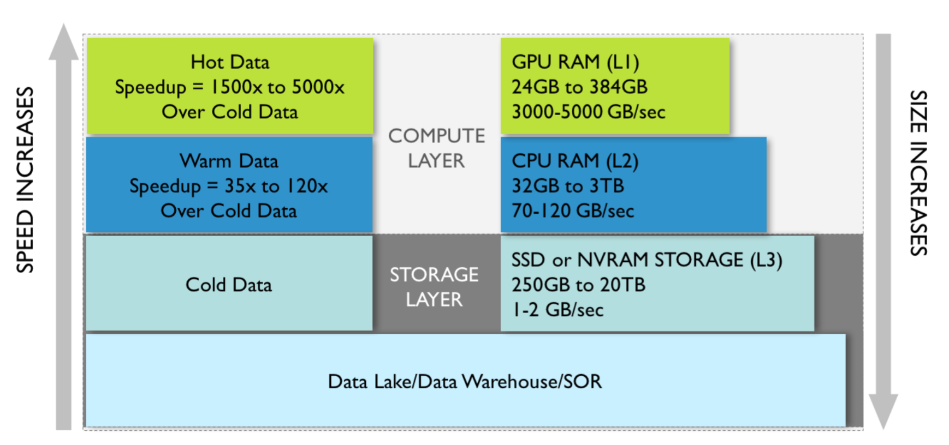
Storage, processing, plotting

Slide 3
Connecting to data in EDA

Slide 4
Scientific visualization tools
Notes:
ParaView, etc, to run across multiple clusters.
MapD

Slide 5
Tableau, Python
Notes:
One of the most powerful features of Tableau!
Practical limit is around 10GB.
Spark- in memory vs. disk

Slide 6
Optimizing for explanatory vis

Slide 7
Browser loading
Notes:
We ended with this before, and now the JS has to get the data!
Compression across browsers

Slide 8


