Slide 1

Minimizing elements

Slide 2
Minimizing elements

Slide 3
Strategies
Simple: remove non-essentials

Slide 4
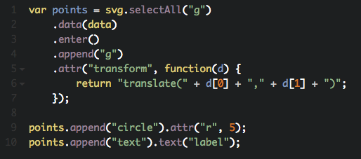
Remove non-essentials

Slide 5
Strategies
Simple: remove non-essentials
Use canvas backend

Slide 6
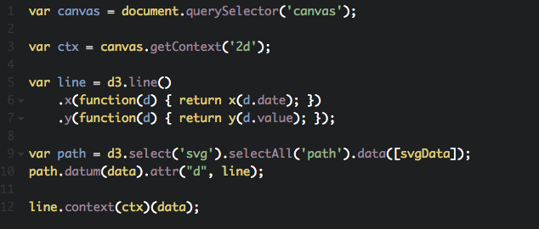
Use canvas backend

Slide 7
Strategies
Remove non-essentials
Use canvas backend
Filter data

Slide 8
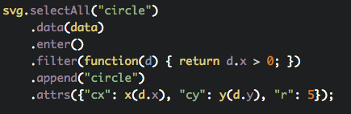
Filter data

Slide 9
Strategies
Remove non-essentials
Use canvas backend
Filter data
Use paths instead of many elements

Slide 10
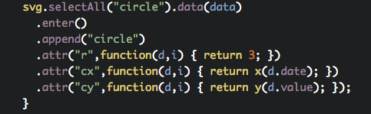
Using paths

Slide 11
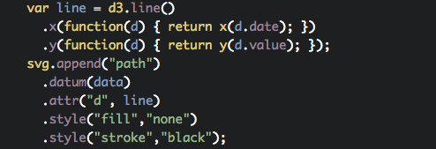
Using paths

Slide 12


