Slide 1

Update pattern

Slide 2
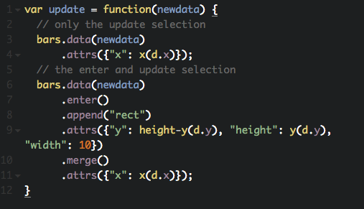
Using update pattern

Slide 3


