Slide 1

Time line debugging

Slide 2
Using timeline
Inside web inspector, open time line tab

Slide 3
Using timeline
Inside web inspector, open time line tab
Refresh to save data

Slide 4
Using timeline
Inside web inspector, open time line tab
Refresh to save data
Use event log to search for function call

Slide 5
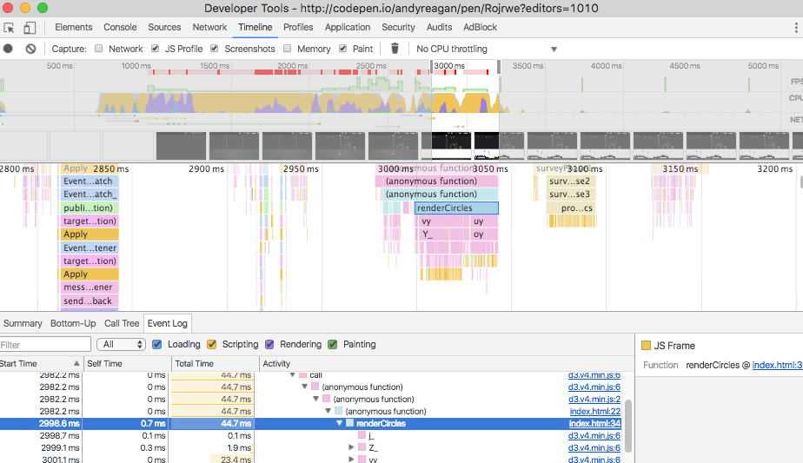
Using timeline

Slide 6
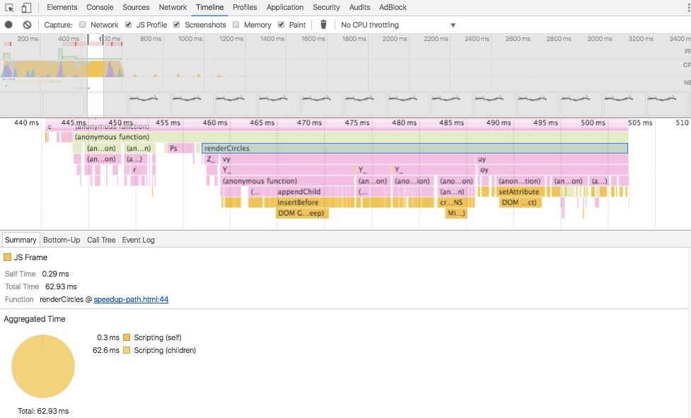
Using timeline

Slide 7


