Slide 1

Trees & Hierarchies

Slide 2
Tree Node Structure
Root node
Internal nodes
Leaf nodes

Slide 3
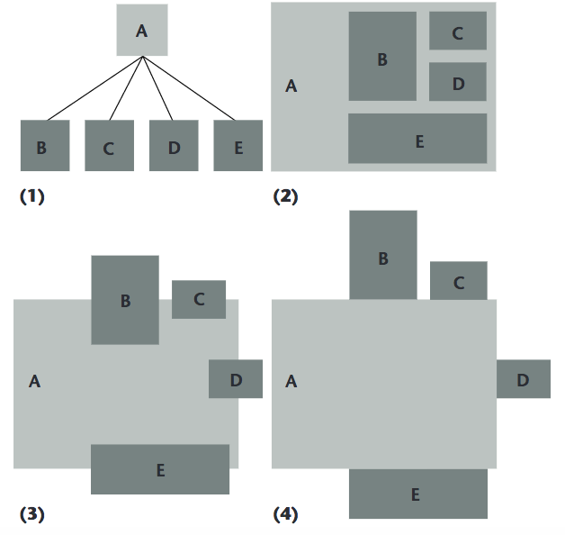
Edge Representation
Diagram Source: Schulz, H. J. (2011). Treevis. net: A tree visualization reference. IEEE Computer Graphics and Applications, 31(6), 11-15.
Notes:
Implicit or explicit
https://www.researchgate.net/profile/Hans-Joerg_Schulz/publication/262149604_Treevisnet_A_Tree_Visualization_Reference/links/546f1d440cf29806ec2f20d5.pdf

Slide 4
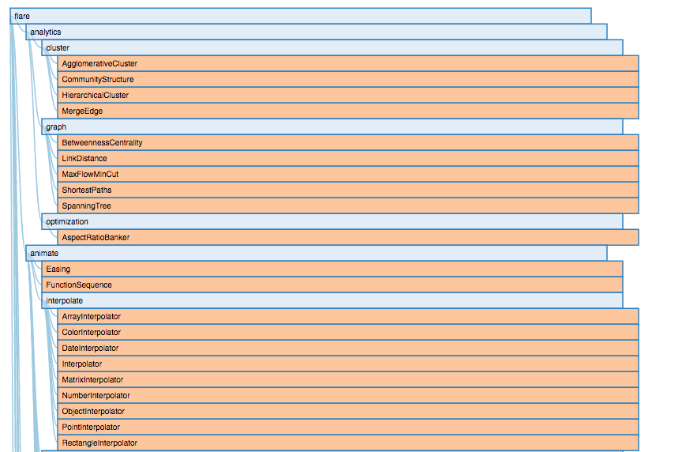
Indented Tree / Tree List
https://bl.ocks.org/mbostock/1093025
Notes:
Most commonly seen in file browsers such as Microsoft Explorer
https://github.com/d3/d3-hierarchy

Slide 5
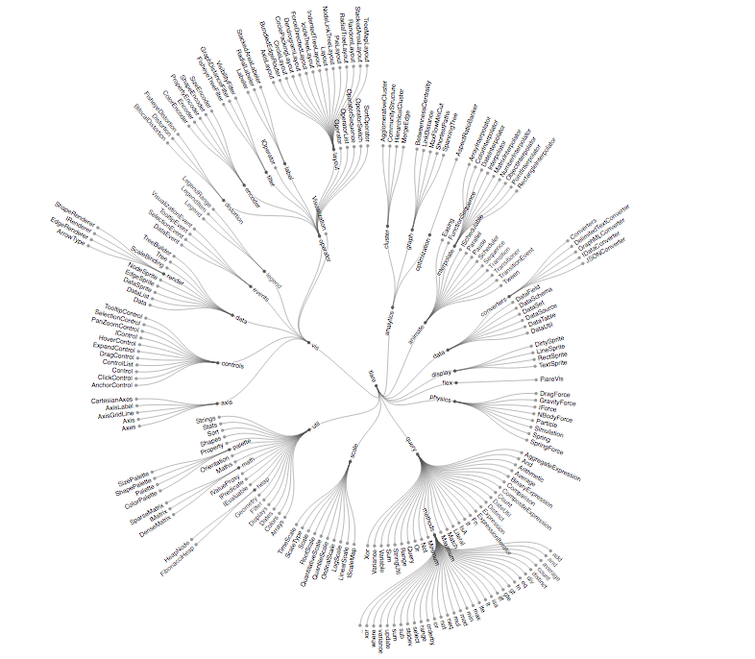
Radial Node Link
https://bl.ocks.org/mbostock/4063550

Slide 6
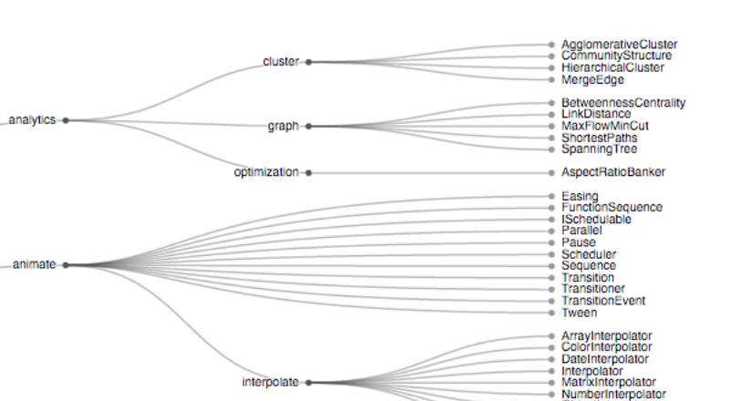
Dendogram
https://github.com/d3/d3-hierarchy
Notes:
Dendogram is a node link where all the Less compact than radial node link but good for when all the tree leaves are at the same level.

Slide 7
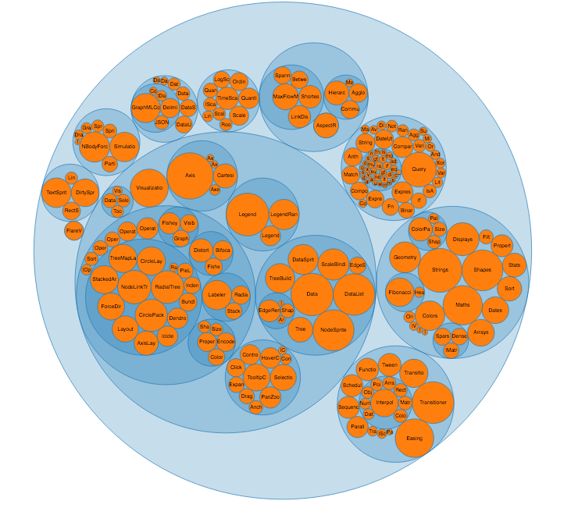
Nested Circles
http://bl.ocks.org/mbostock/4063530

Slide 8
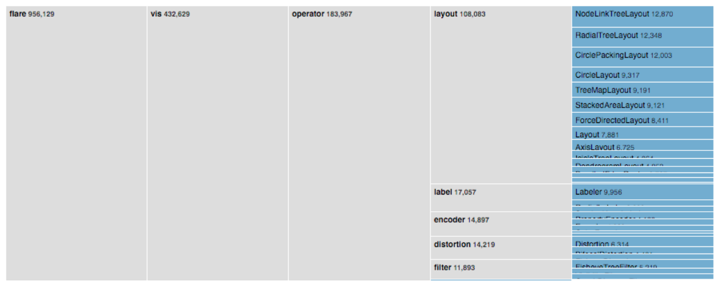
Partition
https://github.com/d3/d3-hierarchy
Notes:
Similar to node link but saves space.

Slide 9
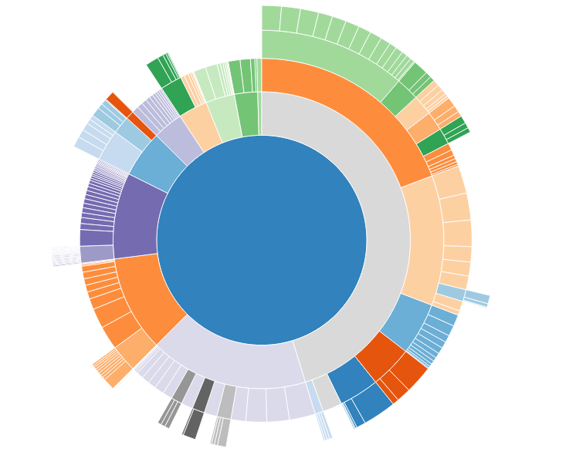
Sunburst
http://bl.ocks.org/mbostock/4348373

Slide 10
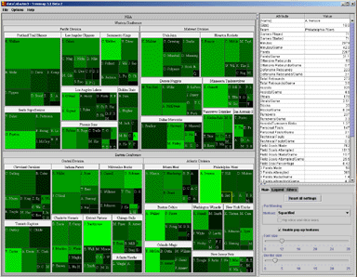
Treemaps
Good for:
Saving space
Seeing entire tree
Seeing large/ small
Challenging:
Depth accuracy
Chart Source: http://www.cs.umd.edu/hcil/treemap/index.shtml
Notes:
Introduced by Ben Shneiderman in 1991, a treemap recursively subdivides area into rectangles according to each node’s associated value. Uses enclosure to encode hierarchy similar to

Slide 11
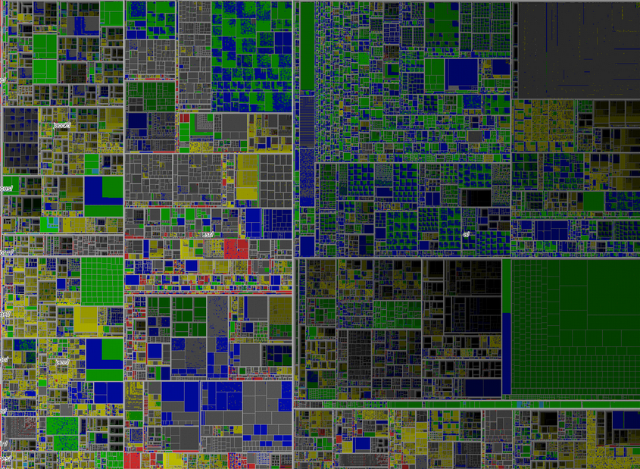
Scaling Treemaps
Goal: Show 1 million items effectively
Used:
Shading
Transparency,
Stereo-vision
Animation
[Fekete & Plaisant, 2002]
http://www.cs.umd.edu/hcil/VisuMillion/

Slide 12
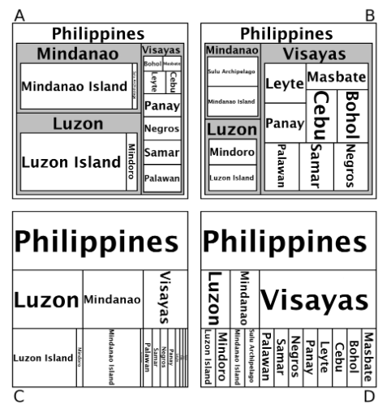
Labels
Notes:
http://iihm.imag.fr/blanch/teaching/infovis/readings/2010-McGuffin-Tree_Representation_Efficiency.pdf

Slide 13
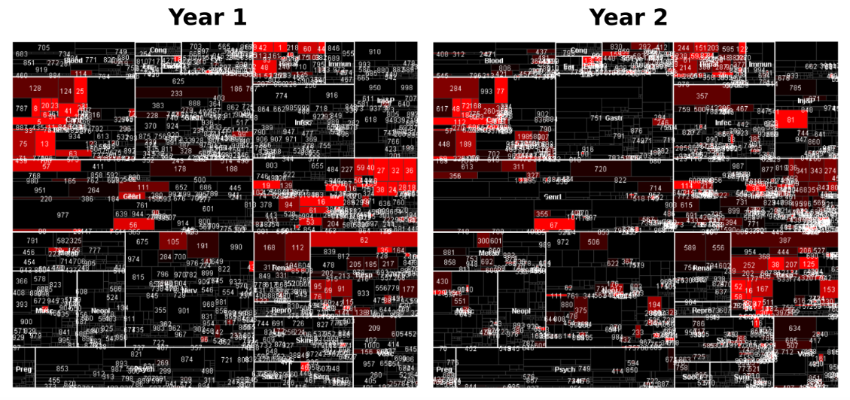
Comparison - Poor
Diagram Source: Guerra Gomez, J., Pack, M., Plaisant, C., & Shneiderman, B. Visualizing changes over time in datasets using dynamic hierarchies.
Notes:
http://hcil2.cs.umd.edu/trs/2013-06/2013-06.pdf

Slide 14
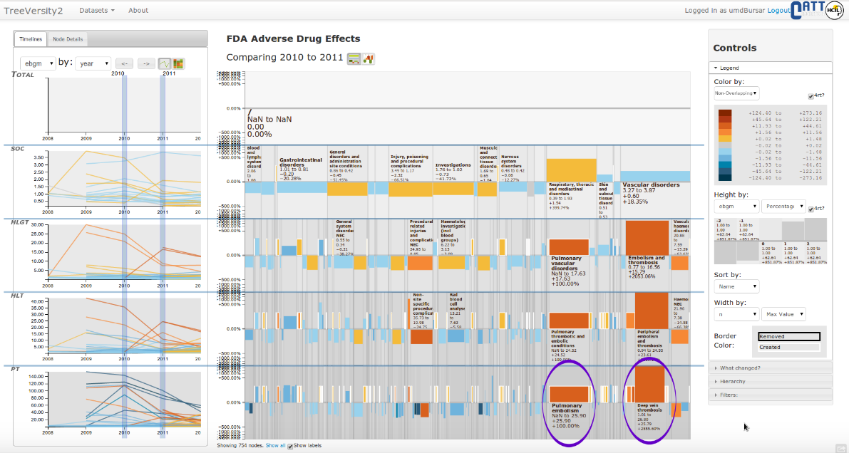
Comparison – Better
Diagram Source: Guerra Gomez, J., Pack, M., Plaisant, C., & Shneiderman, B. Visualizing changes over time in datasets using dynamic hierarchies.
Notes:
Fig. 8. Changes in the FDA’s EBGM index of adverse effects (e.g. Pulmonary Embolism) for a non-disclosed drug between 2011 and 2010. Using
the StemView analysts were able to identify two relevant adverse effects that received more reports than expected for 2011,
Pulmonary Embolism
that wasn’t reported in 2010 (i.e. created node denoted with white border) and
Deep Vein Thrombosis
. The EBGM index is distributed in a fixed,
non-aggregated tree and it is a measure of how many more reports than expected are received for a certain adverse effect. A value of 1.0 indicates
that the expected number of reports for a certain adverse effect were received, decreasing values are good. The change of each the index is
shown using the height of the boxes, so boxes going up are effect getting worse and boxes going down the opposite. The width of the boxes in the
StemView represents the total number of reports, so wide boxes are more important. The color was specially crafted to meet a special requirement
from the FDA, to highlight adverse effects with non-overlapping confidence intervals (shown on yellow and red). Therefore, analysts searched for
wide, red/yellow boxes going up.
http://hcil2.cs.umd.edu/trs/2013-06/2013-06.pdf

Slide 15
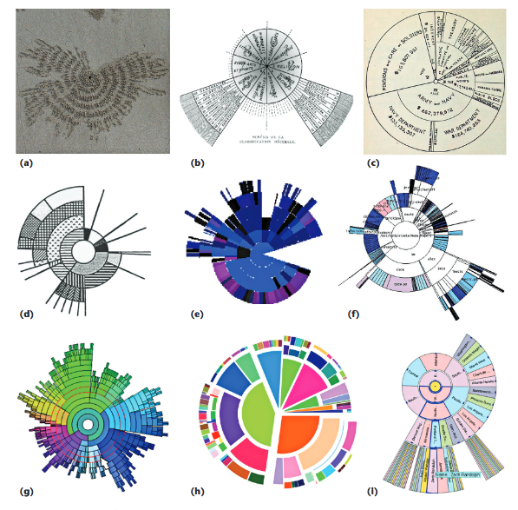
Design Guidelines
Diagram Source: Schulz, H. J. (2011). Treevis. net: A tree visualization reference. IEEE Computer Graphics and Applications, 31(6), 11-15.
Notes:
https://www.researchgate.net/profile/Hans-Joerg_Schulz/publication/262149604_Treevisnet_A_Tree_Visualization_Reference/links/546f1d440cf29806ec2f20d5.pdf

Slide 16
Selecting a Layout
Consider the data: node number, depth, and ordering
Rectilinear or radial layout

Slide 17

Label Visibility
Match label and leaf-node aspect ratio
Orient labels appropriately
McGuffin, M. J., & Robert, J. M. (2010). Quantifying the space-efficiency of 2D graphical representations of trees. Information Visualization, 9(2), 115-140.
Notes:
Match label and leaf-node aspect ratio to that of the labels
Modify labels to match the aspect ratio of nodes
Orient labels to be perpendicular when possible
Radial representations labels should be along radial lines
If not using enclosure, layout skinny leaf nodes along a curve as long as possible
http://iihm.imag.fr/blanch/teaching/infovis/readings/2010-McGuffin-Tree_Representation_Efficiency.pdf

Slide 18
Interactions
Use interaction capabilities to save space when appropriate
Zoom
Collapsible
Hover over

Slide 19
When in doubt, test it!
Notes:
When in doubt, test prototypes of several possible designs!

Slide 20


