Slide 1

Information Graphics

Slide 2
What is an infographic?

Slide 3
Some Definitions
Explanation graphics (Holmes)
Stories, narrative (Visual.ly, Segel & Heer)
Journalism + data + design (Vital)
Functional art (Cairo)
Notes:
Nigel Homes, prominent designer of infographics in popular press of /70s and 80s
Edward Segel and Jeffrey Heer, Visual.ly web site
Anna Vital, also stresses visual analogy
Alberto Cairo (book The Functional Art)

Slide 4
Cairo's Continuum
Infographics
Visualization
Presentation
Exploration

Slide 5
A More Inclusive Approach
Visualization
Presentation
Exploration
Infographics

Slide 6
A Practical Definition
Infographic: an explanatory visualization of data or ideas that uses visual analogies to convey complex information in a manner that is easily understood.
—Mark Smiciklas
Notes:
From book, The Power of Infographics

Slide 7
A Practical Difference
“What is the key difference between a visualization and a data-based infographic? The visualization is created by a program that can be applied to many datasets, the infographic is hand-crafted for a particular dataset.”
—Robert Kosara

Slide 8
Possible Goals
Explain something specific
Aid understanding by visual means
Attract attention (“go viral”)
Notes:
Goal: aid understanding, convey meaning

Slide 9
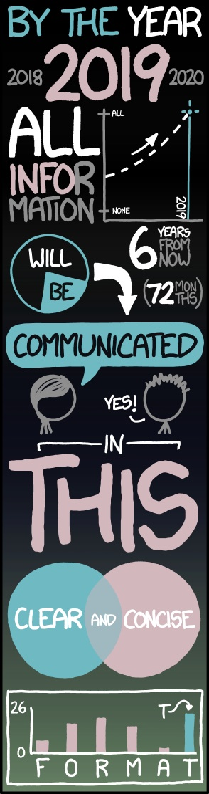
Not the Goal
Aesthetically pleasing images that don't add to meaning
Randall Munroe, XKCD
Notes:
“tarting things up” isn’t a good objective

Slide 10
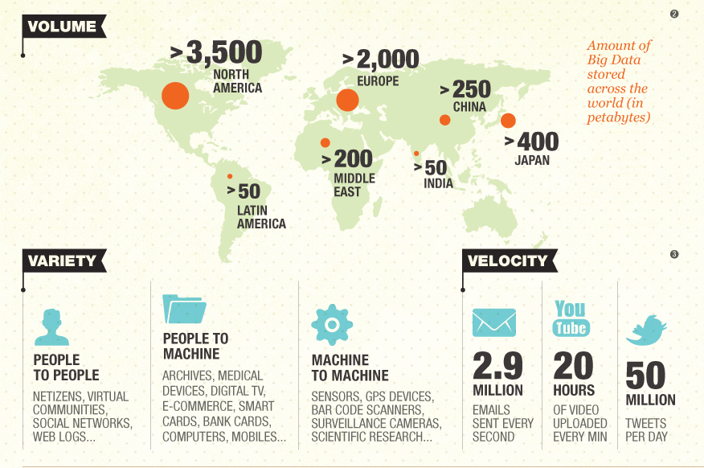
Wipro Ltd.
Notes:
https://s-media-cache-ak0.pinimg.com/originals/a0/35/1c/a0351c5a8c2bc454c352075e7669300b.jpg
How much info do you get from this? How helpful are the graphics?

Slide 11
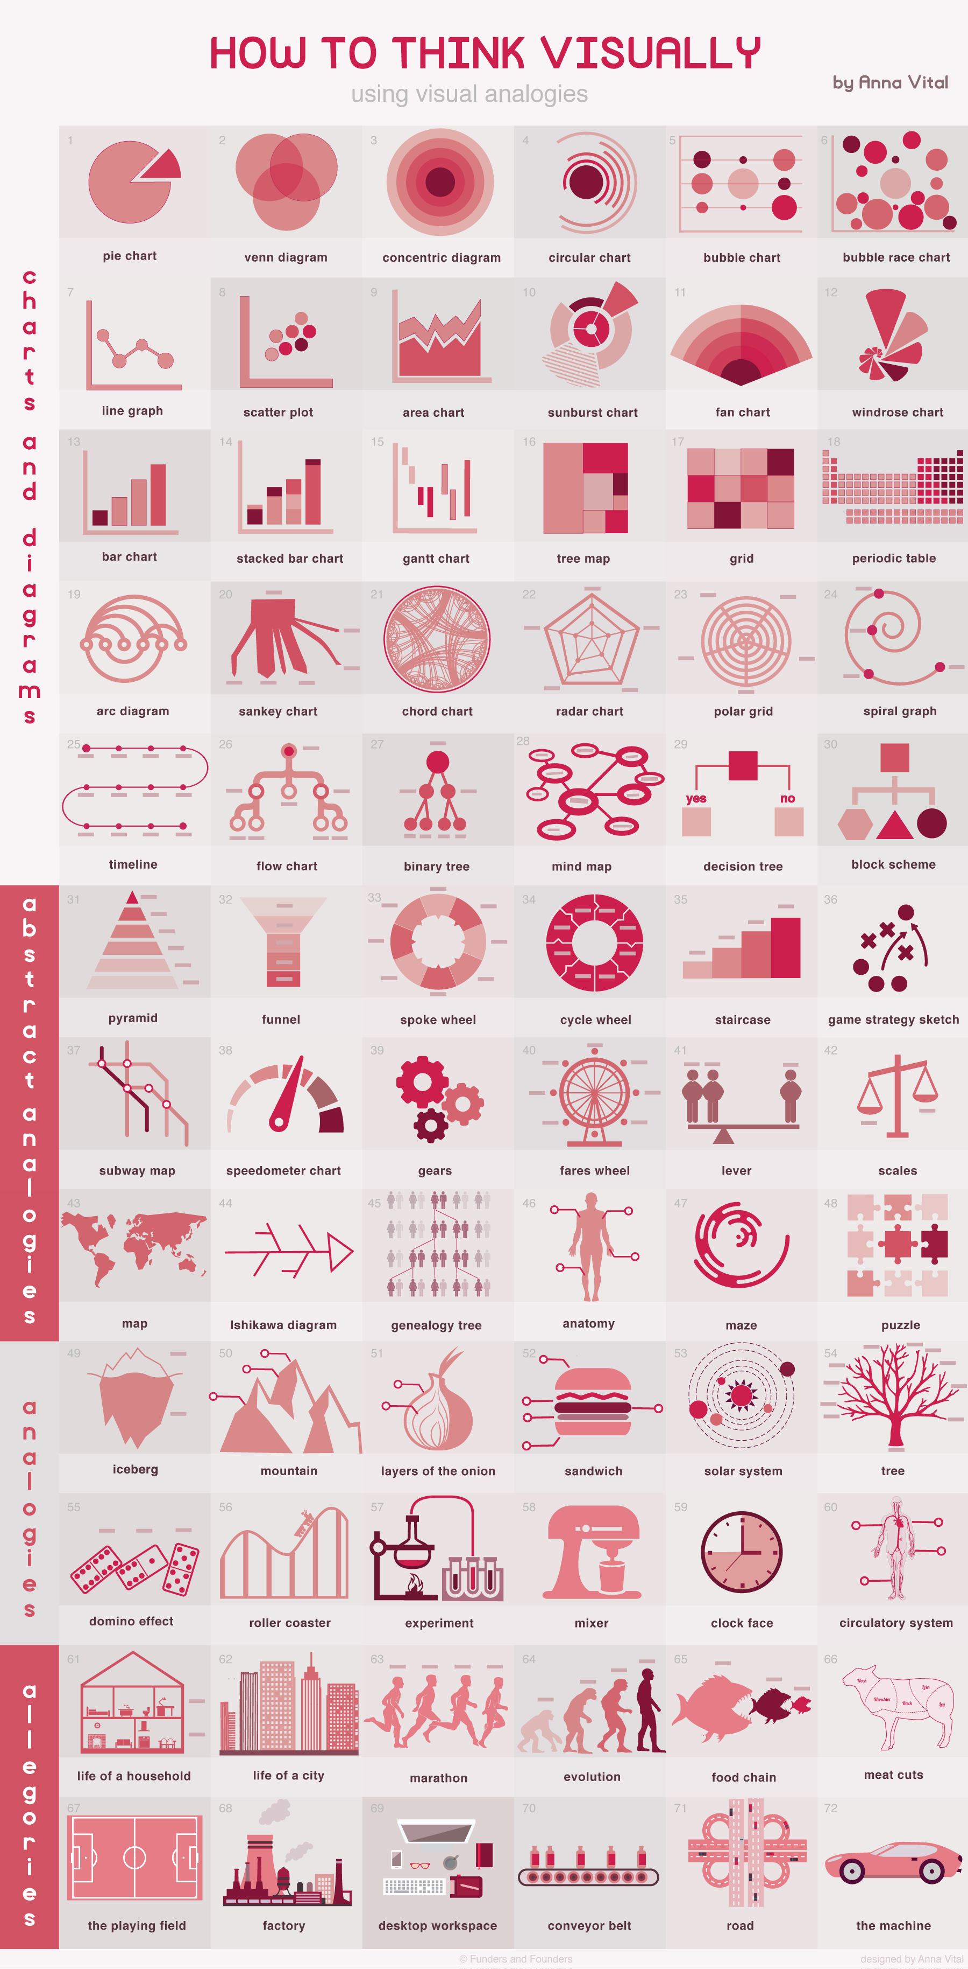
Visual Analogies
Anna Vital
http://anna.vc/image/112863438962
Notes:
Represent the story with visual analogies
Chart by Anna Vital shows options to get you thinking
See link for high-res version
Note that this infographic itself uses icons that are good visual abstractions of the analogies

Slide 12
Visual Analogies
Notes:
Zooming in…
Top to bottom, more to less abstract
Charts and diagrams section can be helpful for picking overall shape

Slide 13
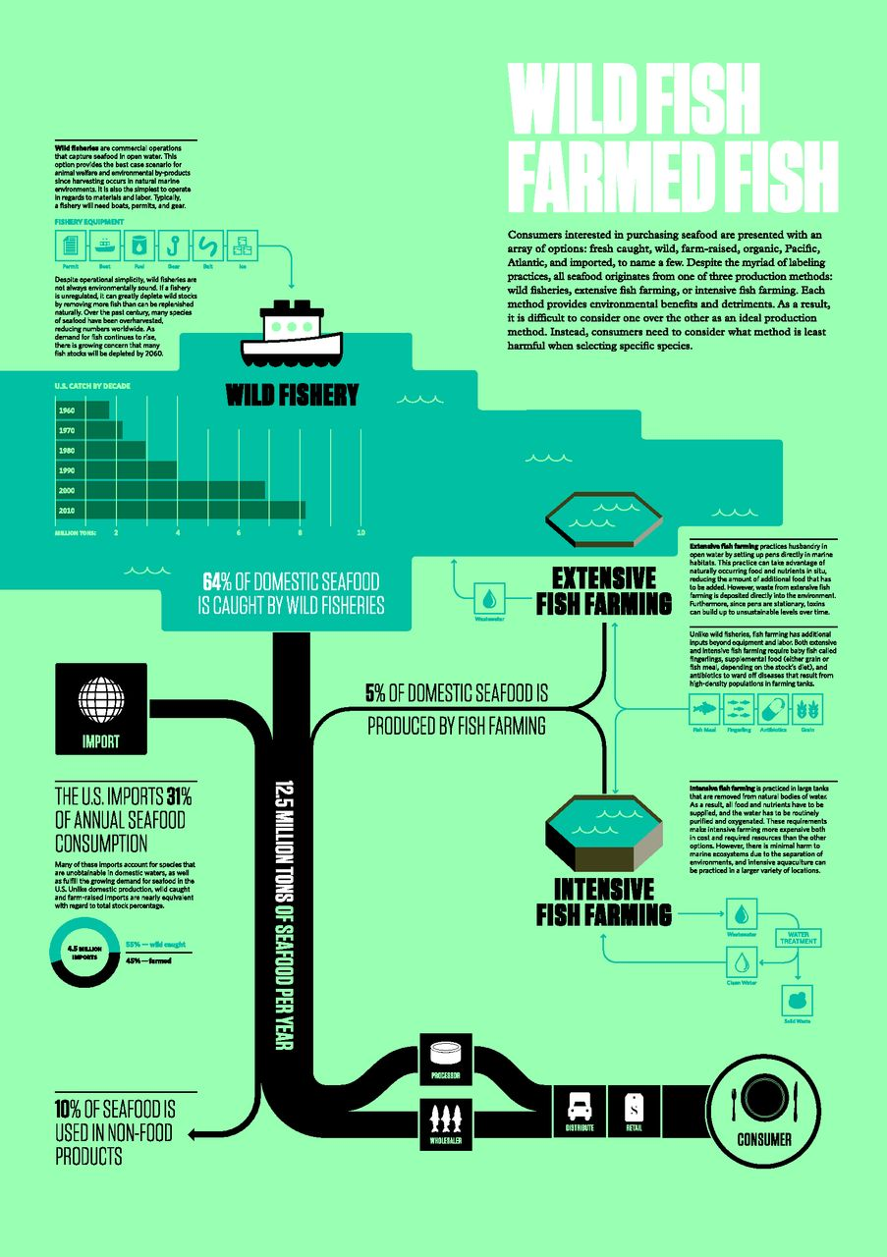
Jennifer J. Otten et al. Health Aff 2015;34:1901-1907
Notes:
Bear with me, don’t worry about reading small text. Here, a Sankey diagram is the overall structure, visual analogy with breakdown of sources.

Slide 14
Revisiting Chart Junk
What about the data-ink ratio?
Notes:
Remember the data ink ratio – interested in quantitative comparison

Slide 15
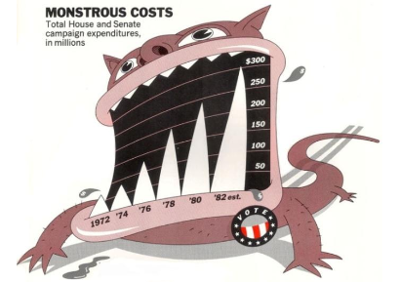
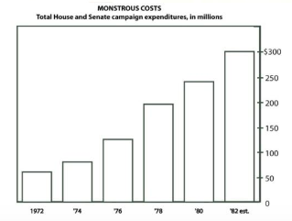
Revisiting Chart Junk
Bateman et al, 2010. Useful junk?: The effects of visual embellishment on comprehension and memorability of charts.
Notes:
Bateman study looked at comprehension and recall. Comprehension was no worse with infographic, and long-term retention was significantly better.

Slide 16
Icons & Images

Slide 17




Icons
Follow icon standards
Be aware of cultural differences
Avoid ambiguity
Be aware of how context affects meaning
Use a consistent style

Slide 18
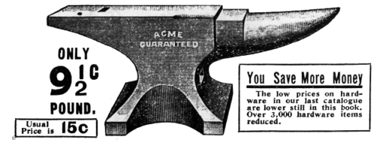
Use literal analogies
Make an abstract idea concrete
Notes:
Weight = abstract concept, anvil = concrete object
Show, don't tell
What you need to do with images as well as icons
BTW, this is what good poetry does as well.

Slide 19
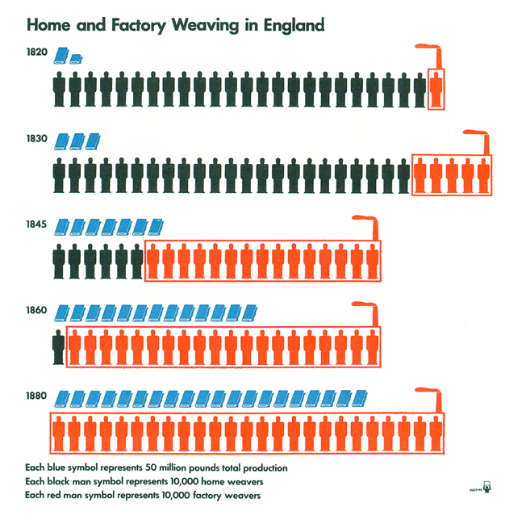
ISOTYPE
International System Of TYpographic Picture Education
Otto and Marie Neurath, Gerd Arntz
Notes:
Developed in late 1920s Vienna. Neuraths wanted to educate the public about economics, statistics. Invented style of visualization based on repeated icons.

Slide 20
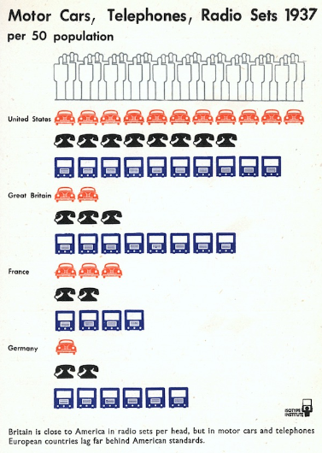

Slide 21
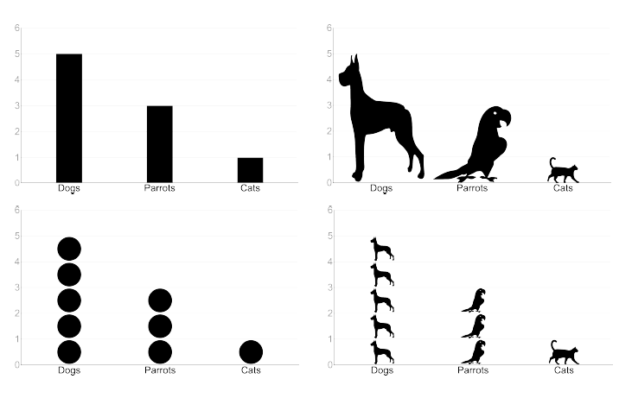
Is ISOTYPE Effective?
Haroz, Kosara, Franconeri, ISOTYPE Visualization—Working Memory, Performance, and Engagement with Pictographs, CHI 2015
Notes:
Steve Haroz, Robert Kosara, Steven L. Franconeri, ISOTYPE Visualization—Working Memory, Performance, and Engagement with Pictographs, CHI 2015
showed people isotype-style graphs (repeated small icons) vs bar graph, sized large icons, multiple circles, bar graph with distracting background
Tested memory, comprehension, engagement
Isotype was easier to read and compare, as long as number was low
Icons increased memory
Icons as labels were worse than words
Distracting background was bad for reading performance, memory

Slide 22
Is ISOTYPE Effective?
Repeated small icons were easier to read & compare
Increased memorability
Words were better than icons as labels
Complex backgrounds were bad for performance, memory
Haroz, Kosara, Franconeri, ISOTYPE Visualization—Working Memory, Performance, and Engagement with Pictographs, CHI 2015
Notes:
Steve Haroz, Robert Kosara, Steven L. Franconeri, ISOTYPE Visualization—Working Memory, Performance, and Engagement with Pictographs, CHI 2015
showed people isotype-style graphs (repeated small icons) vs bar graph, sized large icons, multiple circles, bar graph with distracting background
Tested memory, comprehension, engagement
Isotype was easier to read and compare, as long as number was low
Icons increased memory
Icons as labels were worse than words
Distracting background was bad for reading performance, memory

Slide 23
Icon Sources
The Noun Project (https://thenounproject.com)
Flat Icon (http://www.flaticon.com)
Glyphicons (http://glyphicons.com, used in Bootstrap)
AIGA/USDOT (http://www.aiga.org/symbol-signs/)
Google searches
Make your own in Illustrator or Inkscape
Notes:
Noun project, flat icon, glyphicons are big collections. AIGA/USDOT is signage icons, an example of a domain specific collection.

Slide 24
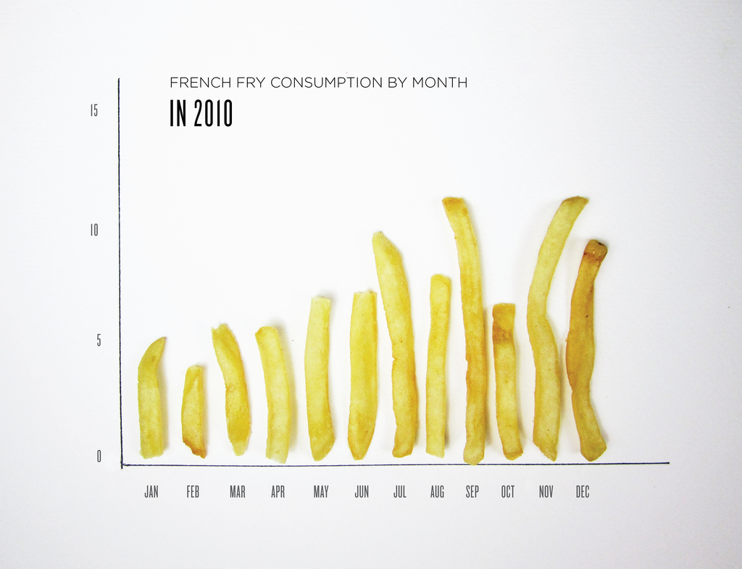
Lauren Manning, https://www.flickr.com/photos/laurenmanning/5658951917/
Notes:
Photo realism? Quantified self

Slide 25
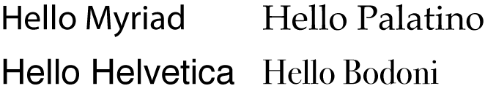
Good Typography Helps
Stick to 1 or 2 typefaces
Mix fonts carefully (use same font family unless you want contrast)
Keep line lengths short
Use white space
Notes:
The type samples are all the same point size. Sans serif on left, serif on right. Notice differences in shapes of e and o, serif, letter widths
Short line lengths are easier/faster to read.
White space prevents visual clutter.

Slide 26
Infographics & Icons are Good for:
Simplifying complex ideas, relationships, or processes
Improved long term retention (if used effectively)
Viewer enjoyment & engagement

Slide 27
Research is Mixed
3D takes longer to evaluate
High data-ink ratio correlates with faster response and greater accuracy
OR no significant difference
Notes:
The research is mixed; generally minor design embellishments could be Okay. Talk about these studies a bit.

Slide 28
Be Mindful of:
Whether quick quantitative comparisons are necessary. If so, don’t use infographic form
Finding good visual analogies
Using graphical icons that match the data story
Notes:
Mention Gestalt again

Slide 29


