Slide 1

New Narratives
Subtitle goes here

Slide 2
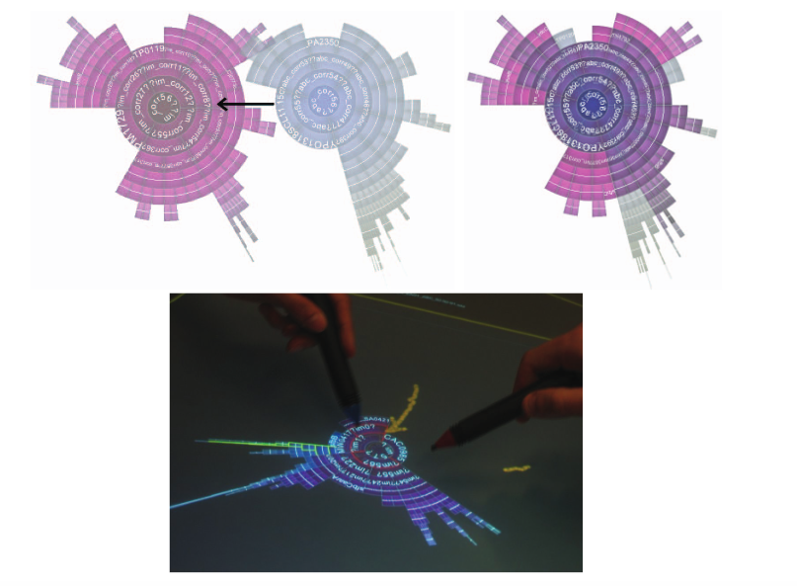
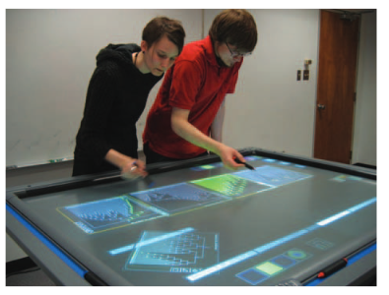
Collaborative Annotation
Isenberg, P., & Carpendale, S. (2007). Interactive tree comparison for co-located collaborative information visualization. IEEE Transactions on Visualization and Computer Graphics, 13(6), 1232-1239.
Notes:
http://innovis.cpsc.ucalgary.ca/innovis/uploads/Courses/TableTopDetails2009/Isenberg2007.pdf
Instead of communicating a known narrative, more similar to improvisational techniques – narrative forms as you go.

Slide 3
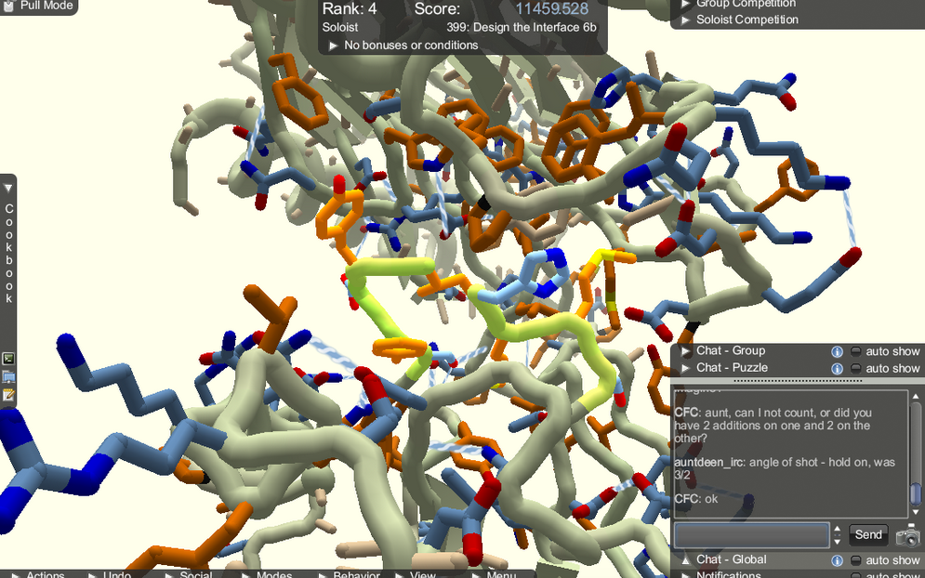
Image Source: https://web.cs.wpi.edu/~rich/courses/imgd4600-c15/analyses/foldit/index.html
Notes:
FIND NEW FOLDIT IMAGE. Pushing the boundaries, here we see a useful 3D where

Slide 4
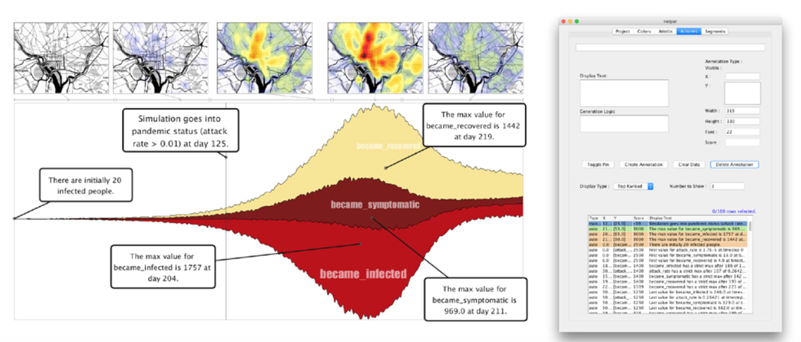
Temporal Summary Images
Bryan, C., Ma, K. L., & Woodring, J. (2017). Temporal Summary Images: An Approach to Narrative Visualization via Interactive Annotation Generation and Placement. IEEE Transactions on Visualization and Computer Graphics, 23(1), 511-520.
Notes:
Annotation generation

Slide 5
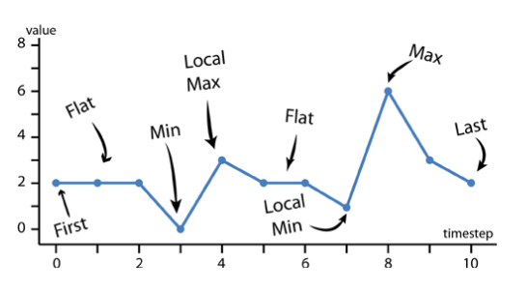
Time Series
Bryan, C., Ma, K. L., & Woodring, J. (2017). Temporal Summary Images: An Approach to Narrative Visualization via Interactive Annotation Generation and Placement. IEEE Transactions on Visualization and Computer Graphics, 23(1), 511-520.

Slide 6
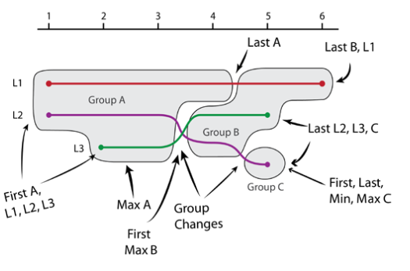
Storyline
Bryan, C., Ma, K. L., & Woodring, J. (2017). Temporal Summary Images: An Approach to Narrative Visualization via Interactive Annotation Generation and Placement. IEEE Transactions on Visualization and Computer Graphics, 23(1), 511-520.

Slide 7
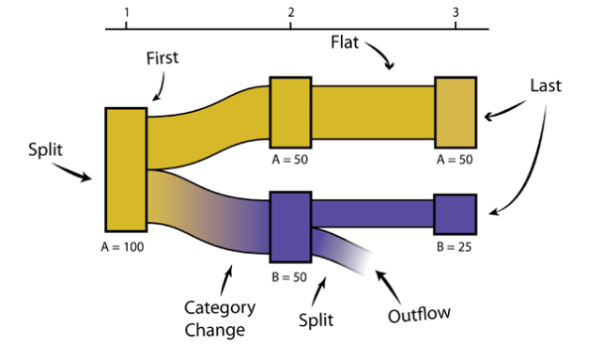
Alluvial
Bryan, C., Ma, K. L., & Woodring, J. (2017). Temporal Summary Images: An Approach to Narrative Visualization via Interactive Annotation Generation and Placement. IEEE Transactions on Visualization and Computer Graphics, 23(1), 511-520.

Slide 8
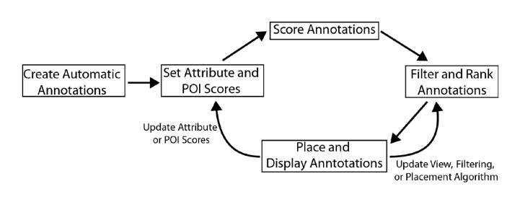
Bryan, C., Ma, K. L., & Woodring, J. (2017). Temporal Summary Images: An Approach to Narrative Visualization via Interactive Annotation Generation and Placement. IEEE Transactions on Visualization and Computer Graphics, 23(1), 511-520.

Slide 9
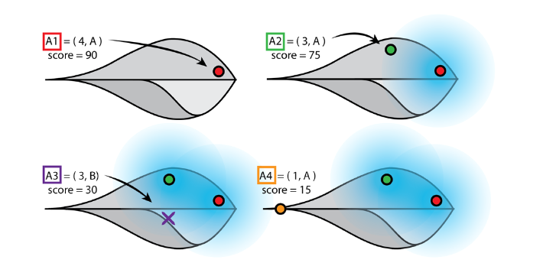
Placement Algorithm
Bryan, C., Ma, K. L., & Woodring, J. (2017). Temporal Summary Images: An Approach to Narrative Visualization via Interactive Annotation Generation and Placement. IEEE Transactions on Visualization and Computer Graphics, 23(1), 511-520.

Slide 10
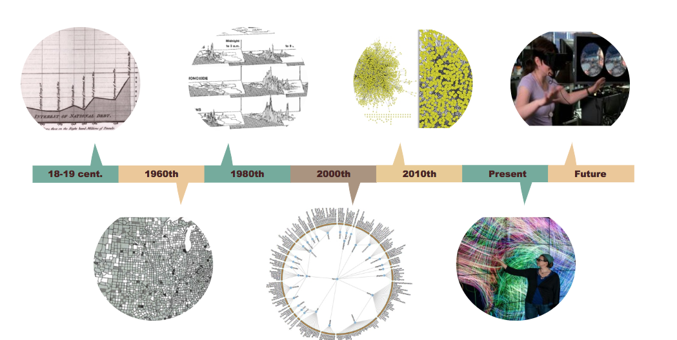
[placeholder image]

Slide 11
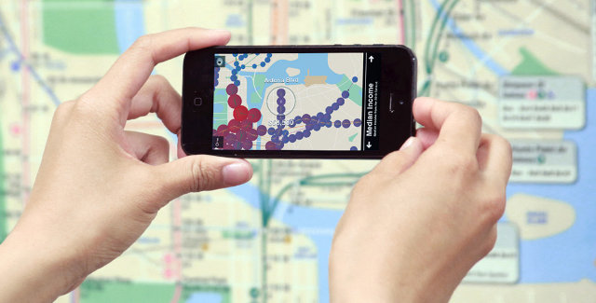
A Mixed Reality
[placeholder image]
Notes:
Need further experiments into how this mixed reality impacts perception E.g. what is front and center in a dedicated space may need to be peripheral when interacting with heavy machinery etc.

Slide 12
Contextual Data
Design Grammar / Code
Annotations
Contextual Metadata (activities, location, text/speech, biosignal, etc.)
Notes:
On the design decisions and process, what was found or used

Slide 13
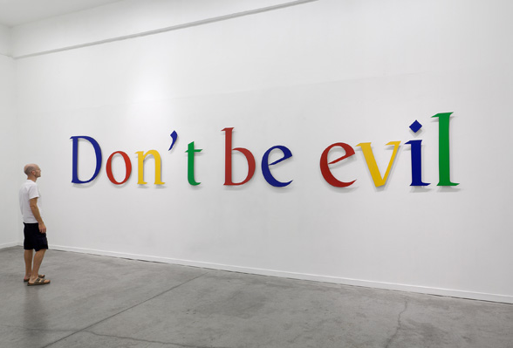
Image Source: http://ctj.org/images/2014/googleevil.jpg

Slide 14
[Placeholder for image]
Notes:
Be awesome! Visualization is one of the most powerful, use these combined with other data sources to harness for good.

Slide 15


