Slide 1
Evolutie fizica prin algoritmi genetici

Slide 2
Full control
Head & Headless mode

Slide 3
Algoritmul Genetic
Cromozom
Funtie Fitness
Selectie
Crossover
Mutatie

Slide 4
Cromozom
Solutia cautata
Reprezentare binara
4 numere
Fx, Fy, Fz ∈ [0,63]
μ ∈ [0,7]

Slide 5
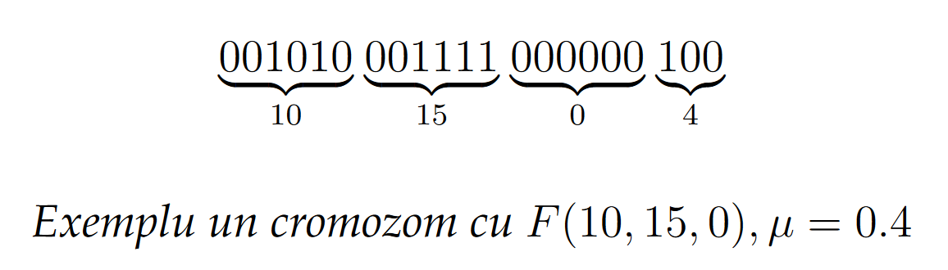

Slide 6
Functia Fitness
F(x) = dt
F(x) = d(x) * dt
dt = elapsed time
dx = distance from target

Slide 7
Tourney selection
Randomly choose n participants
Select the first and second place to pass their genes
Run 1-4 tournaments per generation

Slide 8
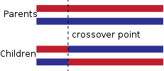
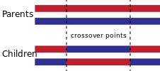
Crossover
Single Point CrossOver
Two Point CrossOver

Slide 9
Mutation
Uniform single bit mutation
Partial Mutation

Slide 10
Results

Slide 11
Fixed Optimum

Slide 12
Dynamic Optimum

