Slide 1

CPEN 311: Digital Systems Design
Introduction to Lab 4

Slide 2
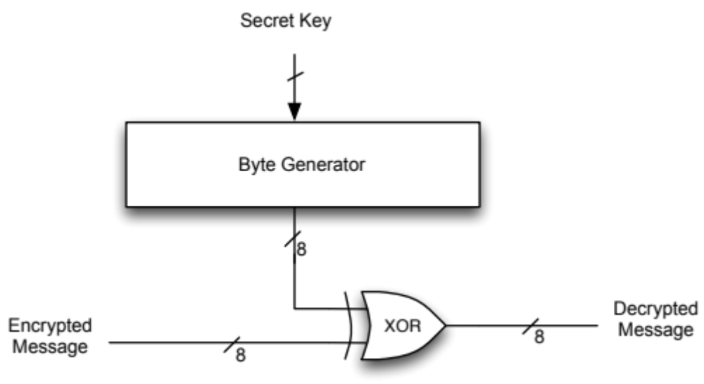
RC4 Stream Cipher Encryption
Encrypted Message
Plaintext Message

Slide 3
RC4 Stream Cipher Decryption

Slide 4
RC4 Overview
RC4 is a widely used cipher but is not considered secure anymore
RC4 is an example of Symmetric Key Cipher because the encryption and decryption keys are the same
It is a Stream Cipher because each byte is encoded individually (unlike a block cipher where bytes are encoded as a block)
One of the advantages of RC4 is that it has simple and fast hardware implementations, so it has been used in phone telephony
Many other ciphers have a similar structure and operation

Slide 5
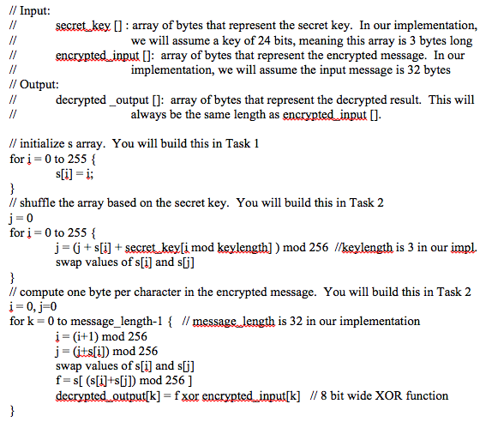

Slide 6
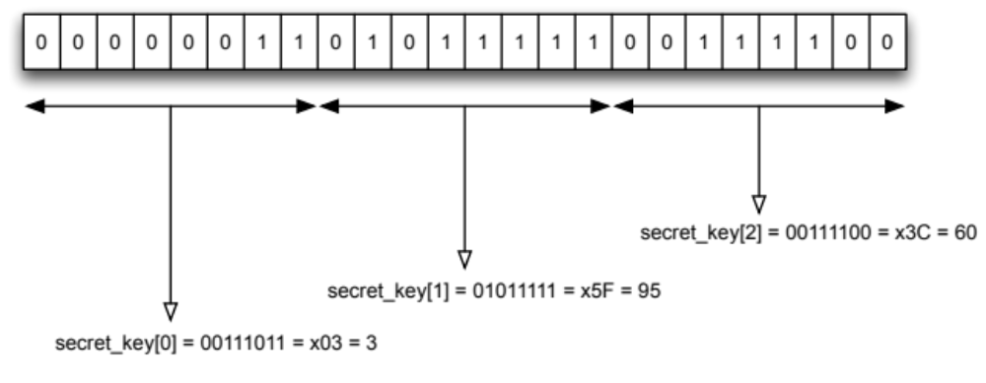
The “Secret Key”

Slide 7
Simplifications
However, if you define the variables i, j, and f as 8-bit registers, and since s[i] and s[j] are also 8-bit numbers, then due to the "automatic" modulo-256 that we get by having an 8-bit number, we can drop all the "mod 256"
This is a significant simplification since the modulo operations could be synthesized by the compiler using divisions, which we know takes up a lot of resources.
We still need to implement "i mod keylength". The Verilog keyword for mod is "%"

Slide 8
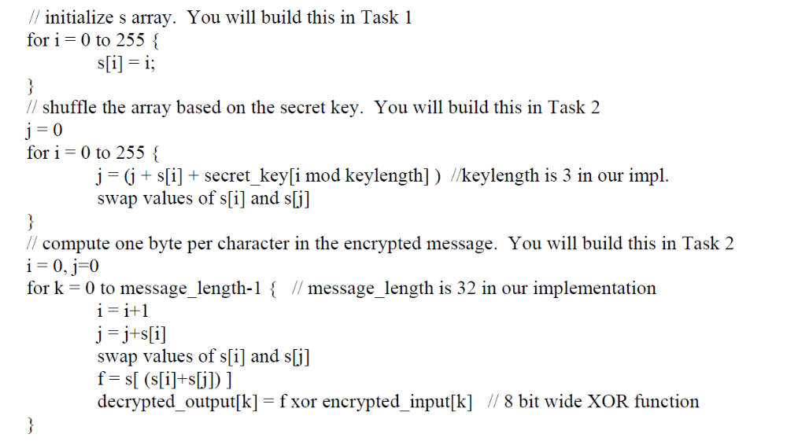
Simplified Equivalent Algorithm

Slide 9
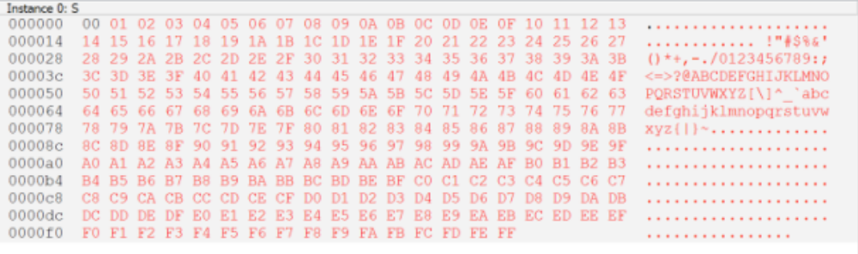
Task 1
Implement first loop of algorithm.
This will give you practice:
- Instantiating memories using
MegaWizard
- Writing into memories
- Using the In-System Memory
Content Editor
for i = 0 to 255 { s[i] = i;
}

Slide 10
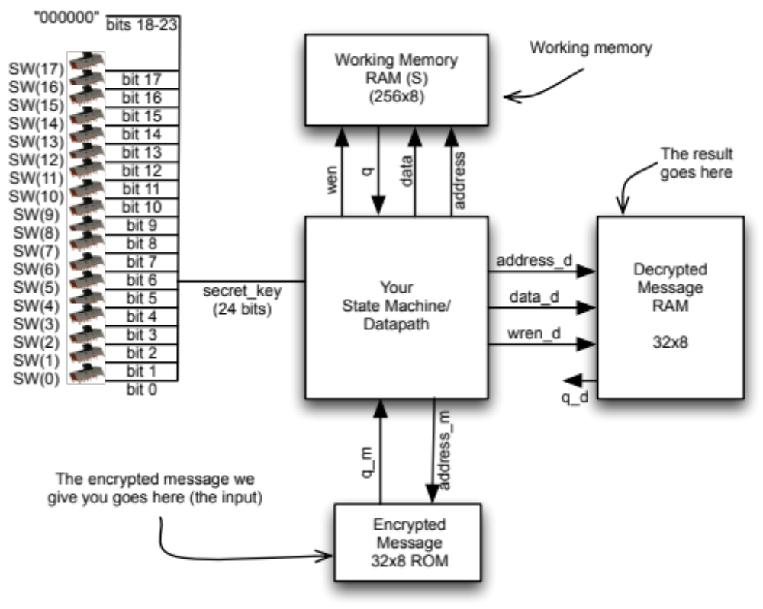
Task 2

Slide 11
Task 3
RC-4 Cracking:
Cycle through all keys. For each key, if the message is something
readable, you have cracked the message!
To make this feasible, you will assume 24 bit keys
- My implementation takes about 10 minutes to cycle through
- In the lab, bits 24 and 23 are both 0 -> 2.5 minutes
Scaling to a real implementation: 40 bits
(10 min) * 2⁽⁴⁰⁻²⁴⁾ = 455 days
We can probably fit about 8 of these on a chip -> 56 days
If the 20 groups in a lab got together -> 2.8 days

Slide 12
Challenge Task
Implement multiple “cores” on the chip
- When one finds the solution, all should stop

Slide 13
Two Approaches
One approach, adopted by Prof. Wilton who originally designed the lab, is to solve it using one FSM that is continually enhanced
Another approach, which I took, is to solve the lab using the modular FSM approach along with the start-finish protocol to communicate between FSMs
I used about 6 different FSMs to solve this lab
Both approaches are valid and have their advantages and disadvantages
The important thing is to design the FSM(s) in a reliable manner

Slide 14
Don’t freak out
Do not be fooled by the complexity of this lab.
Although it is more complicated than previous labs, we are still talking about an algorithm that can be expressed in a flowchart (or, in the case of the modular FSM approach, multiple flowcharts).
You already know from the lectures and Lab 2 how to reliably convert any proper FSM flowchart to an FSM.
In essence, therefore, this is not fundamentally different from Lab 2 except that the algorithm and flowcharts will be much more complicated.

Slide 15
Don’t freak out (2)
Implementing “for” loops just means implementing a counter and checking its value
You already did this for lab 2
Multiple “for” loops mean multiple counters
Remember that you just need to control those counters from your state machines, i.e. control resetting them and incrementing them
Implementing reads from memory is something you also did in Lab 2. Here we need writes too.
Here we are using embedded memories, so reading and writing from the memories is almost trivial and does not necessarily require using a dedicated FSM (though I did do that in my modular approach)

Slide 16
Working in groups of 4
For this lab you may work in groups of 2 lab groups (total 4 people)
The 4-person groups MUST be formed by 2 lab groups
If you choose to work in a group of 4, then:
  You must use the modular FSM approach with a standardized communications protocol to solve the lab
  You must implement the challenge task (it is a bonus for groups of 2)
I am adding the 4-person group option because:
  I want to maximize your chances of success
  I want to promote good modular hierarchical team design practices in this course
If you work in groups of 4, you must use good design practices as discussed in the course, otherwise you will find that it is less efficient and less productive than groups of 2.

Slide 17
Final thoughts
I suggest that you start work on this lab immediately. You know everything you need to know to in order to be able to work on it.
Work on this in parallel to Lab 3
Again, do not be fooled by the complexity of this lab: it is just another algorithm. You know how to convert algorithms to FSMs.
Incremental design is extremely important in this lab.
Good Luck!!!

