Slide 1
FMRD OUS
Process and Wireframe Review

Slide 2
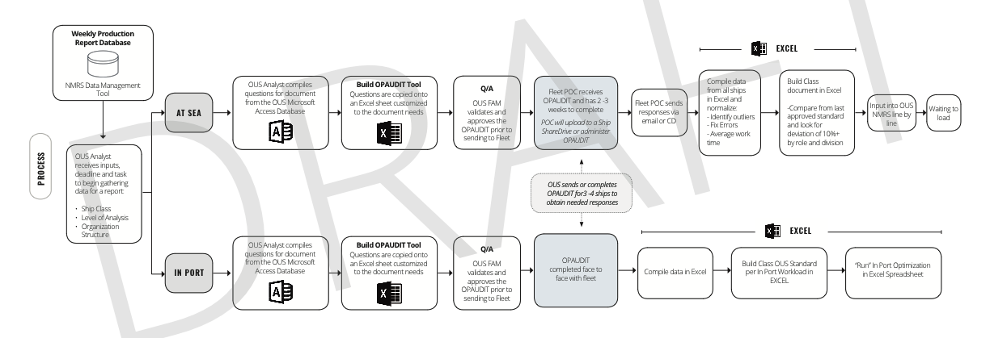
OUS Current State

Slide 3
OUS Future State

Slide 4


Slide 5
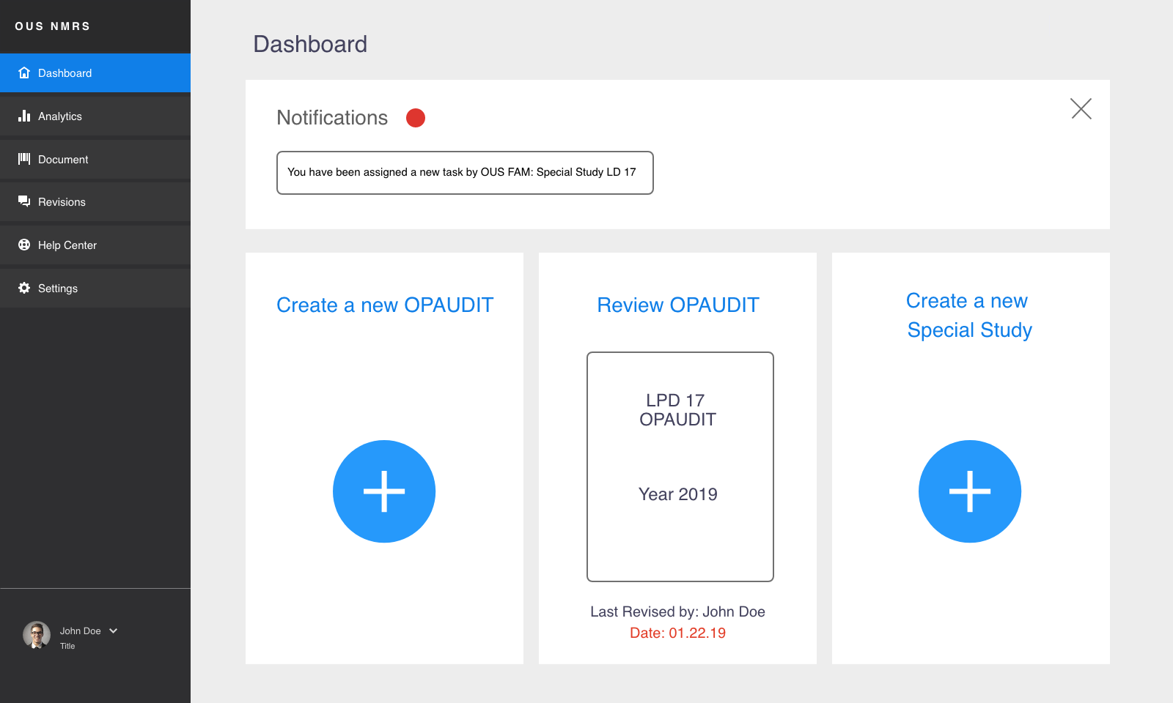

Slide 6
OUS Future State

Slide 7
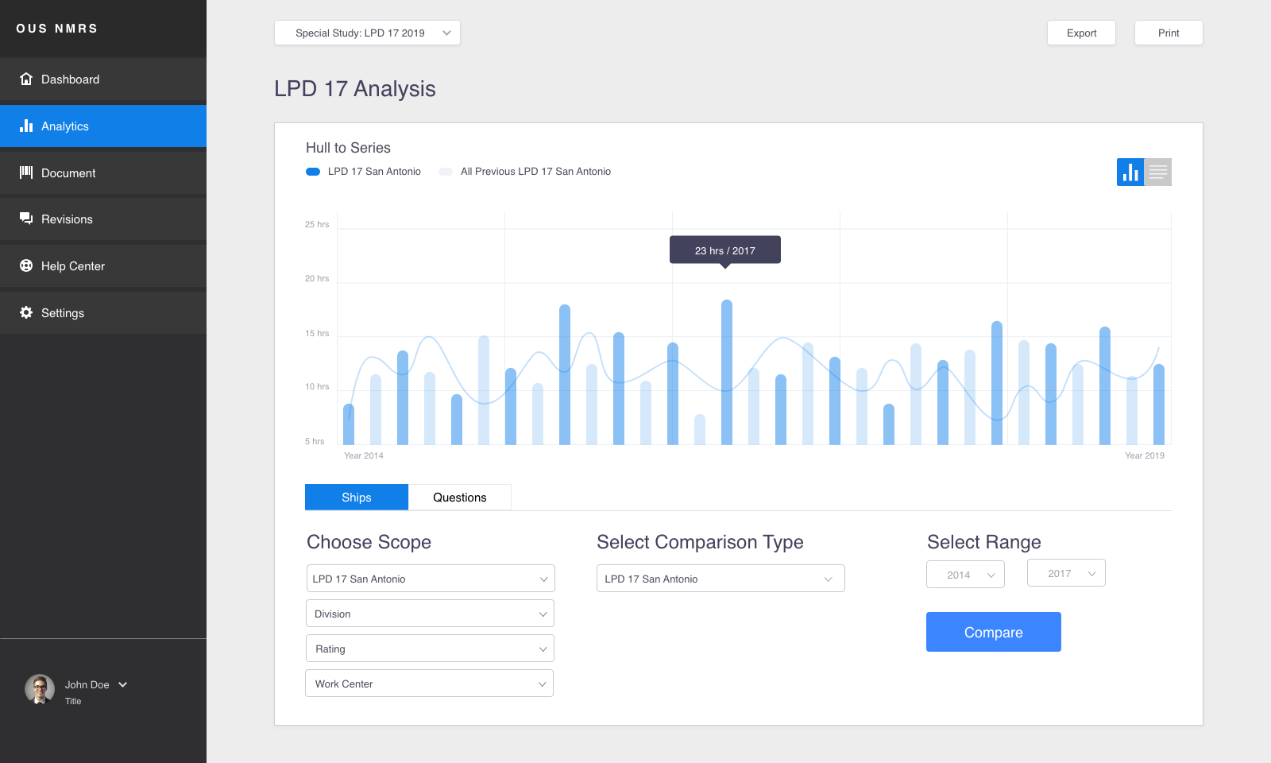

Slide 8
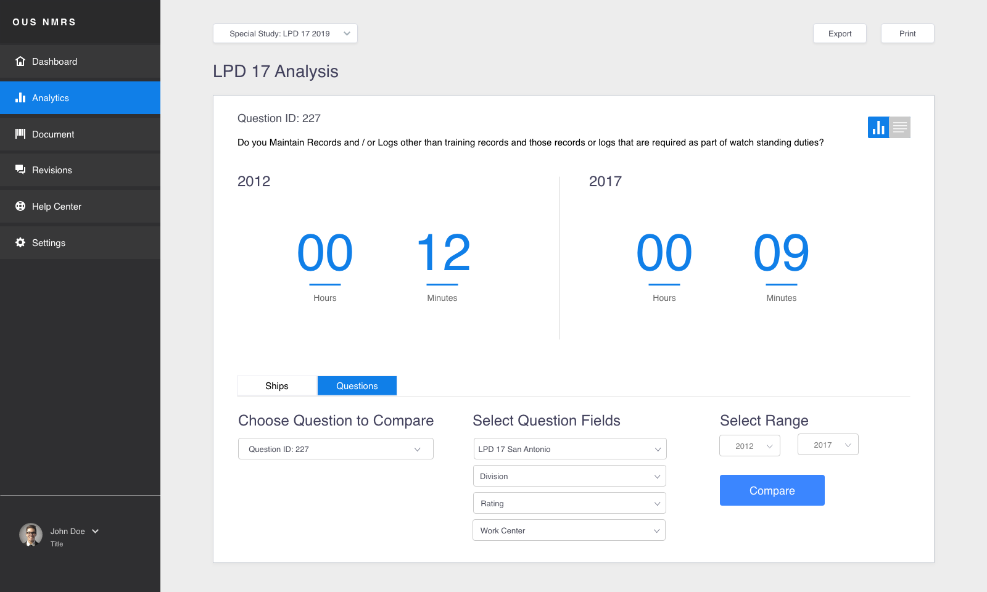

Slide 9
OUS Future State

Slide 10
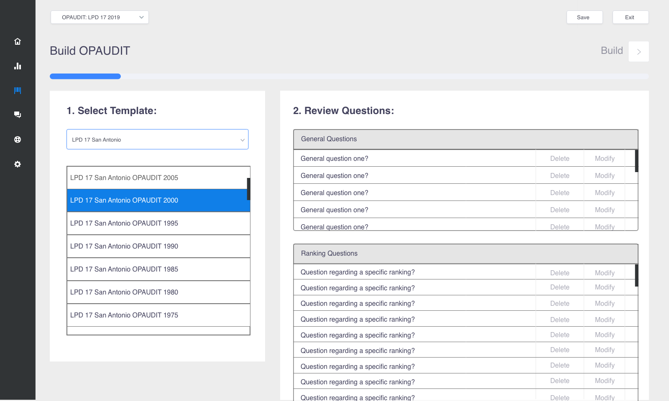

Slide 11
